Slide 1
Business Plan

Slide 2

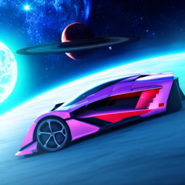
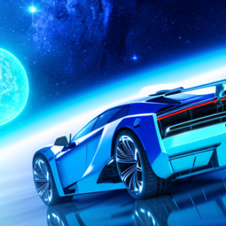
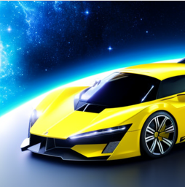
Business Idea
I want to start an electric automotive company named Oribical, which sells goods.
My company will attract customers, because it will produce cars that are faster, cheaper and higher in quality than other cars.
In the future I will invest my profits in my business by opening more branches and spend more on advertisement.
The name Oribical came from the word orbit which is related to space which indicates that that the cars Oribical will produce are going to be out of this world.

Slide 3
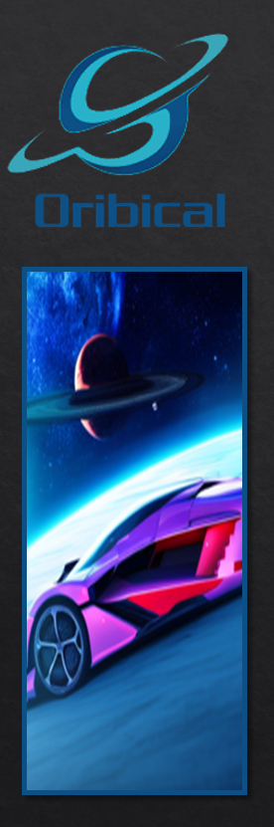
Target market & Demographics
My target customers will be people with money who are looking to buy fast and good looking cars (Men & Women).
Other companies that my company will be competing with are Porsche, Lotus, Tesla and Mercedes.
I will open an Oribical car dealership in Swefieh, Amman where customers will be able to buy cars.

Slide 4
Financial Information
To start my business I will use my savings and loans from banks.
I will charge $75,000 per vehicle, while my competitors are going to be charging $85,000-$2,000,000.
The total estimated cost for me to make one car is $55,000 and I will be selling it for $75,000, so my profit would be around $20,000 per sale.

Slide 5

My name is Sanad Hamdi Al Salhi and I am 13 years of age and I am a very hard worker, innovative, creative, very reliable and I am hoping to start the company
Oribical

