Slide 1
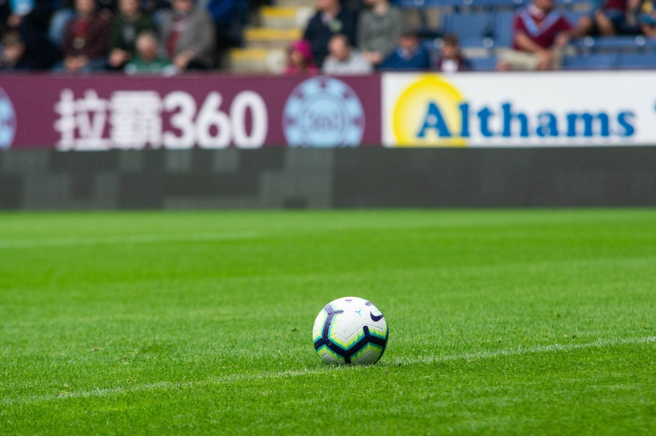
Code football

Slide 2
Business idea
1-open a football store
2-start a football magazine or newspaper
3-sponsor with big players
4-buy football kits and shoes and balls and equipments
5-open an instagram page
6-injury equipments

Slide 3
Business idea
It is a good and a service
People would want to but my products because I sponsor with big players and I have kits a shoes that no other store has
The name is just like any other store name but the name is unique
The name is easy to pronounce and it is memorable

Slide 4
Target marketing and demographics
My customers will be mostly teens and men
My competitors are: Nike, adidas and puma
The main location will be in jordan but there are many other locations in other countries
There would be delivery so for the people who are lazy can either email us or message us from instagram and send us their location and there number

Slide 5
Financial information
The money I got are from my personal saving and from the bank(loan)
I charged over 450,000$
My competitors charged each one charged over 530,000$

Slide 6
Predicated profit
Shoes 50,000$
Kits 20,000$
Equipments 11000$
Injury equipments 13,000$
Store 100,000$
Store name 100$
TOTAL=190,100$

Slide 7
Owners details
I would save it for collage and donate some of it to the poor

