Slide 1
Underground Gym
Underground Gym
Underground Gym
Underground Gym
Underground Gym
By: Nabeel Zureiqat, Basel Ebaid, Karam Samara

Slide 2
Underground Gym
Underground Gym
Underground Gym
Underground Gym
Underground Gym
By: Nabeel Zureiqat, Basel Ebaid, Karam Samara

Slide 3
Introduction
“If you don’t make time for exercise, you’ll probably have to make time for illness.”
-Robin Sharma
We have surveyed over 45 students, teachers and even sports graduates asking them about building an underground gym at school and in the following slides we will present the data to you and our opinions about the causes, effects, finance, call to action, and more about building an underground gym at school.
We will surely persuade or at least interest you in this idea.
By: Nabeel Zureiqat, Basel Ebaid, Karam Samara

Slide 4
Why Should We Build a Gym?
We think we should build an underground gym because it will provide spatial availability for students to develop physically and mentally and ti is good for health; it gives students a new place for socializing, and helps students enjoy the school more. It can also make them more energized for the day and reduce their stress for exams. Moreover, it can help motivate people to do more exercise and can improve productivity.

Slide 5
Advantages of Building the Gym
There are many long term advantages for building an underground gym:
It will improve the students’ physical health i.e. it can help people with diabetes, make the people more fit, and reduce illness in the school.
It can improve the students’ mental health i.e. reduce stress therefore possible increasing their academic score, improve their personality and mindset, and it will help them clear their minds.
It will create a good social environment, and potentially increase bonds between students.
It will give the students a healthy lifestyle.

Slide 6
Disadvantages of Building the Gym
Although there are many advantages of building a gym, there are also many disadvantages such as:
The students might get hurt while using the equipment incorrectly, i.e. fractured bones, and torn muscles.
The students might overwork themselves.
The students might break the equipment which will cost a lot to repair.
The gym might distract the students from their studies.

Slide 7
Finance / Call to action
It will begin by being funded by the extra money from student tuitions and donations, so donate if you have the extra money. You donate at the accounting office at school.
For every 7jds you donate you will get a free month at the gym for you or anyone from your choosing, this perk will only be available before the gym opens.
Afterwards it will be funded by a 10JD monthly fee for students and people outside the school wanting to join the gym. The donations will still be available.
You will automatically be entered into any raffle/giveaway the gym does and get 1 entry for every 7jds you donate after the gym opens.
More equipment will be added if the gym succeeds.
10% of donations all will go the King Hussein Cancer Center
Donate When Available!
Machine | Price (JD) | Amount | Max Mass (kg) | Total
Fitness Sandbags | 10 | 5 | 25 | 50
Pull-Up Bars | 140 | 4 | N/A | 560
Kettlebells | 30 | 10 | 25 | 300
Dumbbells | 25 | 10 | 25 | 250
Treadmill | 300 | 4 | N/A | 1200
Gym Bike | 215 | 4 | N/A | 860
Weight Bars | 90 | 4 | 100 (Including extra weights) | 360
Resistance Bands | 8 | 12 | N/A | 96
Benches | 70 | 10 | N/A | 700
Adjustable Benches | 110 | 8 | N/A | 880
Bench Press | 170 | 6 | N/A | 1020
Lat Pulldown Machine | 190 | 1 | N/A | 190
Cables and Pulleys | 180 | 1 | N/A | 180
Leg Extension | 130 | 2 | N/A | 260
 |  |  | Total Cost: | 6906

Slide 8
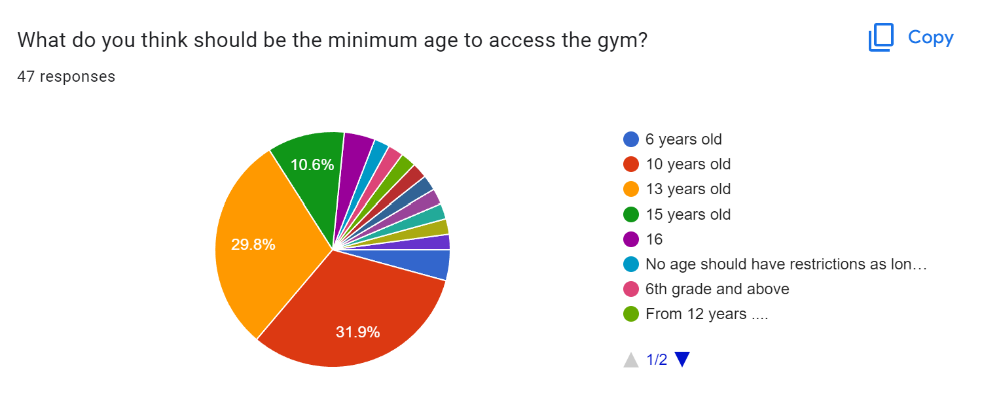
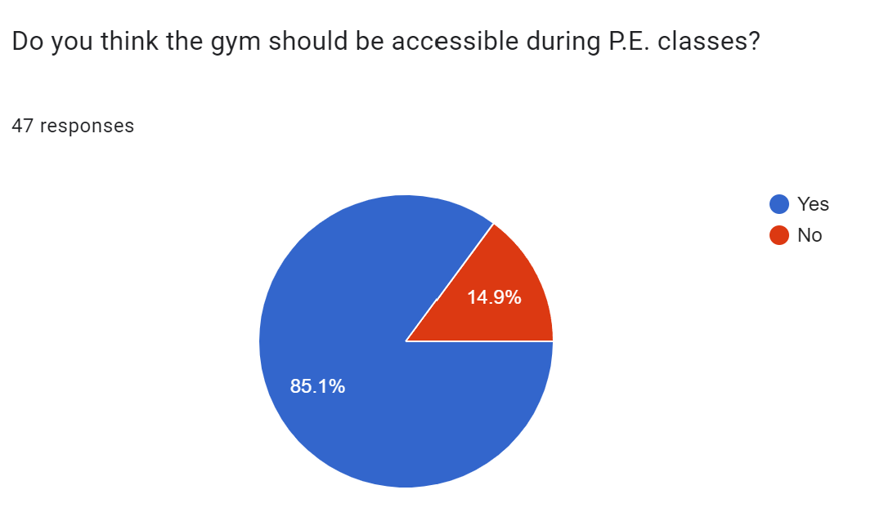
Extra Information
The gym will allow people to enter from ages 10 years old and up.
The gym will be accessible during P.E. class and the breaks for free for students.
The gym will stay open until 8pm, and even will stay open on Sundays and Fridays.
The gym will be built in the empty space on B1 at school.
Survey Link: https://forms.gle/1exEVHGSs4MWBxvRA

Slide 9
Thanks for Listening
Thanks for Listening
Thanks for Listening
Thanks for Listening
Thanks for Listening

Slide 10
Thanks for Listening
Thanks for Listening
Thanks for Listening
Thanks for Listening
Thanks for Listening

