Slide 1
PE sport
By: Carla

Slide 2

PE
The are many sports you can play in PE subject but today I’m going to be explain one sport which is badminton. It is a really fun sport and you can play it in multiple fun ways.

Slide 3
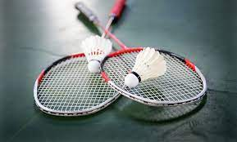
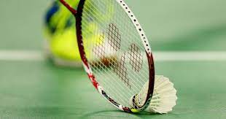
Badminton
Its the objective of the quick-paced racket sport of badminton, which can be played in singles or doubles, is to hit a shuttlecock (or shuttle) over a net and onto the court of the opposition.
-A badminton net that is 1.55m (5 feet 1in) high at the ends and drops to 1.52m (5 feet) in the middle divides the court's two halves, each measuring 6.7m (22 feet).

Slide 4
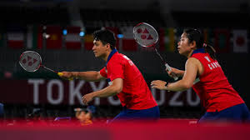
The positions of badminton
There are multiple stances for badminton, for example:-
Attacking Stance
Defensive Stance
Net Stance

Slide 5
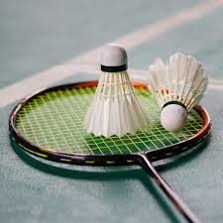
The Stances
Attacking stance: is when you turn your body to face the court's side. Put your non-racket leg in front and your racket leg behind. Legs should be separated by shoulder-width. Your non-racket arm should also be raised.
Defensive stance: it enables the player to be prepared to block an opponent's smash shot. In badminton, you must face your body toward the front of the court while holding your racket in front of you at around waist height and leaning slightly forward.
Net stance: when you put your racket foot forward and your other foot behind you. Put your racket in front of you at a height just above your waist. For balance, raise the arm not holding the racket.

Slide 6

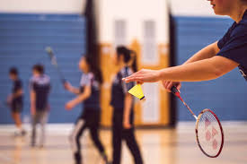
Check your understanding
What is badminton?
What are the different stances for badminton?

