Slide 1
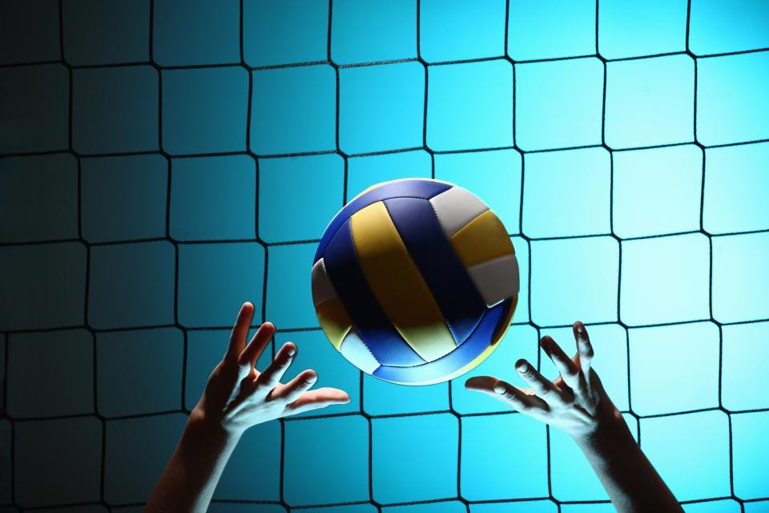
volleyball
By: Hala Abu Baida
Grade/section: 8(C)
Teacher: Eva Al-karadsheh

Slide 2
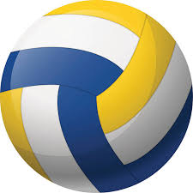
Objectives:
To learn:
What is volleyball?
The history of volleyball.
What are the volleyball court dimensions?
How many players there are on a team and what they do?

Slide 3
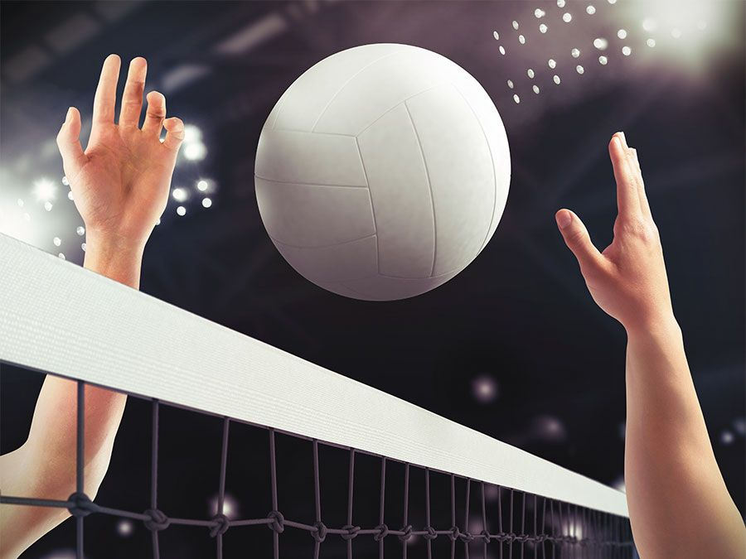
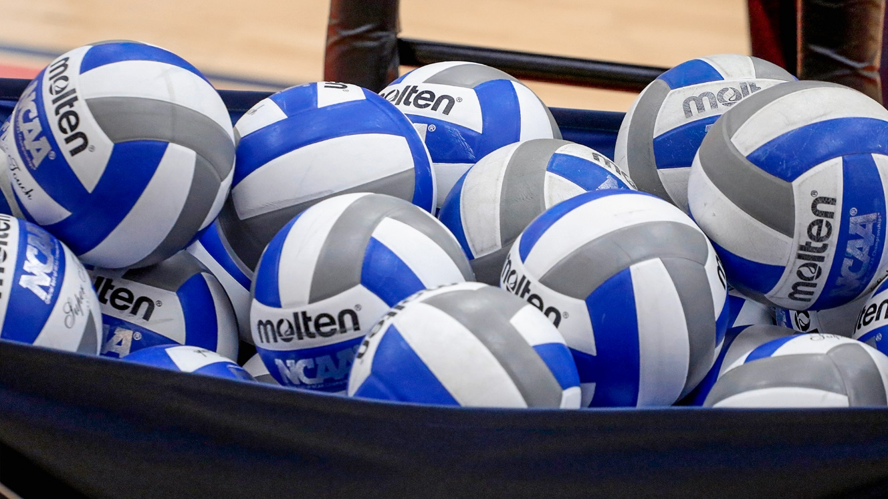
What is volleyball?
Volleyball is a sport that is played by two teams, each team standing on one side of the court. The players use their hands to move the ball across the net trying to make it touch the floor of the opposing teams playing area

Slide 4
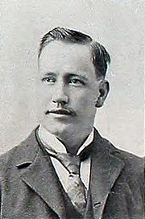
Who invented volleyball?
Volleyball was invented in 1895 by William G. Morgan. He designed it as an indoor sport for businessmen who found the new game of basketball at the time too violent or vigorous.
The original rules of volleyball were written by Morgan .

Slide 5
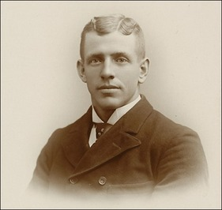
Where did the name come from?
Volleyball was called “mintonette” until a professor that taught in a school in Massachusetts noted the volleying nature of the game and proposed the name of “volleyball”.
“mintonette”
“volleyball”

Slide 6
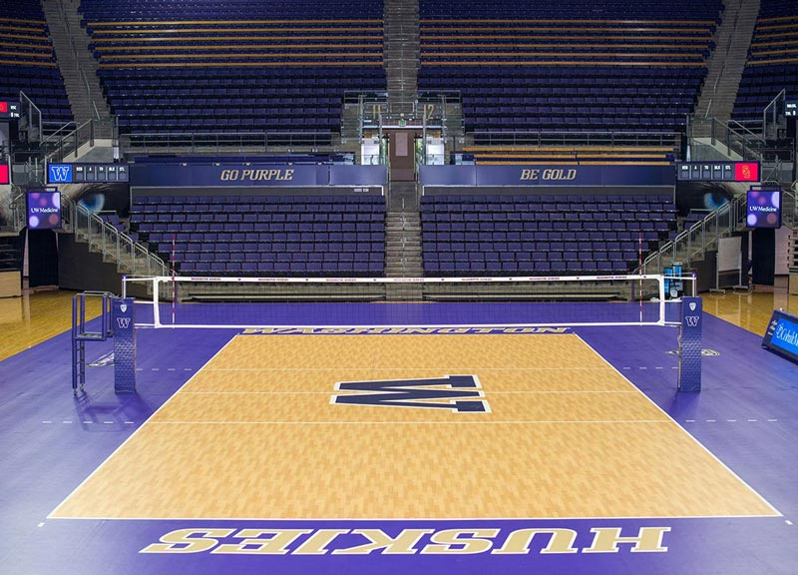
Court dimensions
An average volleyball court is 18 meters long and 9 meters wide, and it is divided into two 9m× 9m halves by a meter wide net placed so that the top of it is 2.43 meters above the middle of the court for men’s competition, and 2.24 meters for women’s competitions.
The size of the net and court may vary according to the age of the players.

Slide 7
How many players on each team?
In traditional volleyball, though the numbers may vary in other types of volleyball, there are 6 players on court and there can be 6 substitute players on the bench.
The players on court are arranged in 2 rows of 3. out of those players there are the captain of the team and the libero.

Slide 8
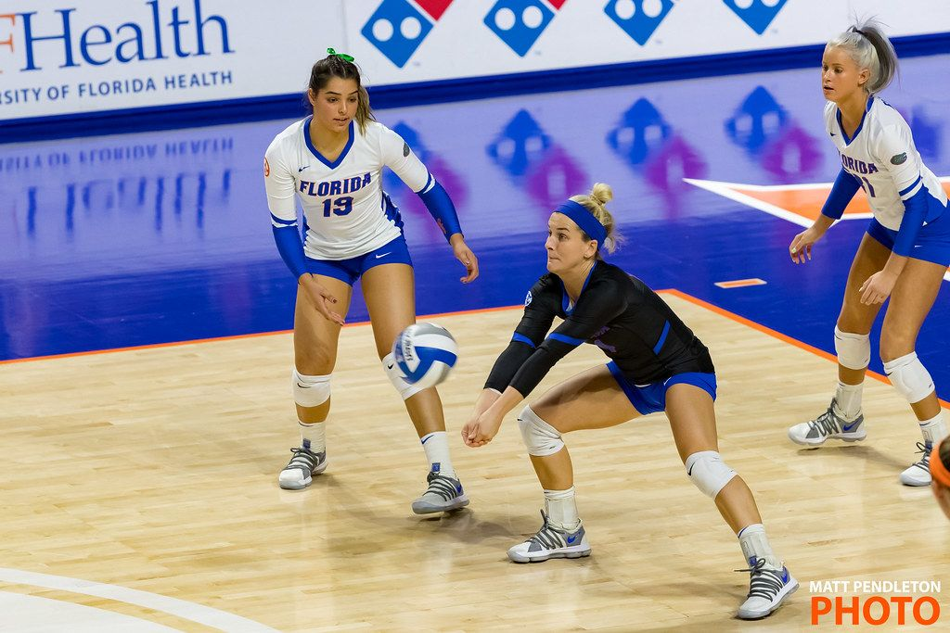
Who is the libero?
The libero is one player on each team that acts as a defense specialist. The libero wears a different color from the rest of the team but they cannot serve or rotate to the front row.

Slide 9
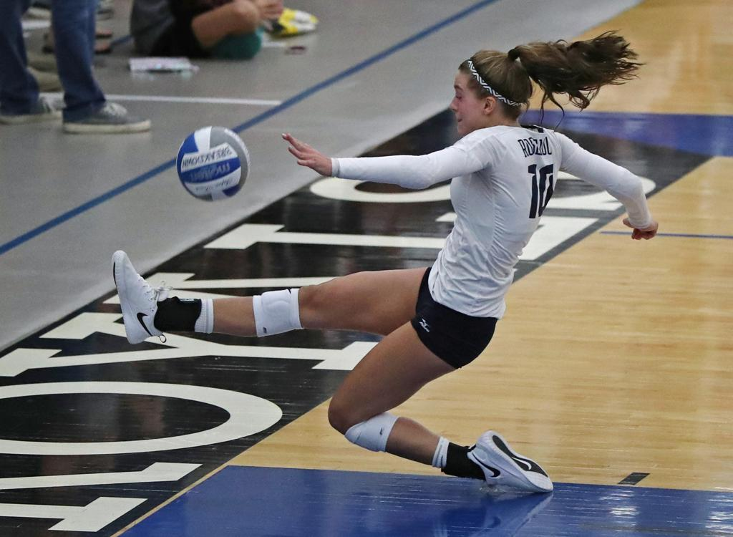
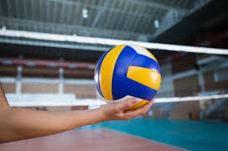
What are some basic rules of volleyball?
1-The players can only hit the ball thrice per side.
2-every hit must be made by a different player.
3-it is allowed for the ball to touch any part of the players body.
4-it is not allowed for a player to catch, hold or throw the ball.

Slide 10
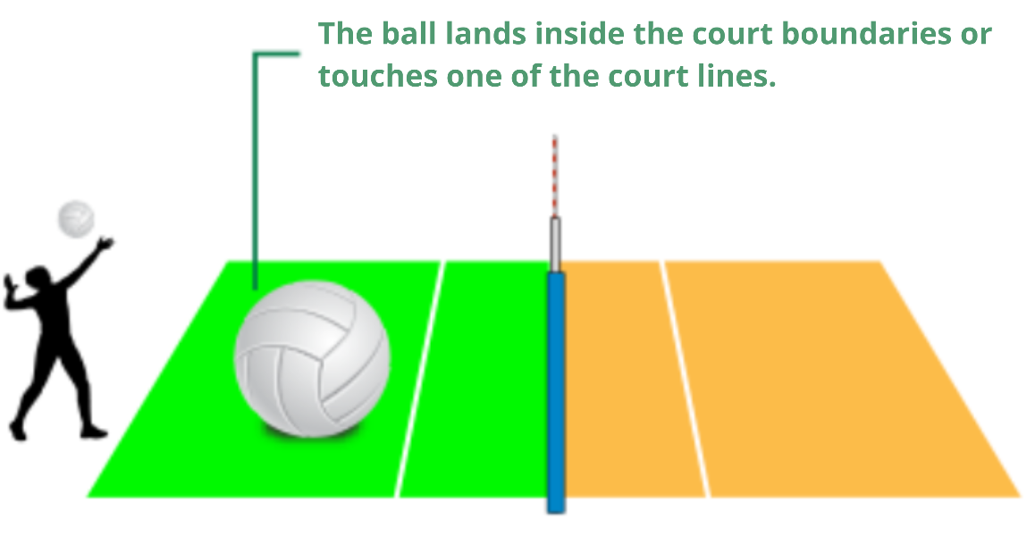
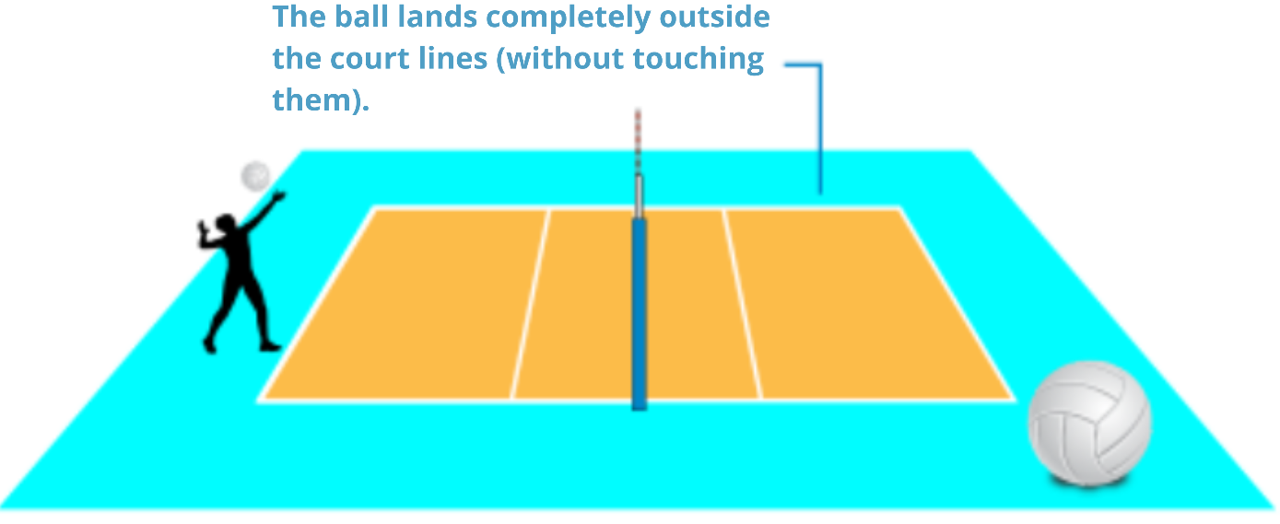
What are some basic rules of volleyball?
5-if the ball hits the boundary line it is considered ‘in’.
6-the ball is considered out if it hits:
The antenna.
The floor completely outside the court.
The referee stand.
The ceiling of the venue.

Slide 11
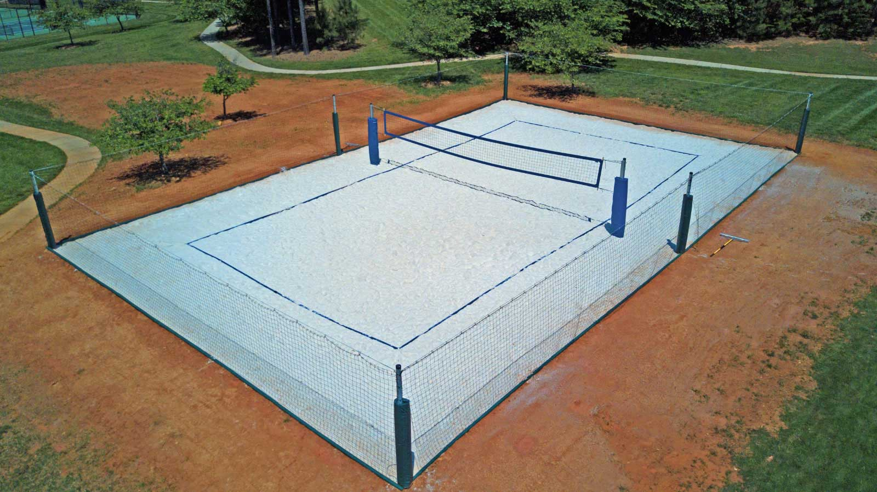
Check your understanding:
What are the dimensions of a volleyball court?
20m ×25m.
9m ×18m.
5m ×8m.

Slide 12
That’s correct!
Next question

Slide 13
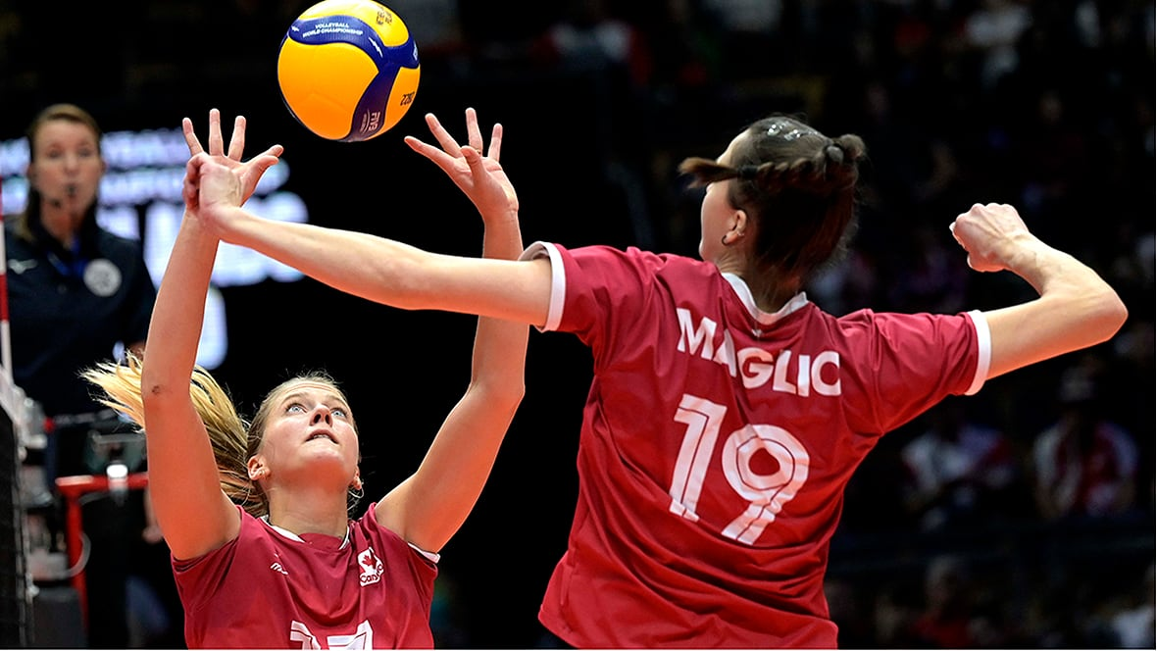
Check your understanding:
How many players are there on each team in a volleyball match?
6 on each team
4 on one team and 6 on the other
5 on each team

Slide 14
That’s correct!
Next question

Slide 15
Check your understanding:
What is a libero’s specialty?
To attack
To serve
To defend

Slide 16
That’s correct!
Next question

Slide 17
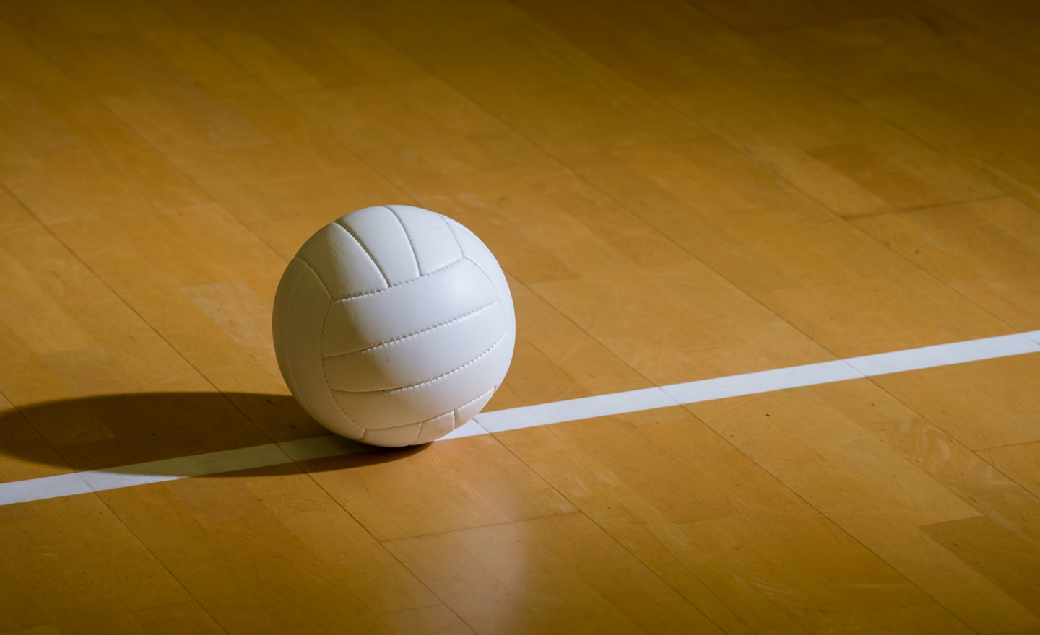
Check your understanding:
In a game, the ball lands on the boundary line, it is considered______.
‘In’
‘out’

Slide 18
That’s correct!
Next question

Slide 19
Check your understanding:
Who invented volleyball?
William Morgan
A professor that teaches a school in Massachusetts
Gabrielle Reece

Slide 20
That’s correct!
Next question

Slide 21
Check you understanding:
What was volleyball originally called?
“volleyball”
“cricket”
“mintonette”
?????
“volleyball”

Slide 22
That’s correct!
End quiz

Slide 23
Oops, that’s wrong…
Try again

Slide 24
resources
https://www.britannica.com/sports/volleyball
http://www.wysc.org/Page.asp?n=32591
https://setupforvolleyball.com/players-per-team-volleyball/
https://www.britannica.com/sports/libero
https://sydneysocialvolleyball.com.au/rules-of-volleyball/

Slide 25
Thanks for listening

