Slide 1
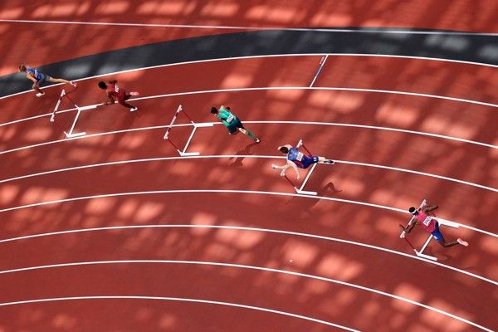
Track
By: Reine and Jana

Slide 2
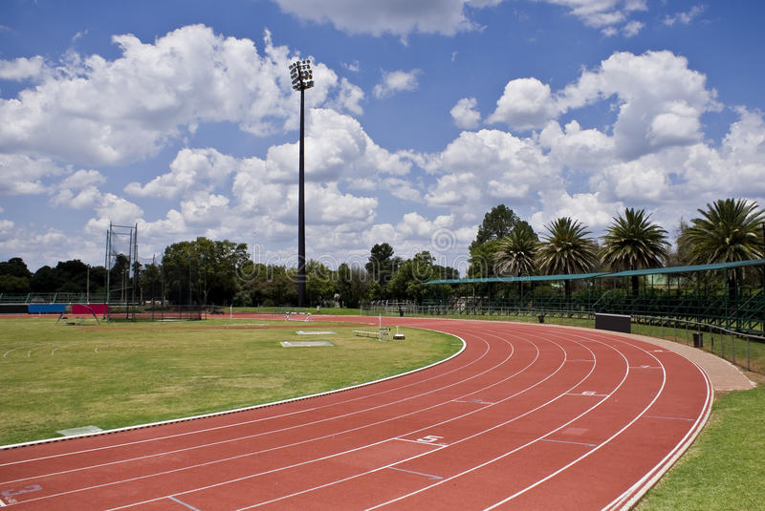
Track
Track is a sport that could assist in increasing students speed, physical health, and mental health. All which would help benefit the students and the school.

Slide 3
Causes
Here are some causes to add track to the school:
Students are ensured to run faster and stay fit, while being an enjoyable and amusing sport.
Builds a tolerance to walking for long periods of time and helping in maintaining a steady pace while walking.
Competitions or tournaments in track would be a fun way of encouragement for students to do track.

Slide 4
benefits
7 students answered that track benefits students health and helps them stay fit.
3 students answered that track can motivate students.
2 students answered that competition in track could be beneficial.

Slide 5
consequences
10 students answered that track could be a potential danger to students.
4 students answered that a track field could take up too much space.

