Slide 1
Gym accessibility at the National Orthodox School
Made by Marwan kakish and Andre kakish

Slide 2
“Take care of your body. It’s the only place you have to live.” – Jim Rohn

Slide 3
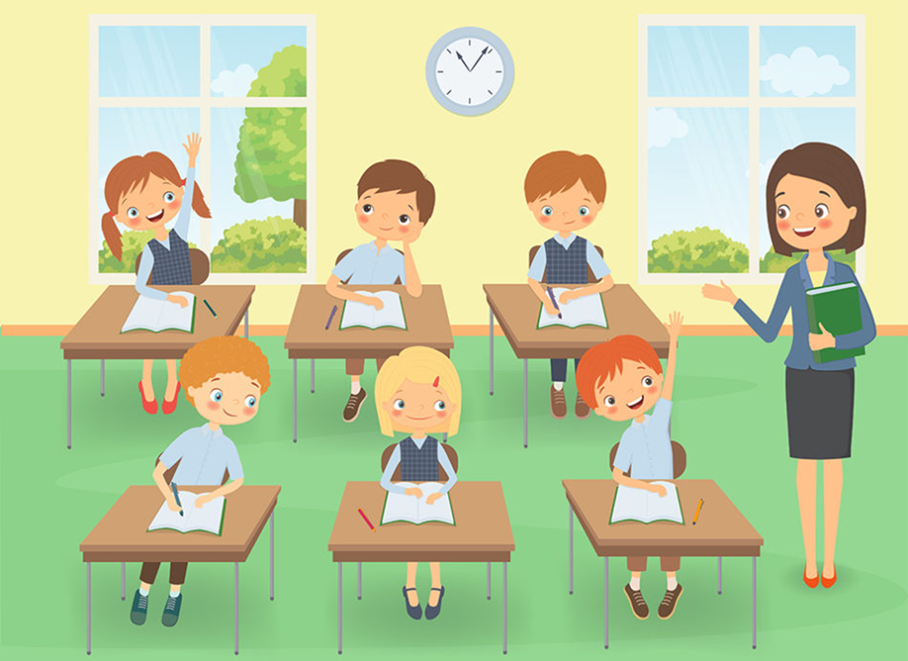
Hello, we are students from the 6-8 department in the National Orthodox School. We are trying to improve the accessibility of sports in our school by having a gym.
Don’t you agree that this is a good idea?
We do believe that exercising strengthens the mental health as well as the physical health. It helps students get better grades, improves their memory, school attendance and class behaviors.

Slide 4
Mental and physical health of our bodies are of equal importance, since exercising is food for the mind and soul, it improves our brain health and nourishes our soul.
Exercising regularly helps us manage weight, reduces the risk of disease, strengthens our bones and muscles, and improves our ability to do everyday activities.
Therefore, it is highly recommended to exercise on regular basis.

Slide 5
We conducted a survey to obtain students feedback about the necessity of having a gym in our school.
In the coming slides, we will show the results of this survey:

Slide 6
We received 29 responses, participants of this survey were male and female students:

Slide 7
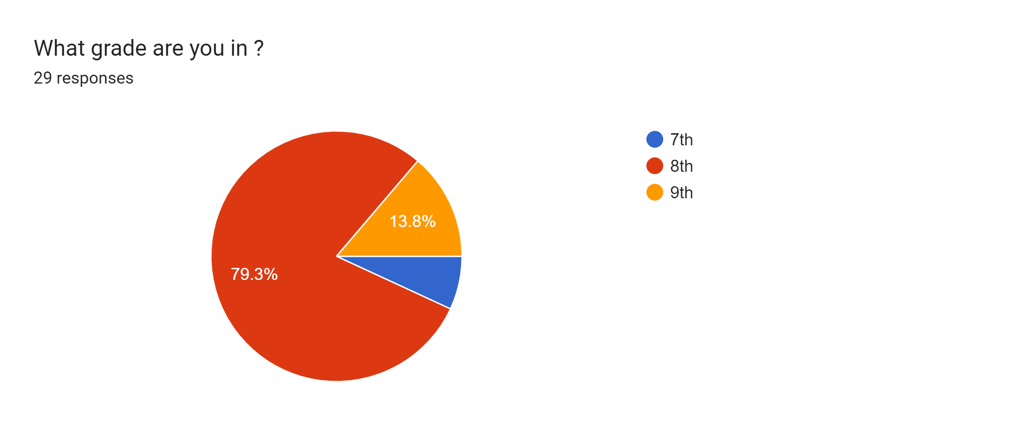
Students who participated in this survey were mostly 13 years old and in the 8th grade:

Slide 8
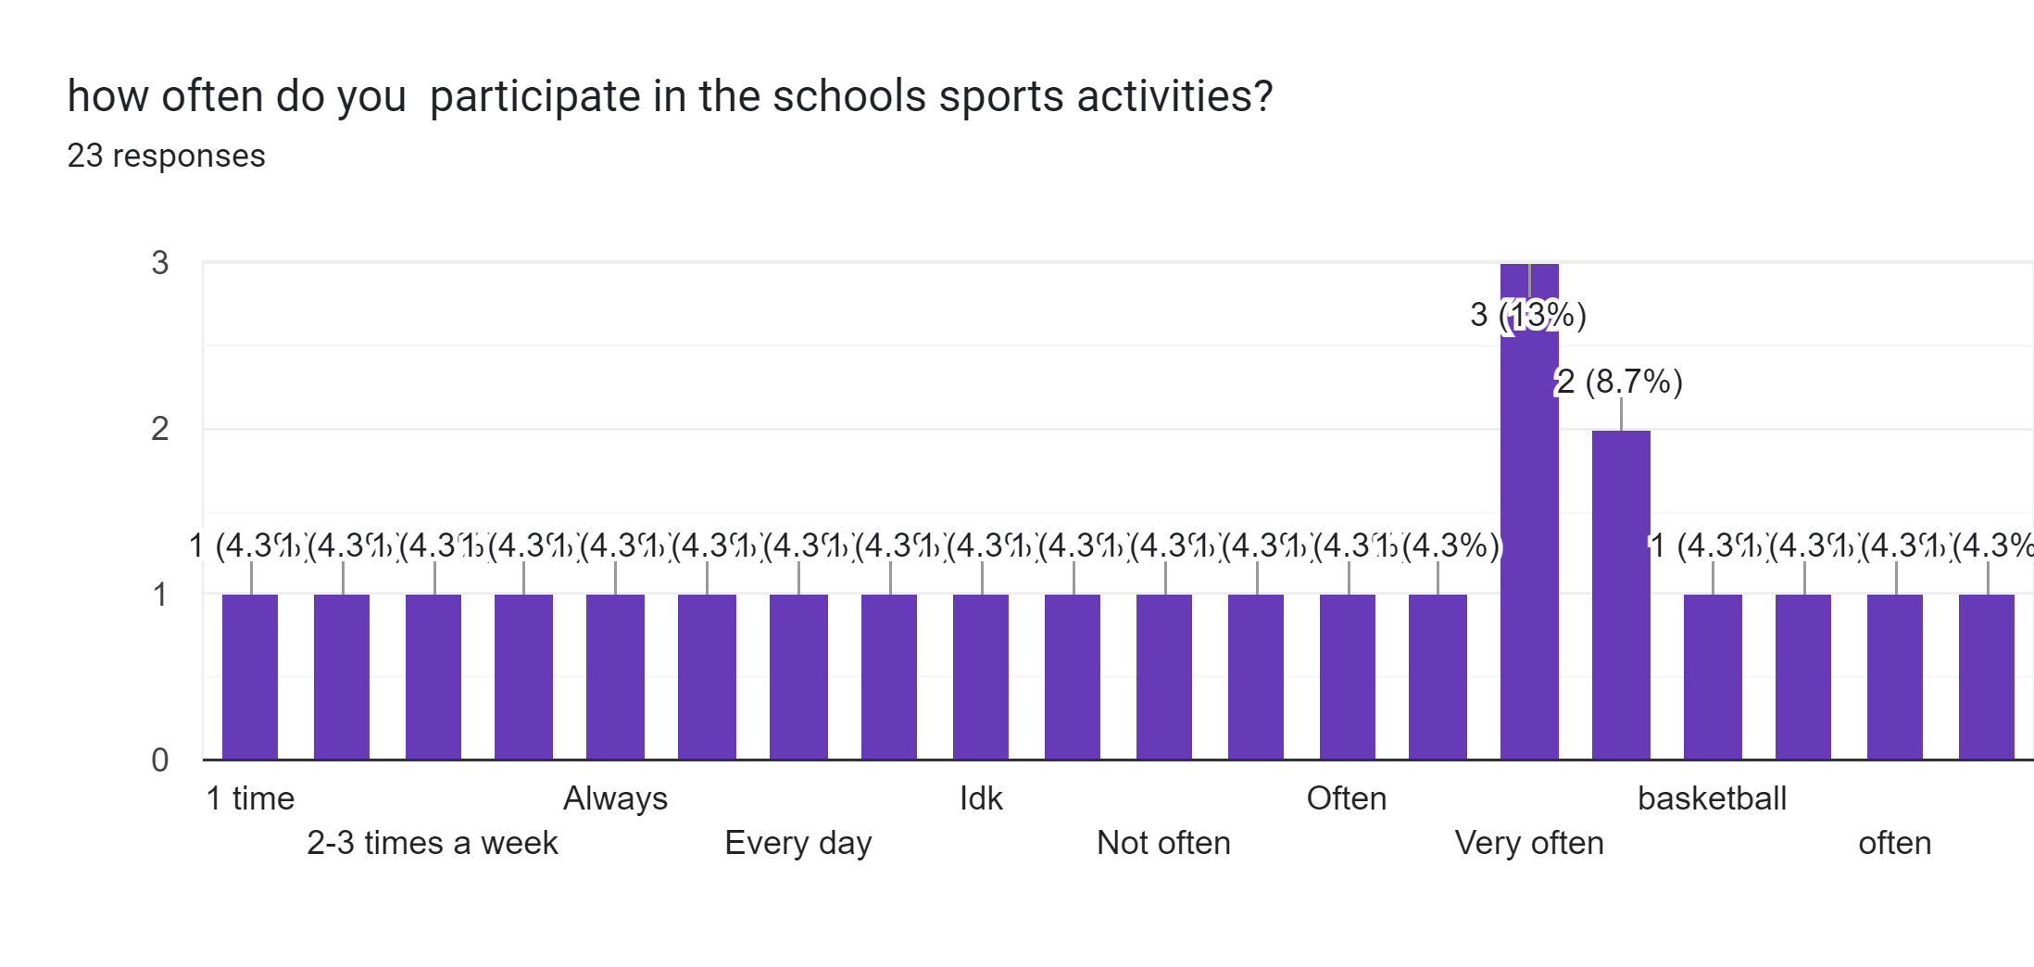
We asked students about how often they participate in schools activities. Majority of the students who contributed in this survey participate in school sport activities very often which indicates that students in the NOS school love having a wide variety of activities to choose from.

Slide 9
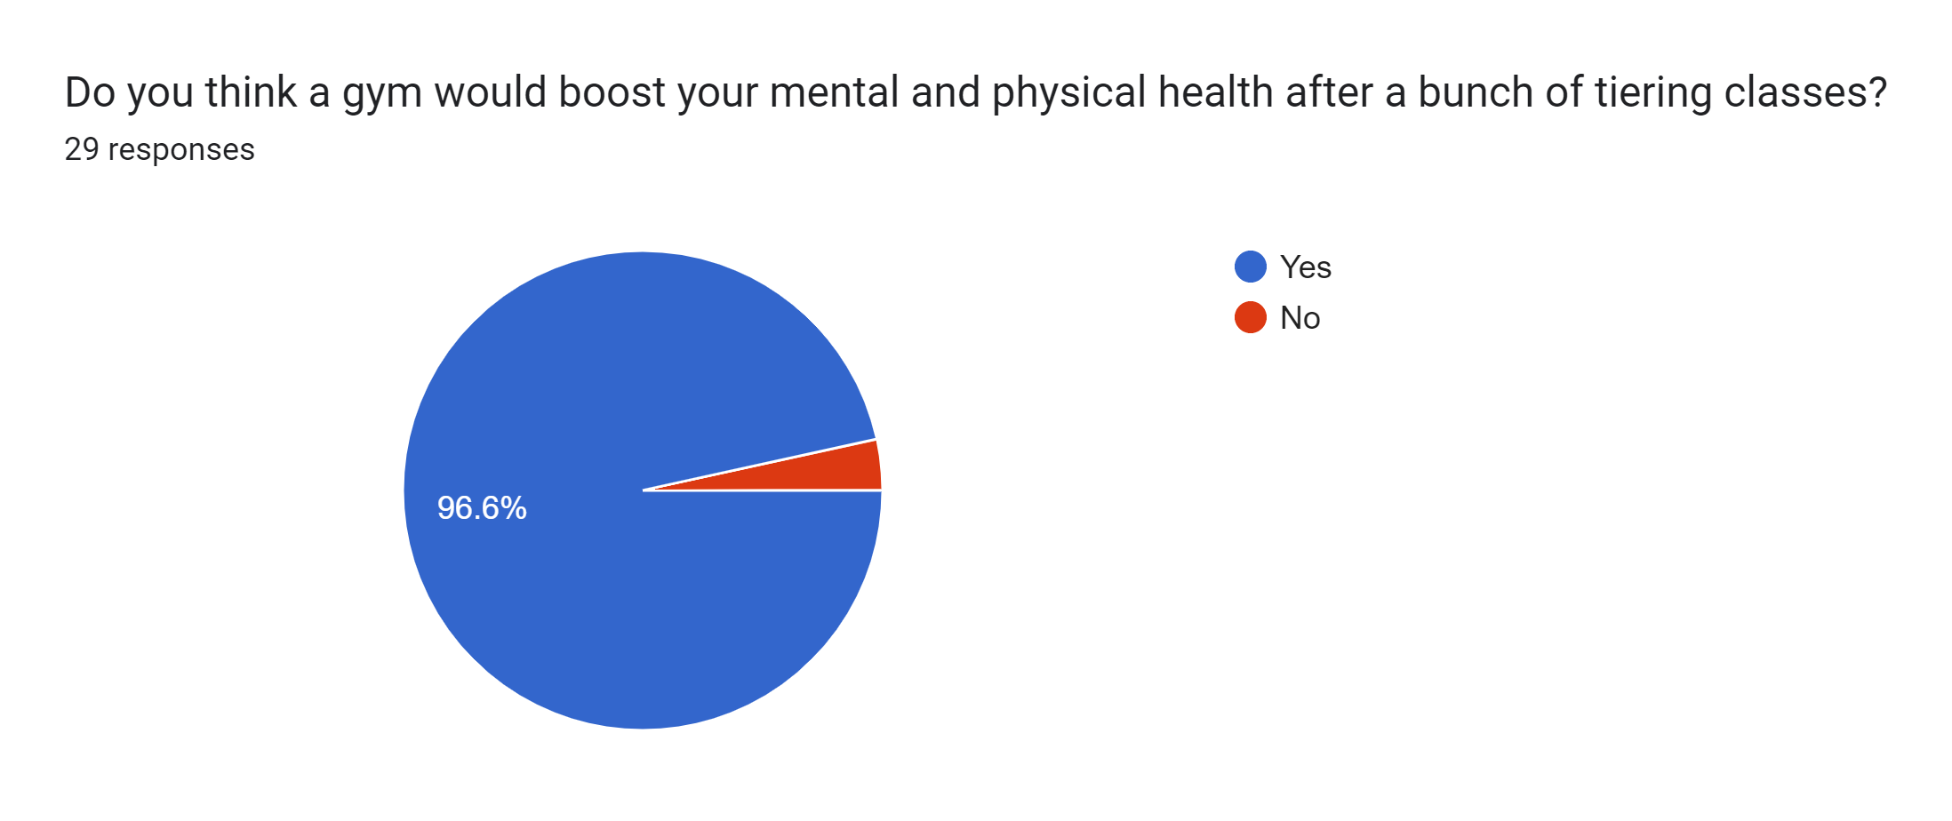
About 96.6% of students in the NOS school would love to have a gym in their school knowing that it would boost their mental and physical health.

Slide 10
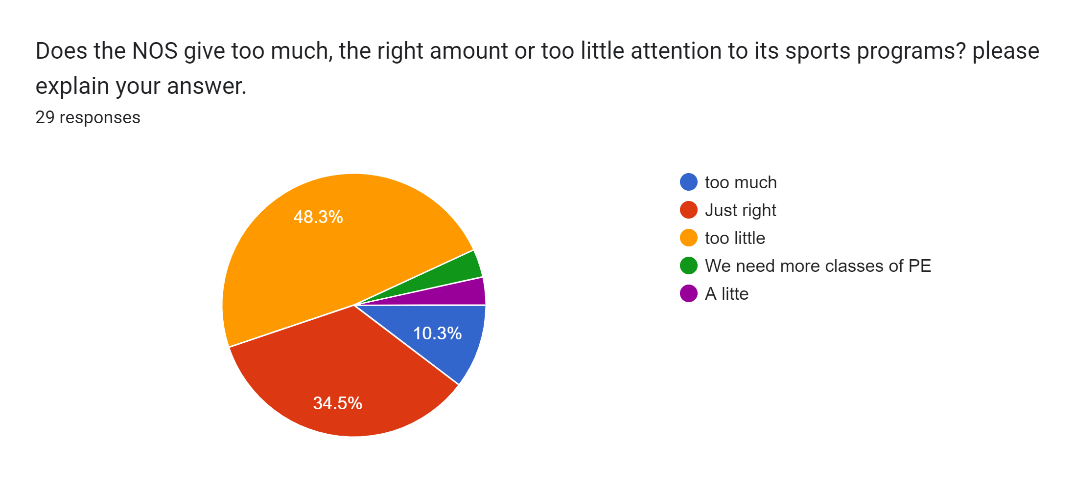
The survey shows that almost half of students think that school does not give the right amount of attention to sport activities.

Slide 11
Last but no least, we think that having a gym in our school would not only affect us positively by improving our memory and ability to focus. It will also reflect back on our school reputation positively, as a motivational and thoughtful school of what its students might desire. This will get more students to be interested to join NOS school.

Slide 12
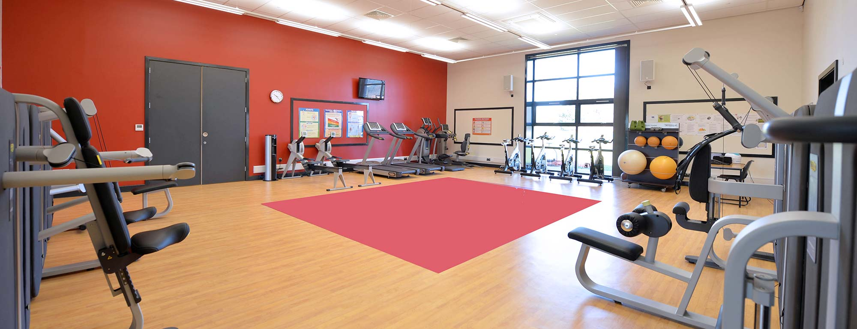
The estimated time to build the gym is about 12-18 weeks.
The estimated cost is 3000$ to make the room, and about 12,000$ to get equipment and tools for the gym.
Although this looks too much, but it is worth it!
We highly recommend building a gym in the National Orthodox School

Slide 13
Thank you for listening

