Slide 1
Global prespective
Hanna.faisal.mohamad.karam

Slide 2
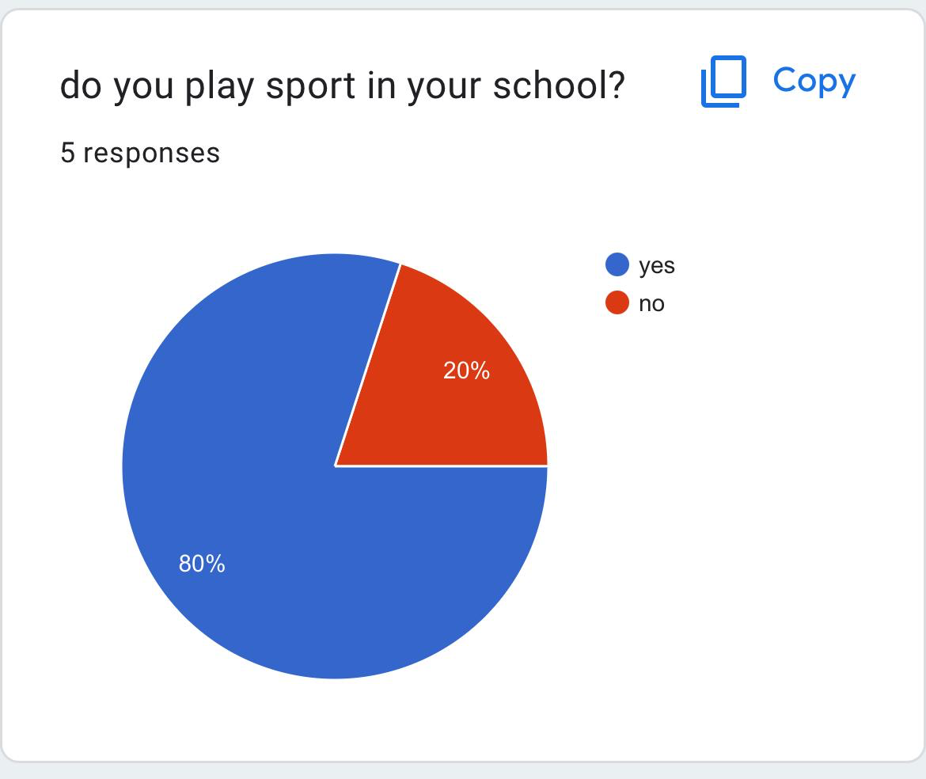
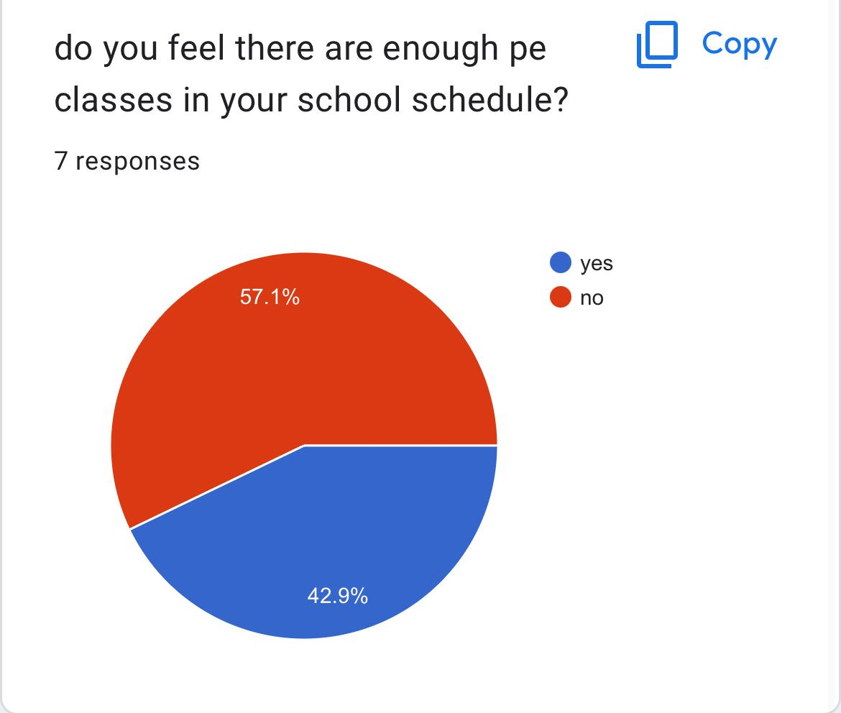
Sports
Problems in nos school about sports
We are concentrating on this problem to have more fun in school and to exercise our bodies
To make others like exercising too

Slide 3
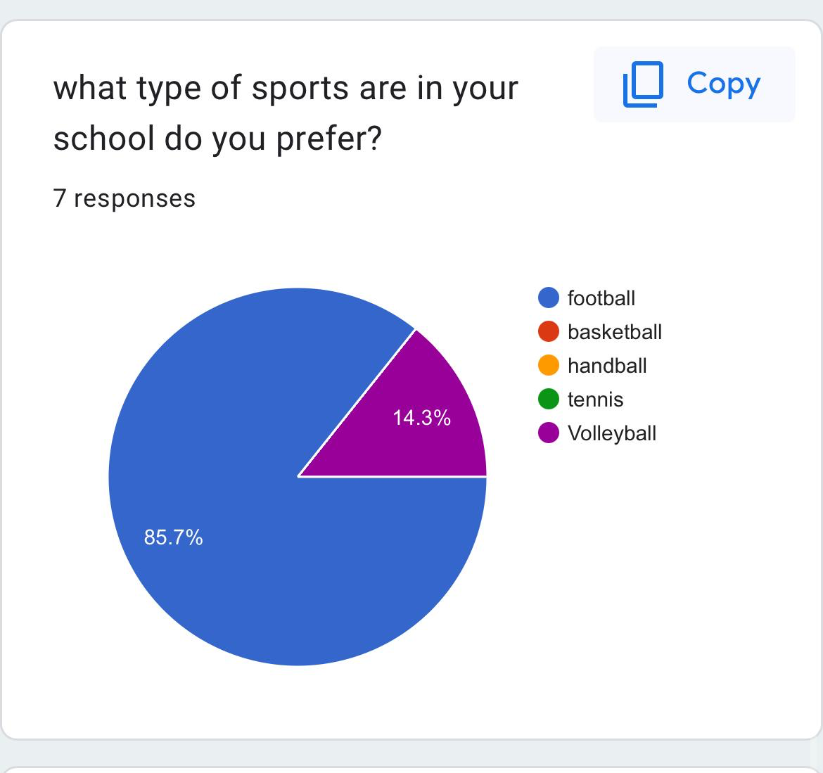
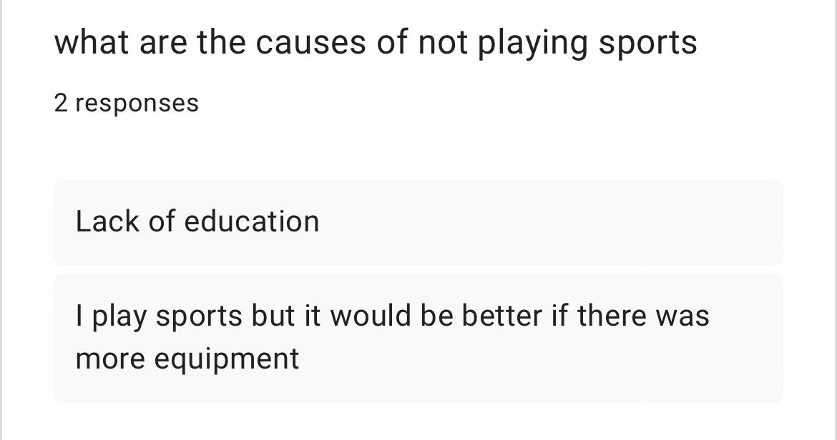
Sports
Not enough pe classes
Equipment breaks easily and in bad condition
Not enough equipment
Short classes
Classes get taken by other teachers
People with disabilities cant play normal sports

Slide 4
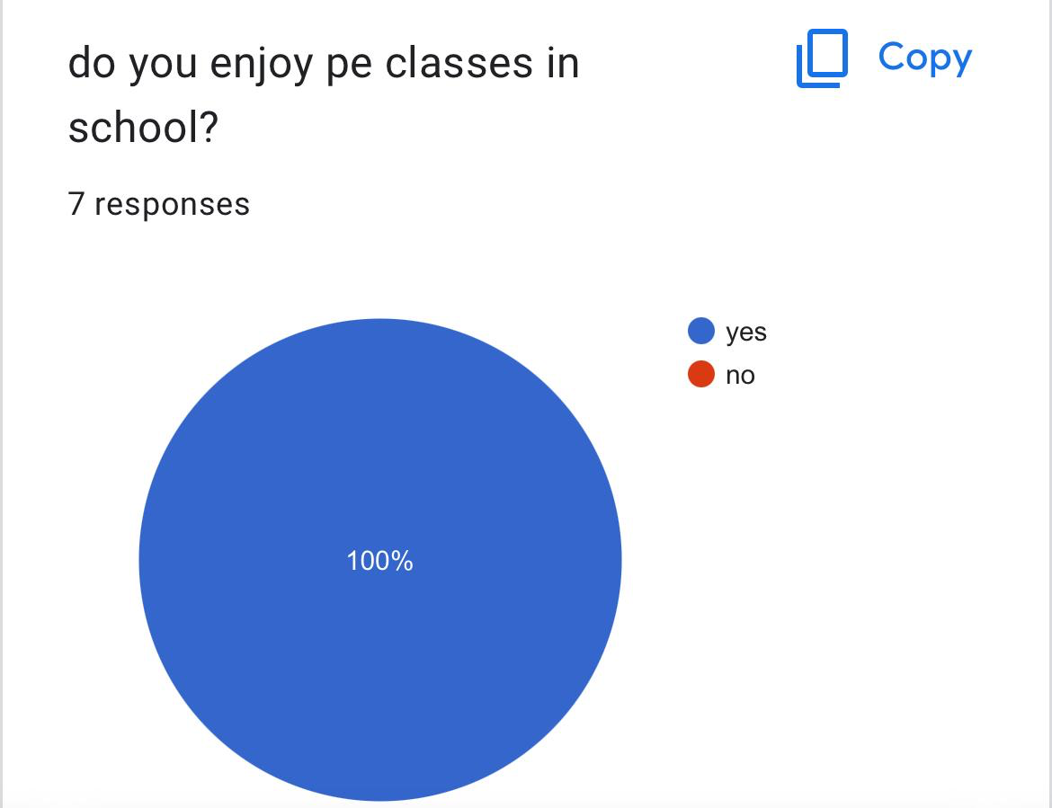
Sports
Tell teachers to make more pe classes instead of one in the week
Order more equipment im better condition and take donations
Order more from donations from outside
Ask teachers to make more time for pe classes
Make that if a teacher misses a class other classes shouldn’t be taken
Make special sports for people with disabilitys

