Slide 1
^{Swimming}
^{pool at NOS}
^{FARIS AL RAWASHDEH} ^{SAMER AL FANEK}
^{8C}

Slide 2
After conducting a survey specifically for collecting students’ opinions on building a swimming pool at NOS and reviewing the numerous responses, the overwhelmingly positive forum results inclines us to forward a proposal to the principle regarding the swimming pool.

Slide 3
Why we would like to have a pool at NOS and what are the consequences?
the simple project of building a pool alongside the NOS community will reflect a positive impact not just by the physicality students are able to create, but the mentality constantly affecting their study and productivity in various good ways.
looking from the side where personality comes in place, the activity of 'swimming' helps reduce any negative energy in a students body, making

Slide 4
Ways a wider selection of sports can help NOS
-One of the benefits is entering sports tournaments with NOS.
-With giving a large variety of sports, students may figure that they had an unfound talent.
-Most students of NOS will become attached to sports.
-A higher percentage of Students at NOS will maintain healthy
lifestyle

Slide 5
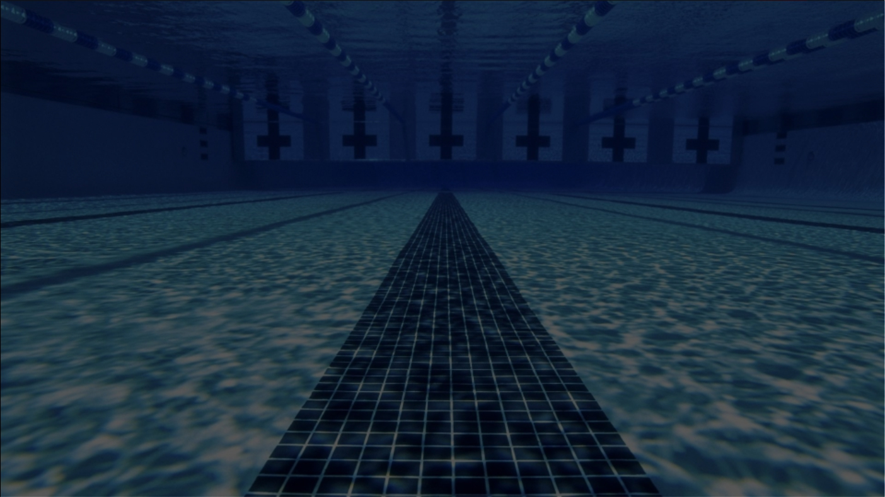
Benefits/Disadvantages of building a swimming pool at NOS
Water activities, especially for the youngest of children, provide the opportunity to learn life skills and healthy habits. Whether integrated into the daily schedule or treated as an extra-curricular option, a swimming pool is an extremely valuable facility for students' physical and mental health.
Benefits:
Take care of your health Strengthen your muscles Increase your flexibility
Boost your mood and relieve stress
With the required training and caution, the activity of swimming can be accomplished at NOS knowing how these pros are able to affect the overall health of a person early from their fresh years.
Disadvantages:
risk of drowning
fear of some young ones from pools due to unreliable use

Slide 6
Collected statistics from NOS students ACCORDING TO THE PICTURE YOU SEE, HERE ARE THE RESULTS

Slide 7
The method used to raise funds in order to fulfill this project
According to what our survey has provided for us, the final outcome is now a settled choice, agreeable by the majority of the who have attended our survey. The larger margin of students claim that the technique of what they think would be the most effective, or how the fund raising should be done, had to be 'rasing money by donations,' etc. , making around 78% of responses going along with that concept.

Slide 8
Where would be a suitable location for the pool?
Following the opinions of the ones who have attended our survey, a clear margin suggests that this project should be accomplished in the arena (indoors), on a separate floor. This choice will increasingly benefit students by providing the ability to swim during winter times, and prevent any risk of catching a cold.

Slide 9
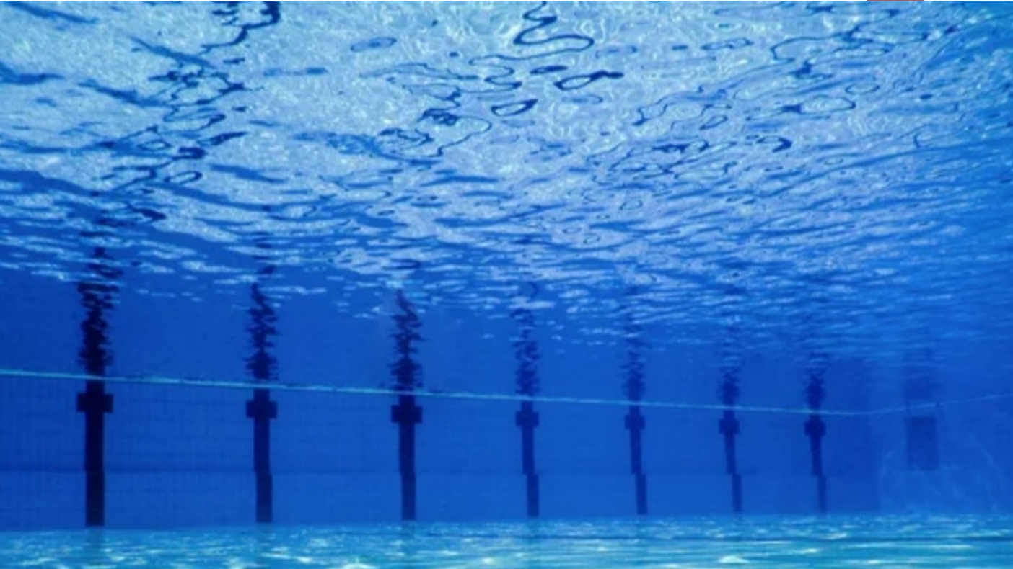
Conclusion
After dedicating hours of work into analysis and other forms of work, the concluded result has finally been extracted from our survey. According to our premier source, the students of NOS are confidently sharing their thoughts here with us. They have noted that they would find this concept very beneficial towards general health and fitness.

Slide 10
Survey link
https://docs.google.com/forms/d/e/1FAIpQLSd9F4jF2xP-DY4EVzuT0k2PG9ZNhlDbdZuudfASASi57YdvVg/viewform?usp=pp_url

Slide 11
THANK
YOU

