Slide 1
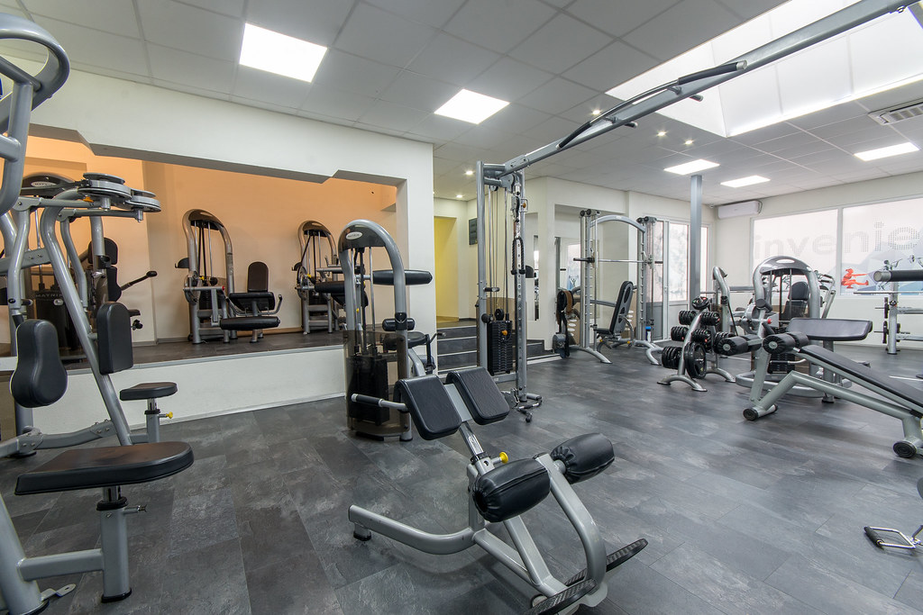
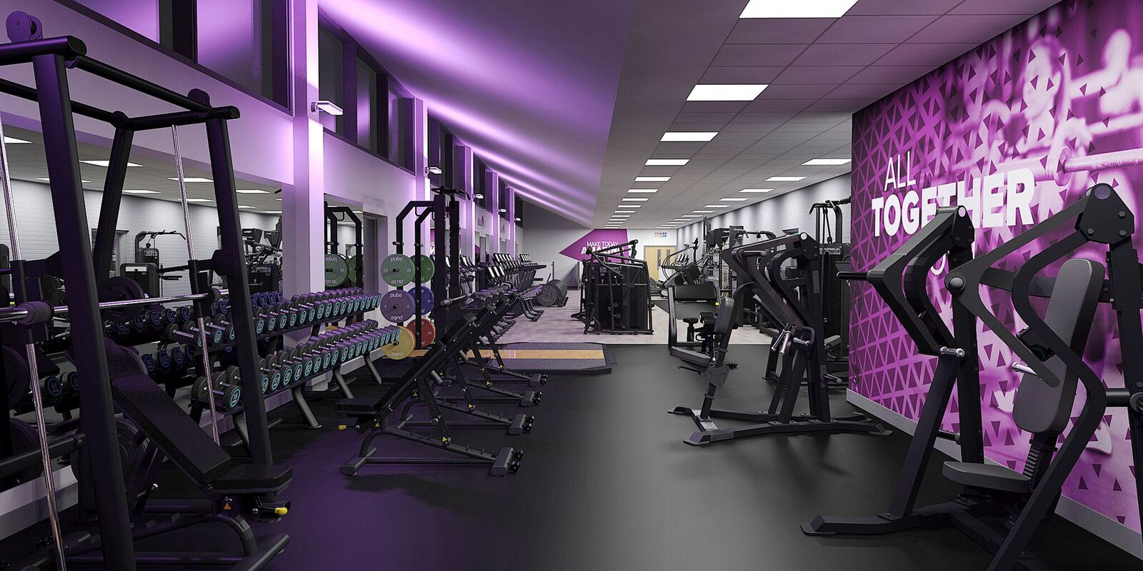
gym
By omAR ZAGHA/RAWAD ABU MWAIS

Slide 2


(Decide. Commit. Succeed.)

Slide 3
INTRODUCTION
Me and my partner have decided to have a gym built in our beloved school, this would help all children in many ways, and we would state all of those ways in the future slides. We have even made a survey to know opinions of different students.

Slide 4


Finance
We'll be opening a new credit line of $35,000 as we start with this plan.
We will get depend on the school to give us money to open the gym.
And the money we will receive from the gym will go to a charity called Jordan Hashemite Charity Organization(JHCO)

Slide 5
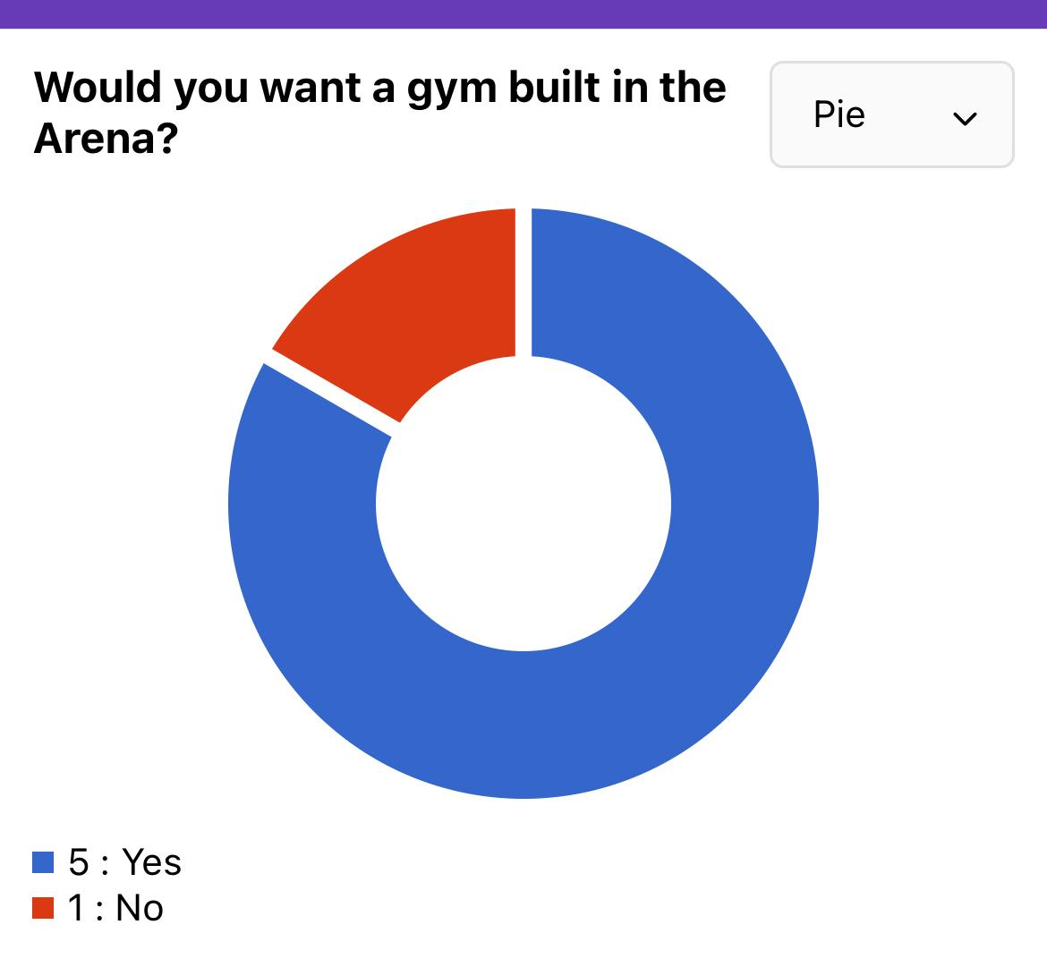
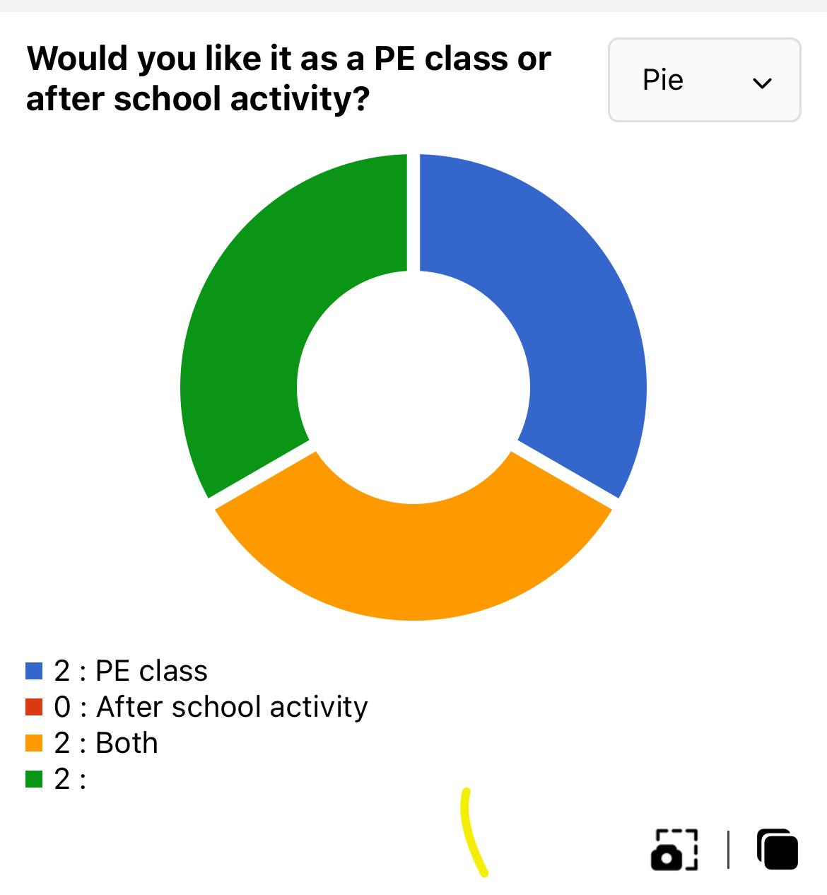

Location
The location will be the school's arena. at a prominent location promotes essential visibility. In the end, people who pass by the health club and can envision visiting the gym as part of their normal routine will be more likely to consider joining.
A successful new gym or fitness center will be built in a visible location where it can be seen and remembered. If people are aware that the gym is close to a busy area, such as the playground across the street, they may be more inclined to stop by and work out. Name and contact information for the studio should be prominently posted on legible signs, including phone number, website, etc.

Slide 6

Advantages
it's good for your health.
It's good for your mind.
It's a great stress buster.
Meet like-minded people.

Slide 7
disadvantages
You may get injured
Gym memberships can be costly.
Some people take it too far.
Can feel like a rather artificial environment.

Slide 9
citations
https://www.glofox.com/blog/gym-financing/
https://www.markelinsurance.com/resources/healthclubs/choosing-a-gym-location
https://environmental-conscience.com/joining-a-gym-pros-cons/
https://www.thelittlegym.com/Jordan
Some of the information is taken from the suervey

