Slide 1
Adding a new sport to the school
Done by: Omar Goussous and Jaafar dajani

Slide 2
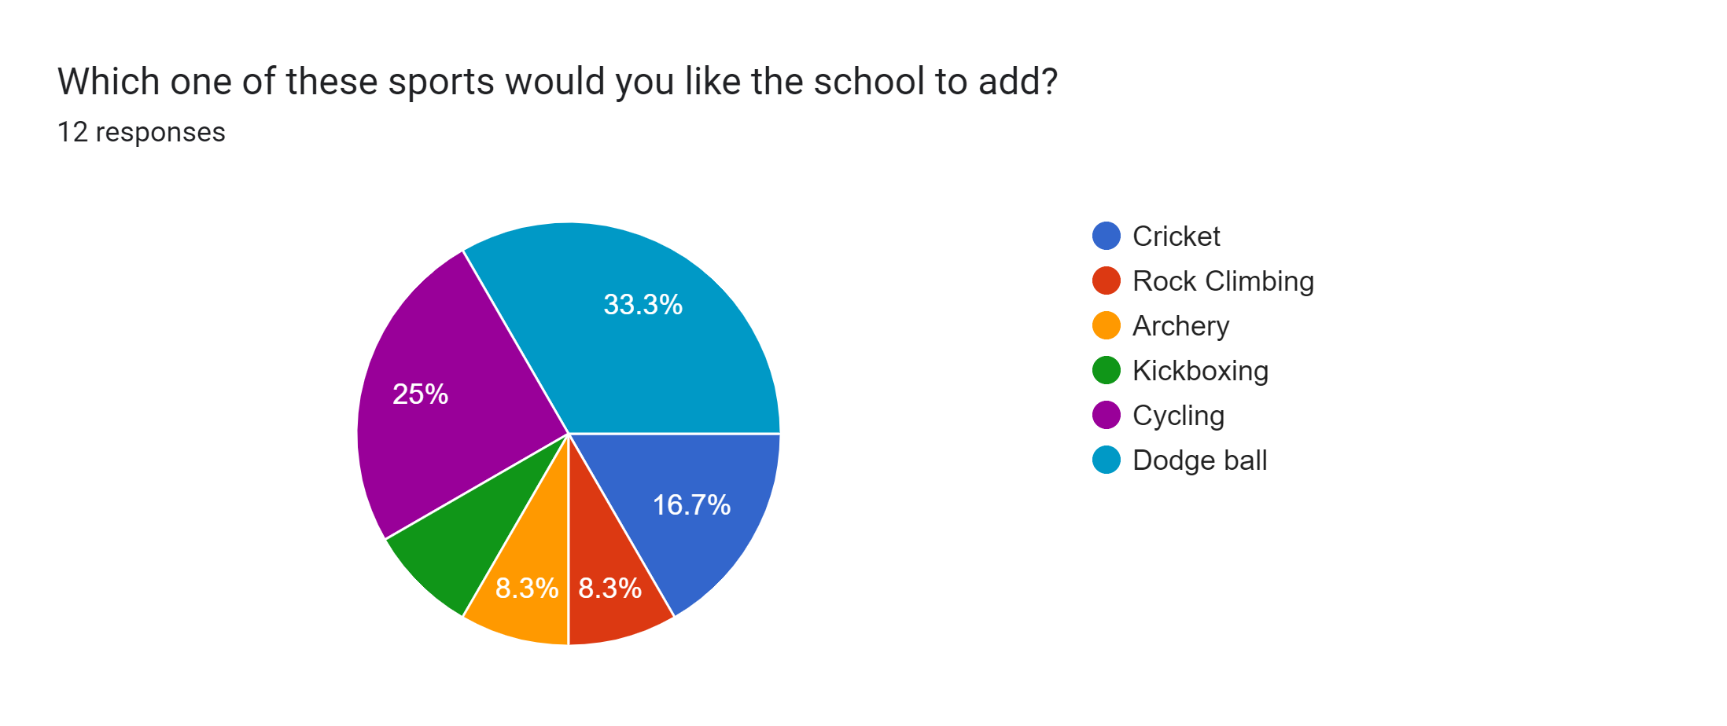
Introduction
We decided to do a survey to see what new sport do the students want.
Here are the results: https://docs.google.com/forms/d/1FWKVCP1ufnQvPqWlSek9ZFra81pjfQuF4VRpv334PbQ

Slide 3
What is dodgeball?
Dodgeball is a sport in which participants throw and dodge balls that their opponent tosses at them. It has gained a lot of popularity in recent years, especially in schools, which is a good justification for adding it to the list of sports.
In the upcoming slides, we are going to talk about the consequences of dodgeball.

Slide 4
Causes of adding a new sport
Here are a few advantages/causes of adding a new sport to the school:
Better Performance in Academics
Students who participate in sports can also improve their academic performance. Students' daily physical activities aid in memory enhancement and mental renewal.
Students can perform better in their academics if sports are a regular part of their schedule. Students will be able to concentrate better on their studies as a result of their improved physical and mental health.

Slide 5
Boost Emotional Fitness
Students who participate in physical activities feel happier and have their minds refreshed. By lowering stress and mental depression, sports also assist students in remaining upbeat and emotionally healthy.
Students can perform better in their studies and reach their objectives if they are in good emotional and mental health. Students who become more interested in sports can turn them into a passion and a career.

Slide 6
Good Fitness Level
For students to lose weight and keep up their physical health, sports are crucial. Due to the growing popularity of indoor activities like television and video games, outdoor sports are on the decline. Students who participate in regular sports can keep their weight and fitness levels in check.

Slide 7
Consequences
Here a few consequences/disadvantages that we think should be considered before adding dodgeball:
Competition and Risk
Sport teams may put themselves under pressure to succeed, which may have detrimental effects on and off the field. Youth sports also carry a risk of injury, and schools with coaches who don't follow safe practices or aren't trained in them can raise that risk. For instance, encouraging players to head the ball without properly instructing them on how to do so increases the likelihood that they will sustain concussions.

Slide 8
Inappropriate Focus
School sports might obstruct learning by taking away time that could be spent studying. Schools need to keep an eye on how much time is spent practicing and make sure that academic success is not put ahead of athletic success.

Slide 9
Finance
Finances and expenses should primarily be taken into consideration because while it may be expensive to add a new sport, we can essentially raise the necessary funds through: donations, the addition of enjoyable events for students and the purchase of amusing plays charging 1 – 3 JDs.

