Slide 1

Adding yoga sessions
By: Toleen Bosheh, Joelle Abualitham

Slide 2
Introduction
Revive and relax!
In this PowerPoint we will be informing you about the advantages, disadvantages and consequences of adding yoga sessions for girls and how, why when and where these session will occur

Slide 3
Why?
toleen
We feel like it is appropriate for the NOS school to add a yoga class for females during the school period to improve physical health as well as mental health.
We believe that us girls deserve a class just for ourselves to have fun as well as stay energized throughout the school day!
joelle

Slide 4
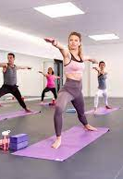
Advantages on students
Effects of yoga on mental health
toleen
Mental health:
Yoga has been demonstrated to reduce stress hormones in our body while at the same elevating healthy brain chemicals like endorphins and GABA . These feel-good substances assist in lowering anxiety and enhancing happiness.
According to Dr. Keenmon, there is less brain shrinkage in the regions of the brain that process information and store memories over time, which is thought to reduce the natural aging process. Making yoga a regular practice can help shield our memory and thinking from the negative consequences of aging.

Slide 5
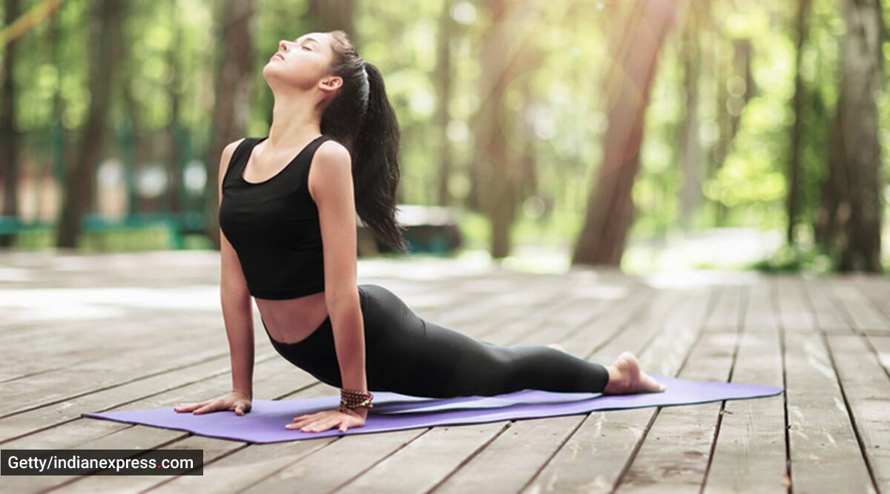
Advantages on students
Effects of yoga on physical health
joelle
Physical health
Regular yoga practice may lower stress levels and overall inflammatory levels, promoting heart health. Yoga can also be used to treat a number of the risk factors for heart disease, such as excessive blood pressure and obesity.
Yoga is a style of exercise that combines cardiovascular and strength training. While certain yoga styles encourage calm, other options provide faster-paced yoga sequences. Most versions involve both breathing exercises and yoga postures.

Slide 6
Consequences
Consequences of yoga on physical health
Physical health
toleen
muscle strain, back pain, musculoskeletal injury, glaucoma complications, abnormally high blood pressure brought on by forced breathing, and others are the consequences of yoga on physical health
Yoga can increase blood pressure, poses physical risks, increases the chance of having a stroke, is not suitable for everyone, and can be dangerous for those with insufficient training or expertise.

Slide 7
Advantages for NOS school
joelle
We already have a yoga room so there is no need to build one
The school can find investors to invest in equipment and matts so the school won have to pay much
students can be more focused in class and get higher marks
Instead of spending their free time on electronics , students have a place they can go to enjoy themselves as well as take care of their health.

Slide 8
Where and when?
toleen
This activity will take place in the yoga/dance room in the NOS school
Classes shall start during school hours so no need to stay after school
But of course students and free to use this room under teacher supervision on their free time.

Slide 9
Questions and answers
Interview questions and answers:
Questions for teachers: what do you feel about adding yoga sessions for girls and do you think that you could teach them?
Questions for students: what do you feel about adding yoga sessions for girls?
All 6 students and both teachers supported the idea and answered yes to the questions asked they all said that it was a good idea and that yoga could aid in concentration and relaxation for students and it could increase the chance of better mental and physical health as well as increase their grades for better chances of a better future in addition to this some students may have an interest in yoga so these classes can be a chance for them to pursue this interest and having it evolve into a hobby. what do you feel about adding yoga sessions for girls

Slide 10

THANK YOU!
link to interview :
https://youtu.be/_WXityAkcn8

