Slide 1
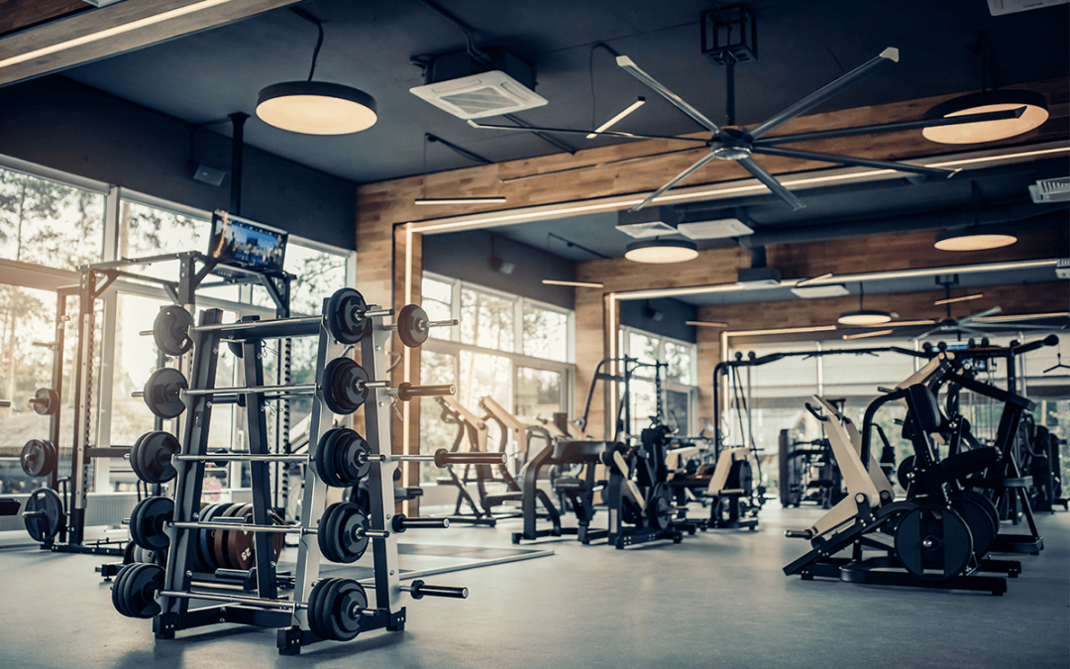
Gym
By Laith Naber

Slide 2
Introduction
I would like to add a gym to the school because a gym can really make for an amazing physical fitness lifestyle. In addition, students and even teachers who do not have time to go to the gym after school can also use the one in school gym. It can also be used for physical education classes and other activities. A gym can also be a great place for students to socialize and build relationships with each other.

Slide 3
What are the pros of having a gym?
Students and teachers can:
Become stronger
Achieve good physical health
Interacting more
Prevent obesity
Have a better mindset

Slide 4
What are the cons of having a gym?
Students and teachers can:
Damage their heart
Injure people or themselves
Scared to get addicted
Feeling guilty

Slide 5
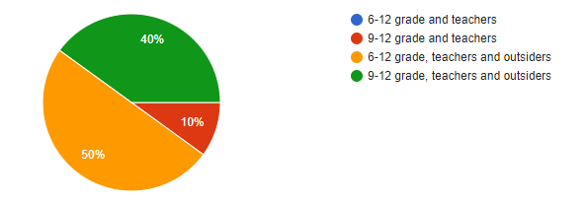
Who is allowed to use the gym?
Grades 6-12 and people from outside the school can enter but they everybody has to pay a fee.

Slide 6
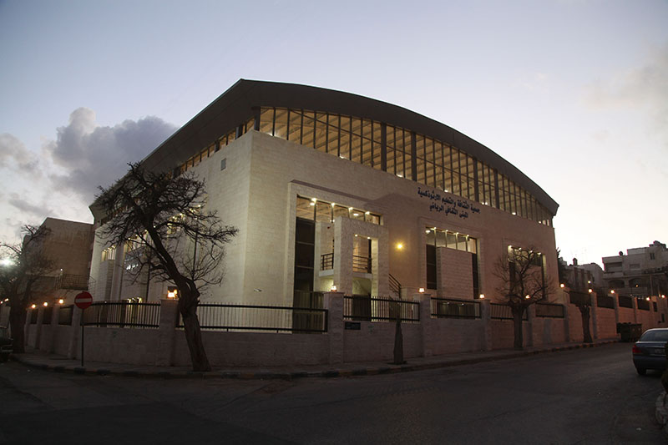
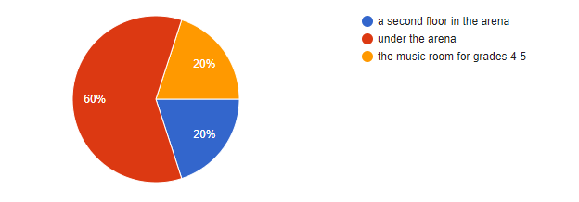
Where will the gym be located?
The gym will be located under the arena because there is so much space to have a gym and there is a decent amount of airing.

Slide 7
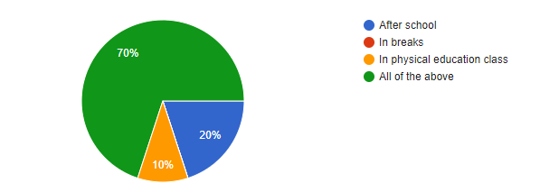
When can people use the gym?
People can go to the gym in the physical education class or in recess and after school. The people from outside the school can go in the gym after our school finishes.

Slide 8
How can the school make profit from the gym?
The school can make profit from making a membership for people who want to use the gym.
Insiders | Outsiders
1 month: 20 JOD | 1 month: 30 JOD
4 month: 65 JOD | 4 month: 75 JOD
1 year: 150 JOD | 1 year: 180 JOD

Slide 9
How can the school make the money to build the gym?
The school can definitely organize a fundraiser to raise money for gym equipment. There are many different types of fundraisers that schools can use to raise money, such as selling products, hosting events, or collecting donations. Some ideas for fundraising events for gym equipment might include a charity run or walk, a silent auction, or a school-wide fitness challenge.

