Slide 1
Gym in school
By:Aoun hammad,Bassam sweis

Slide 2
Introduction
Our topic is about how gym can be established in school, and the benefits of gym in the school. In addition of the consequences and causes of the idea to be established in school. also how can we provide the finance for it . Although is it safe and suitable and safe to have a gym containing heavy machineries in the school community. As well as from what time to time should it be open . moreover where the gym will take place . All of the answers of those questions will be answered in the next slides.

Slide 3
Why was this idea helpful
We came up with this idea because we as students would love having a gym to stay at after school and in the free classes, some students like lifting more than sports and this can help them be more passionate in this field rather than focusing on fields they don’t feel comfortable in.

Slide 4
consequences
Students might get injured
It will cost a lot of money
Machines may be used wrong
some un-responsible students could ruin expensive stuff in the gym or get injured with any machine there
Some people will find it hard using the equipment with no coach
Some parents will find it expensive to spend more money on gym rather than education
Some students may sneak out of class to go to the gym or focus on gym more than classes.

Slide 5
Causes
make the school a more attractive place
students may get fit and healthy
it is healthier for students to exercise more
improves health
give students time to work on their health
Gives more options for students who like to train rather than sports in physical education class.
To play in the break and canceled classes
good mindset for students and increasing
For students to get rid of negative energy
Gym can increase immunity

Slide 6
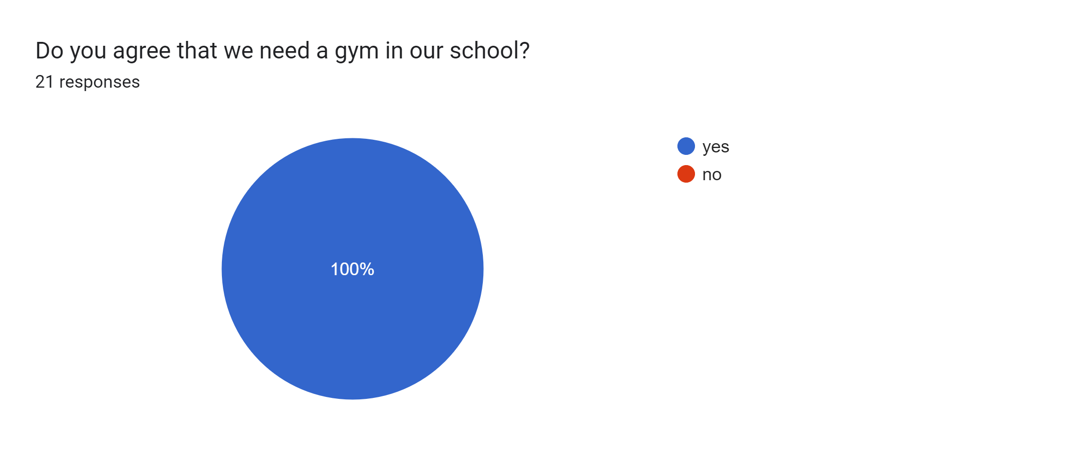
The result

Slide 7
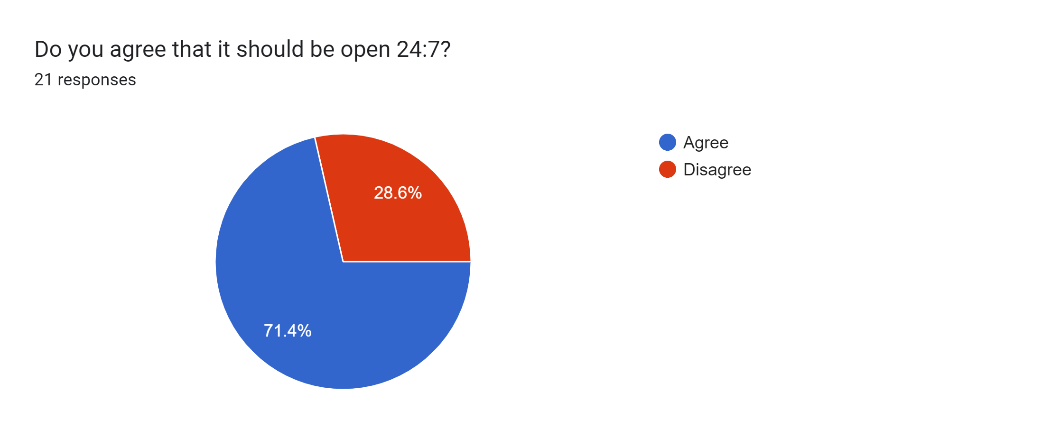
time for the gym

Slide 8
why is this helpful
5:16PM
people can go to the gym any time
More income for the school as students from outside can get a membership
Both students and teachers can use it

Slide 9
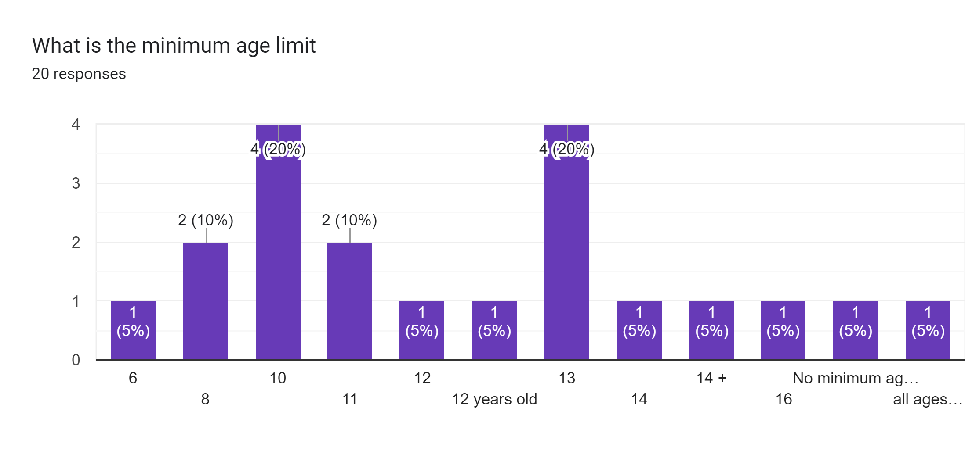
Age limit

Slide 10
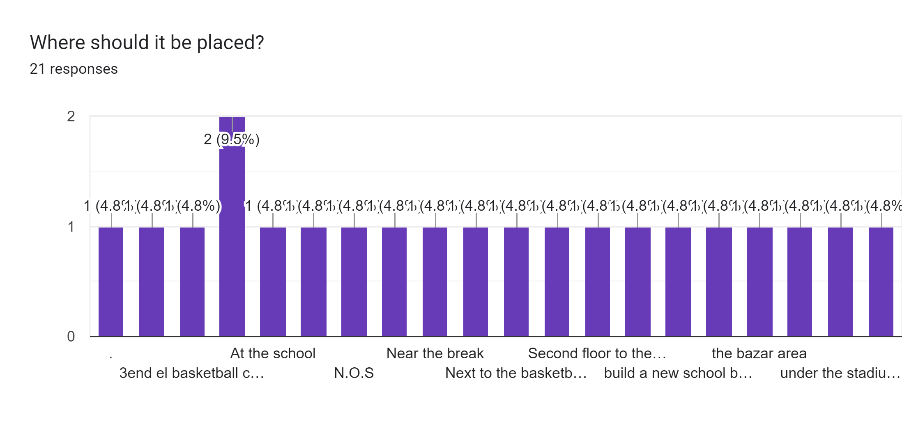
Where should it be placed?

