Slide 1
Create your Business Plan
-business plan

Slide 2
My Business Plan
Business idea (Description &Name) | The name of the business is going to be “team taco”. the store will provide goods and services since it’s a fast food shop. The shop will be based on Mexican food but mostly focused on ta cos dipped in different sauces. People would buy it because the name would be really easy to pronounce. The vison of the shop is to be well known for our amazing
Target market & Demographics | Since this is a fast food restaurant it would be for everyone(but not people with health issues). the competitors of the shop is “chipotle”. The location would be in abdoun, and there would be delivery in the app “talabat” when the business get more recognized.
Financial Information | The money that will be put on the shop is going to be from my savings, the amount would be 100k just to build the business . The prices for the shop will be affordable and reasonable its also very cheap compared to chipotle, the prices would be between 4-9 (depending on how big the serving is) . The total cost will be 8395 per month.
Owners Details: owners name :tala alwazani / owners number:0788904493
What you will do with the money you make if it was profitable? Reinvest in the Business? Save it for collage? Donate? I would save it.

Slide 3
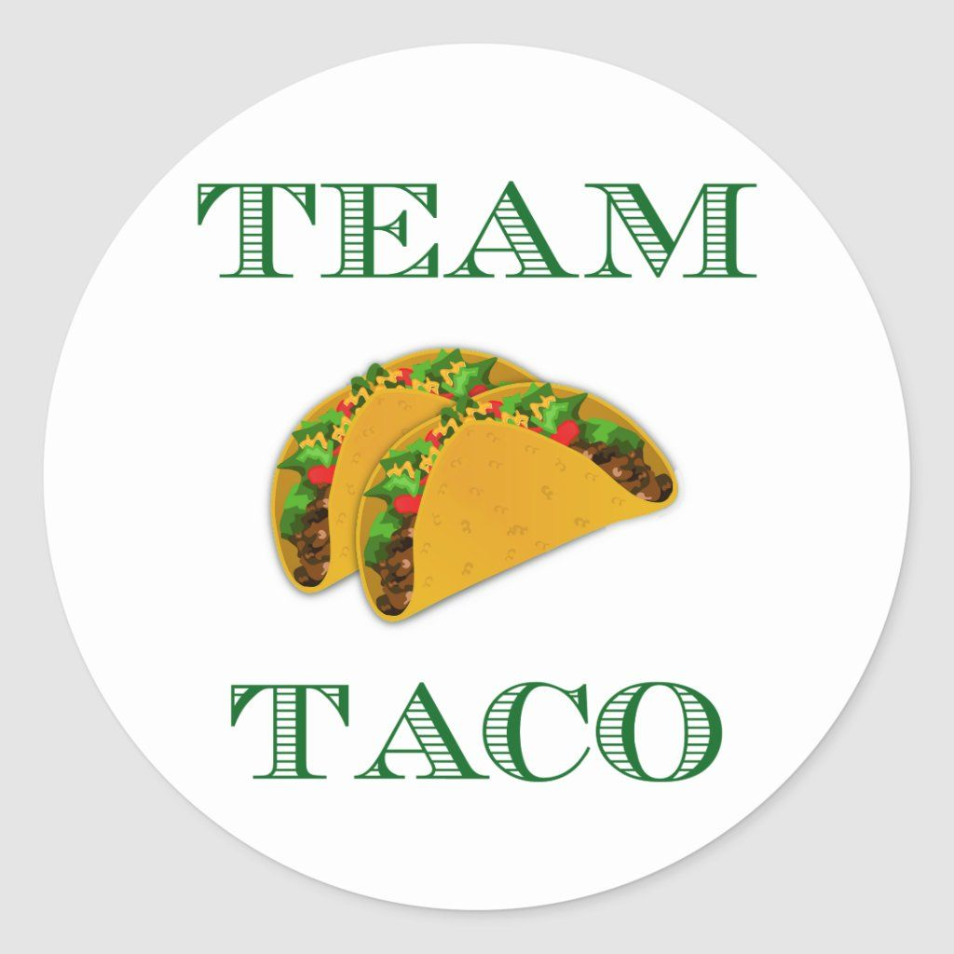
The brands label:

Slide 4
THE END

