Slide 1

Adding a swimming pool to NOS
Made by: Dareen Alfarah, Sama kaawash, Gianna kassabian

Slide 2

Introduction
After much research, we came to the conclusion that the majority of students would prefer to have a swimming pool and an after-school training club. We are here to make sure you are persuaded, after hearing this plan, to us constructing a swimming pool that will help entertain and increase student hobbies.

Slide 3
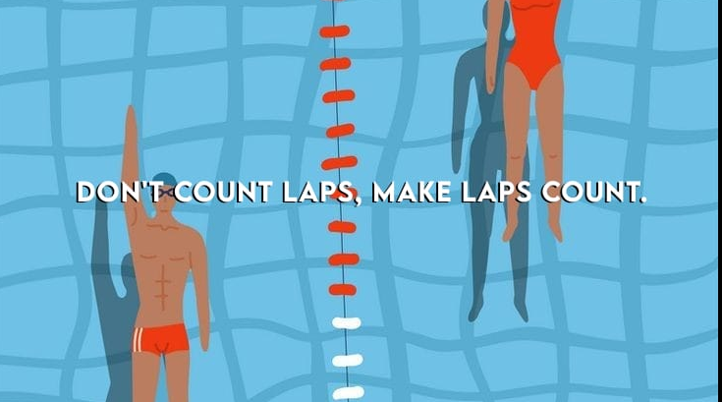

Slide 4
What are the advantages and disadvantages of having a swimming pool and club in our school?
Advantages:
Disadvantages:
It increases students hobbies.
it makes students more active.
it’s a healthy activity for students.
it would add more varieties to after school activities.
it will help benefit our school.
to give students better access to different kinds of exercise and activities.
it will help entertain students.
it may cause threatening injuries and infections.
it can be a distraction from students studies.
there is a slight risk of anything dangerous occuring.
it could cause certain health issues.
It may be unsanitary.

Slide 5
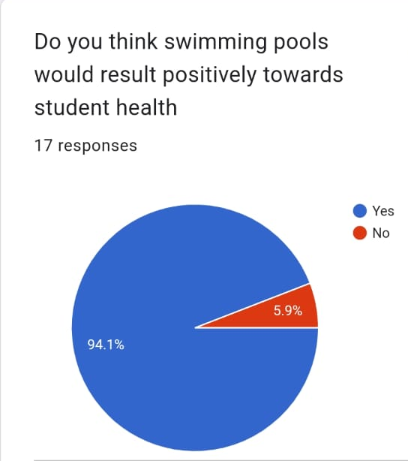
How would swimming result positively towards students health?
it builds endurance and muscle strength.
it strengthens and engages the cardiovascular system. (circulatory system)
it helps maintain a healthy weight including a healthy heart and lungs.
it would help boost students mood and relieve stress.
it can help with students sleep schedule.
it increases students flexibility.

Slide 6

How would having a swimming pool with an after school club benefit the school?
Parents would prefer a school that would enhance their children's interest, as well as their hobbies, and they would like the idea that their child will be volunteering in a healthy activity, so this would also benefit the school profitably.

Slide 7
Where do we want to set up this project?
We want to construct this project in the empty arena, which is located behind the gym, considering it is a huge space and would be perfect use for this idea. Also including that the arena is almost sound proof so it wouldn't disturb the swimmers nor the people outside.

Slide 8

Ways to raise the funds needed for this plan:
We can open up book sales, bake sales or organize a fun event that students would like, we can also open a basketball or football matches with tickets sold for a certain amount of money to enter. We may also sell shirts and items to gain profit for the funds.

Slide 9
Links used:
https://www.betterhealth.vic.gov.au/health/healthyliving/swimming-health-benefits
https://www.cdc.gov/healthywater/swimming/swimmers/rwi.html
￼Our survey:
https://docs.google.com/forms/d/17f5nF5DZLejVWmUm4dpkgHSSwemHZqj8UjRRw5jpfwU/edit

