Slide 1
Gym accessibility at the National Orthodox School
Made by Marwan kakish and Andre kakish

Slide 2
“Take care of your body. It’s the only place you have to live.” – Jim Rohn

Slide 3
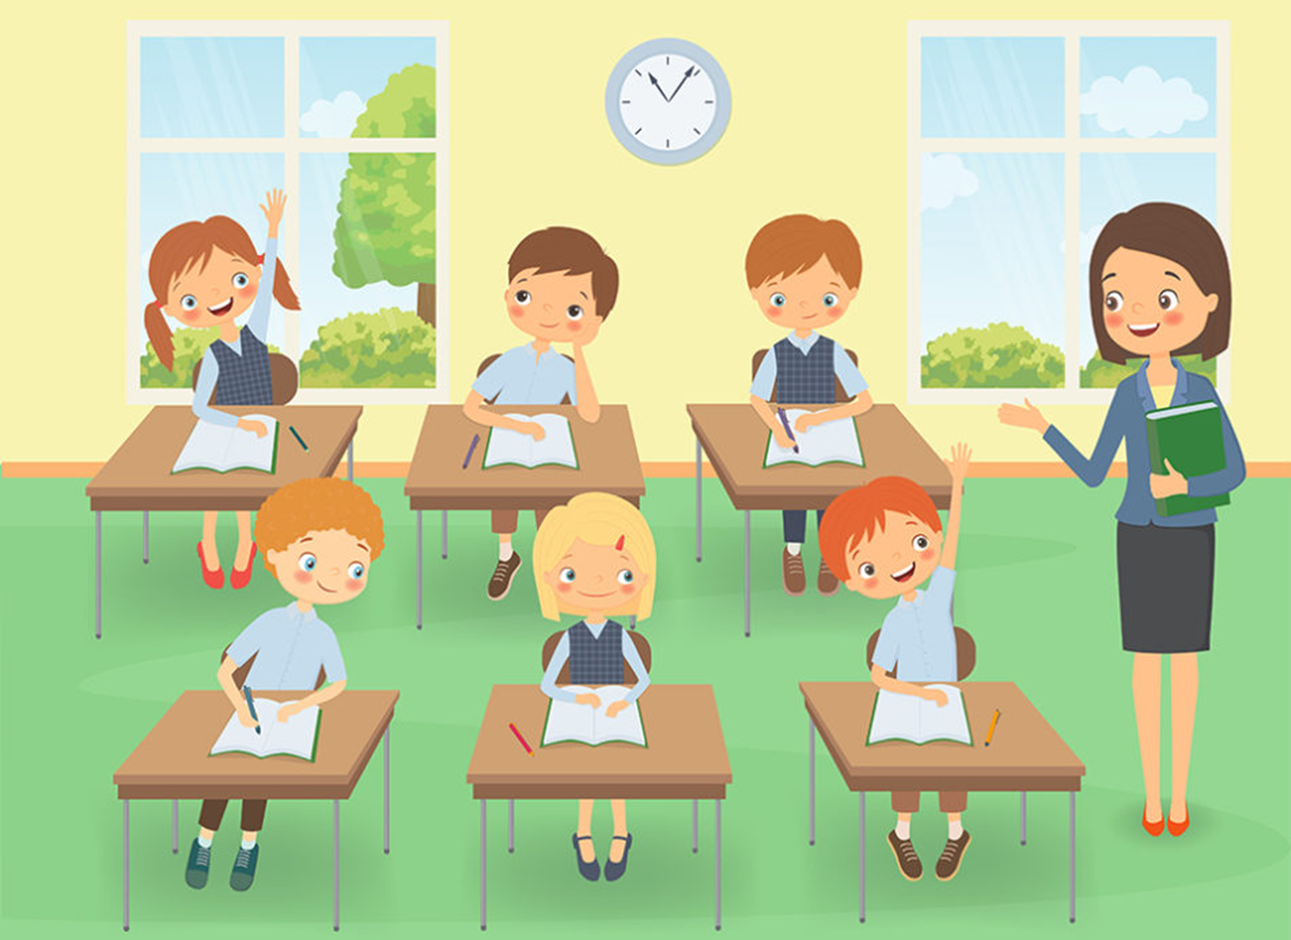
Hello, we are students from the 6-8 department in the National Orthodox School.
We are trying to improve the accessibility of sports in our school by having a gym.
Do you agree that a gym would help students?
Well, we do believe that exercising helps students get better grades, improves their memory, school attendance and on-task class behaviors.

Slide 4
Mental and physical health are the most important things in our life.
Exercising is food for the mind and soul, it improves our brain health and nourishes our soul.
Exercising regularly helps us manage weight, reduces the risk of disease, strengthens our bones and muscles, and improves our ability to do everyday activities.
Therefore, it is highly recommended to exercise on regular basis.

Slide 5
We have made a survey to collect information about having a gym in the school.
Here are the results for the survey which shows that most students wanted a gym..

Slide 6
Most of the people that participated in this survey were males and the others were female.

Slide 7
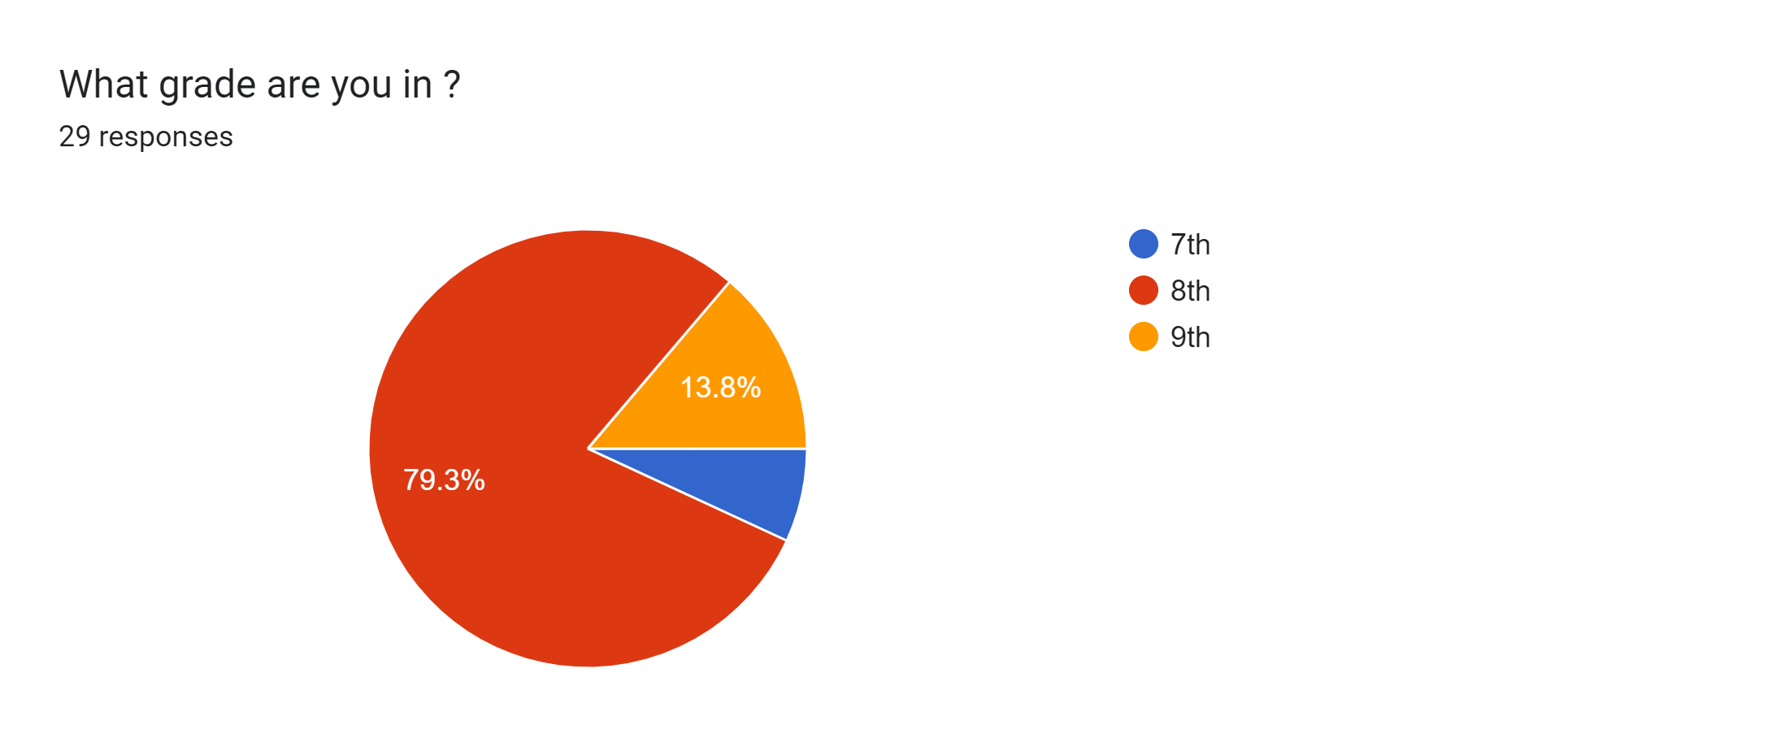
Many people that answered this survey were 13 years old and in the 8th grade which is a great age for sports.

Slide 8
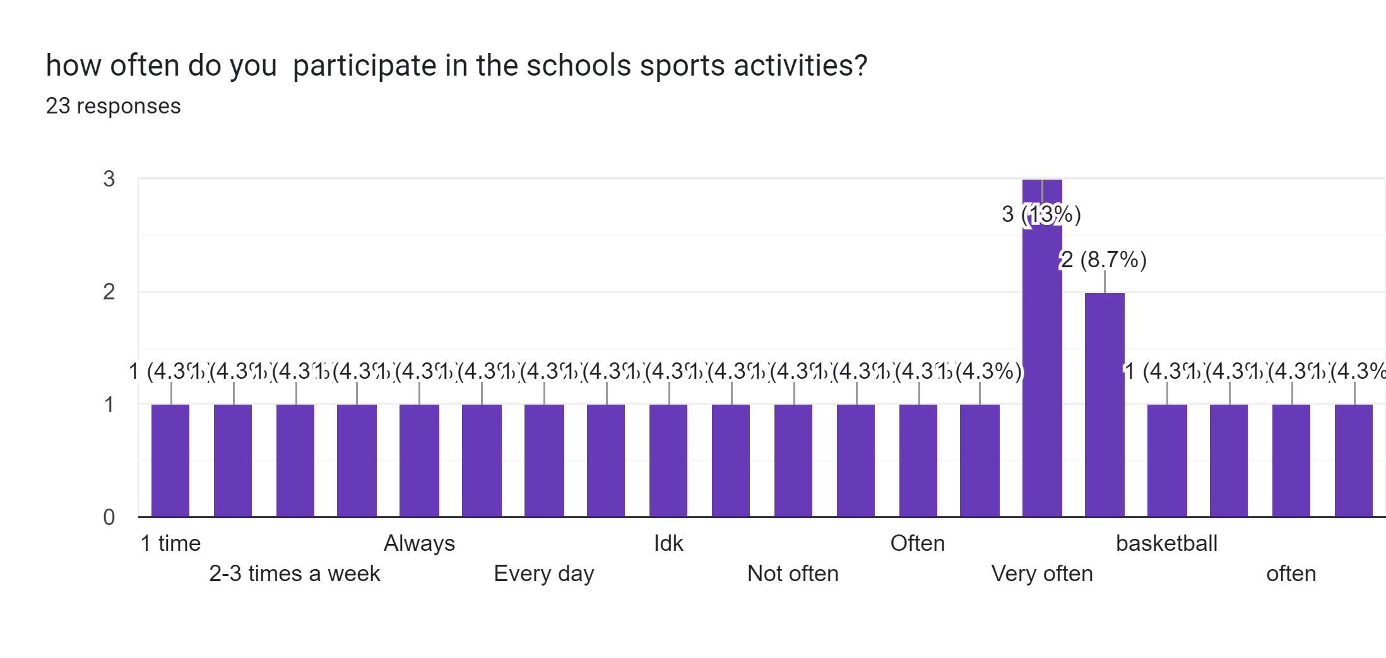
A lot of people that contributed to this survey participate in school sport activities very often which indicates that students in the NOS school love having a wide variety of activities to choose from.

Slide 9
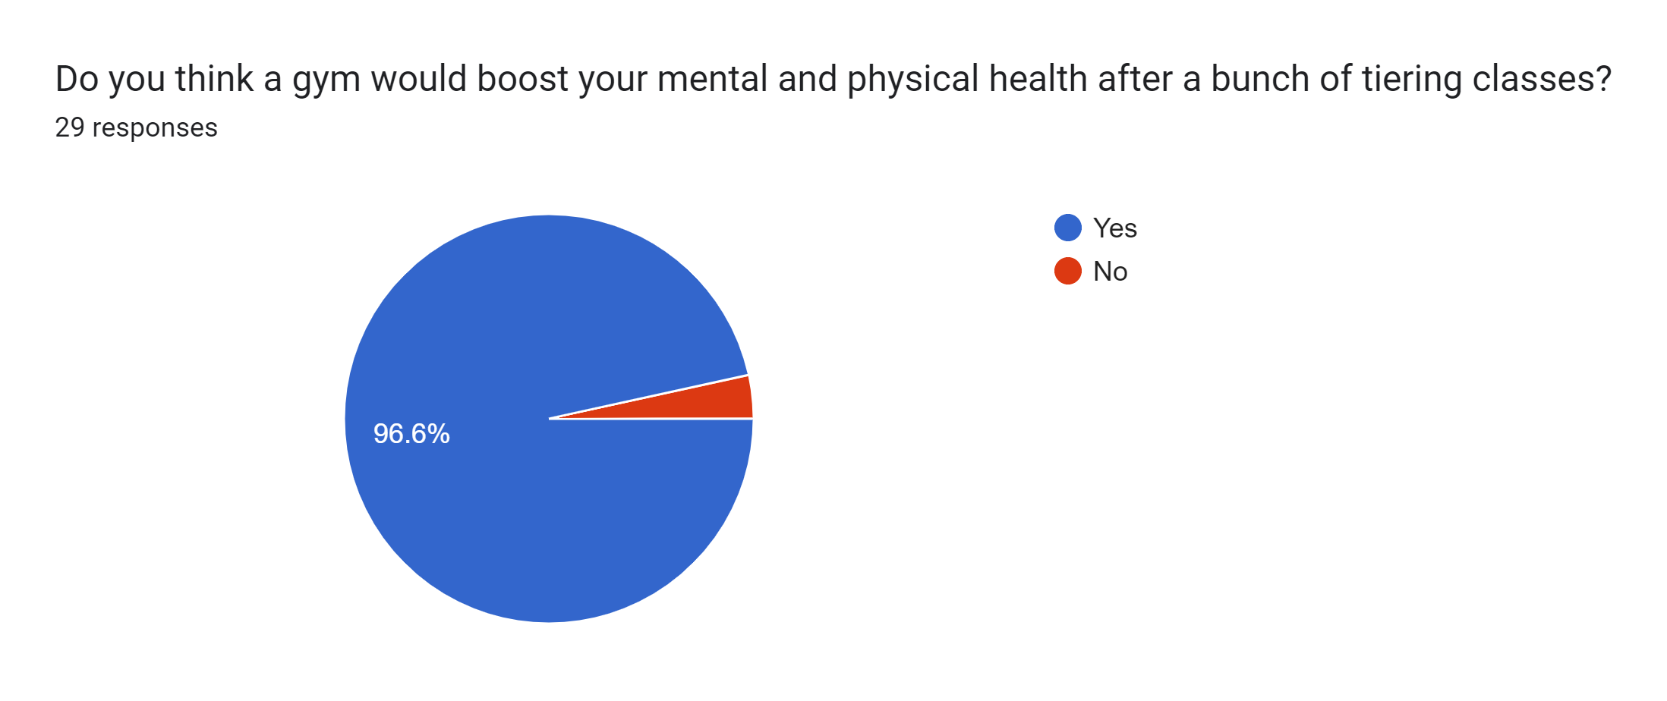
About 96.6% of students in the NOS school would love to have a gym in their school knowing that it would boost their mental and physical health.

Slide 10
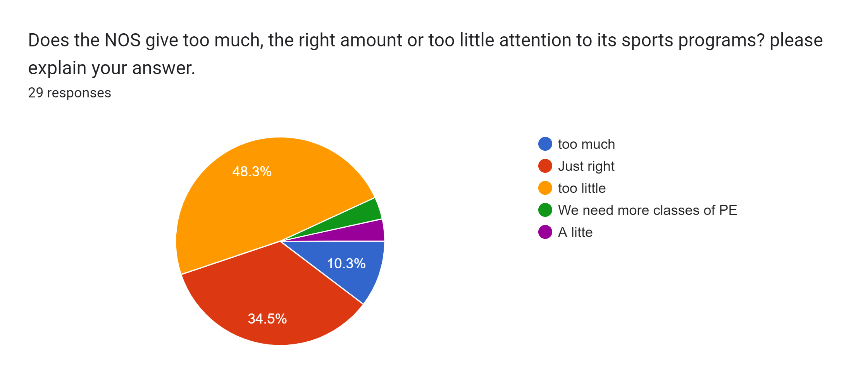
The survey shows that students think that school does not pay much attention to sport activities sue to lack of sport accessibility.

Slide 11
Last but no least, I think a gym would not only affect us but also our school positively since it would increase the memory and focus of the students allowing them to get higher grades making the school seen as motivational and thoughtful of what the students might want which will get more people willing to join the NOS school.

Slide 12
Finally, we estimate about 12-18 weeks to build the gym and it would take 3000$ to make the room and about 60,000$ to get equipment and tools for the gym.
Even after all this work it would still be worth the time and money because of all the reasons we have wrote in the previous slides.
This is why we recommend building a gym in the National Orthodox School.

Slide 13
Thank you for listening

