Slide 1
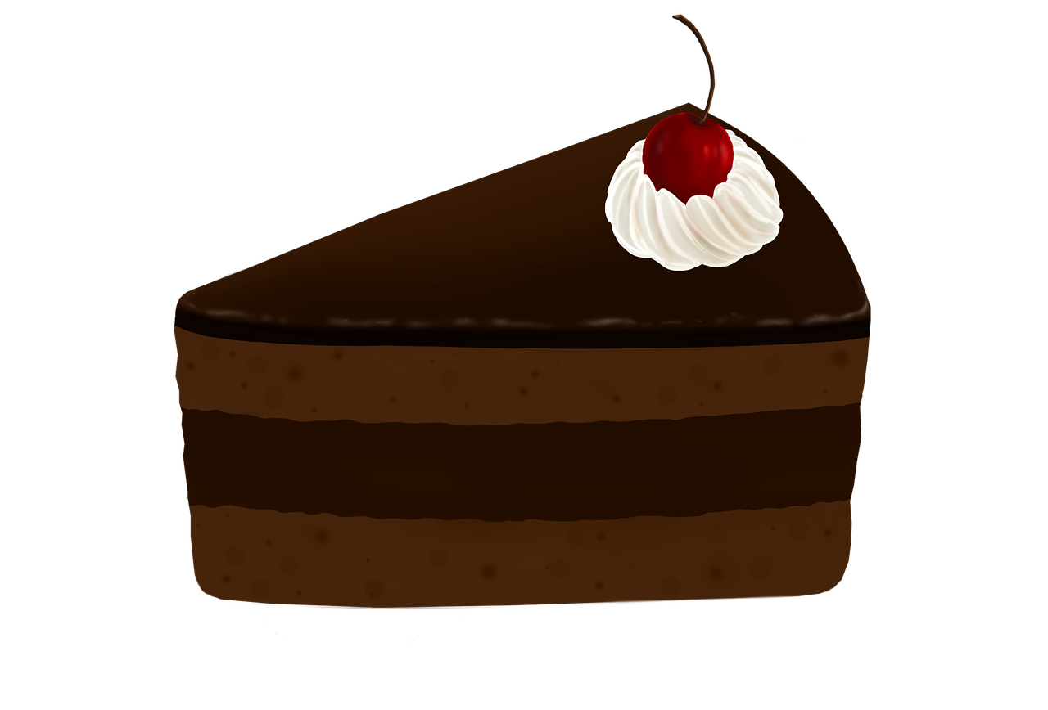
It’s Just A Piece of
By Tia Karadsheh

Slide 2
My business is a bakery, it is considered as a good and a service, because it has goods such as: cakes, cupcakes, croissant, breads and way much more, and it also has services such as: waiters and chefs/bakers.
In addition, I chose this name (it’s just a piece of cake) for my bakery to show costumers that it is easy and simple, and it is also related to the bakery.
I also think that people would buy my products/pastries because I will try my best to make them delicious and not too expensive so that more costumers would come.
Most probably, kids and teenagers would come to the bakery, especially that they probably prefer sweets more than adult costumers. my competitors would definitely be the cakery and chez Hilda, Because their pastries are so good.

Slide 3
Predicted profit: 200,000-10 =199,90
I would save the money I make for something necessary, and I won’t waste it on unnecessary things, or I would use some of it to develop my bakery if the money was profitable
My bakery will hopefully be in France, Paris. i will try my best to bake new and different recipes to attract people to buy my products.
In the bakery I will be needing: ovens, mixing bowls, kitchen utensils (whisks, spatulas, knives) pans, measuring spoons and cups, piping bags and tips.

