Slide 1
NOS BLUE WAVES
Build a Victorious team, one stroke at a time.
By: Laya Nowwara & Alex Petropulo

Slide 2
Our idea(intro)
The one true way to successfully build a school’s athletic reputation is to build a magnificent team, especially a swim team.
The National Orthodox school has nearly everything, except for the most important, efficient and effective sport, which is swimming.
We believe completing this missing piece will make the school perfect.

Slide 3
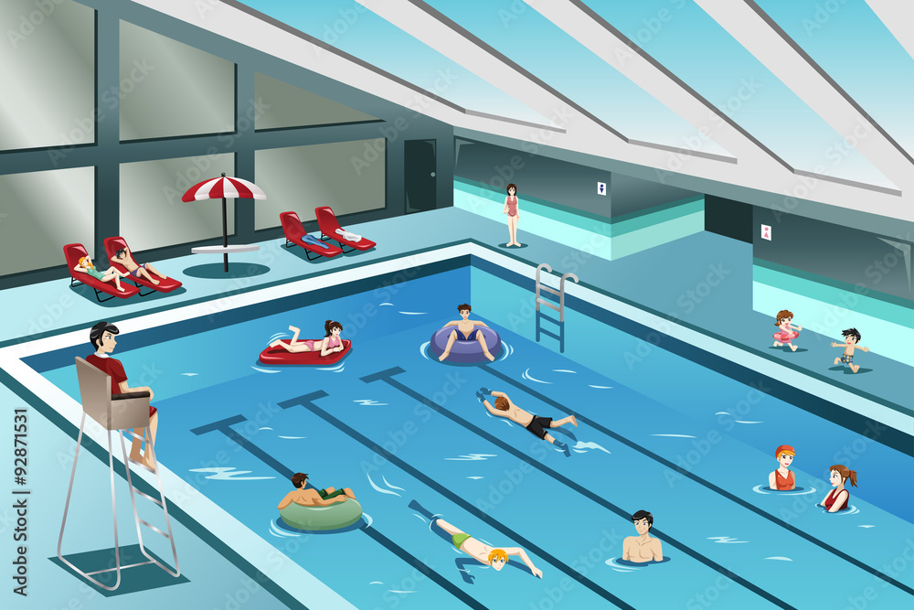
THE LOCATION
We’re convinced that the space under the sports arena would be perfect for our idea.
It is wide enough for comfortable and separate swimming lessons.
Always available to all students.
Easy access to locker rooms.

Slide 4
Benefits to the school
Being able to gain back all the money spent on the pool by the students participating and winning in swimming competitions.
Civilians tend to put their children in schools with a wide athletic range to peak their interests, this will heavily upgrade the school’s reviews.
Taking swimming lessons will help NOS students achieve superior mental and physical health.
All this not only benefits the school’s profits but also its athletic reputation.

Slide 5
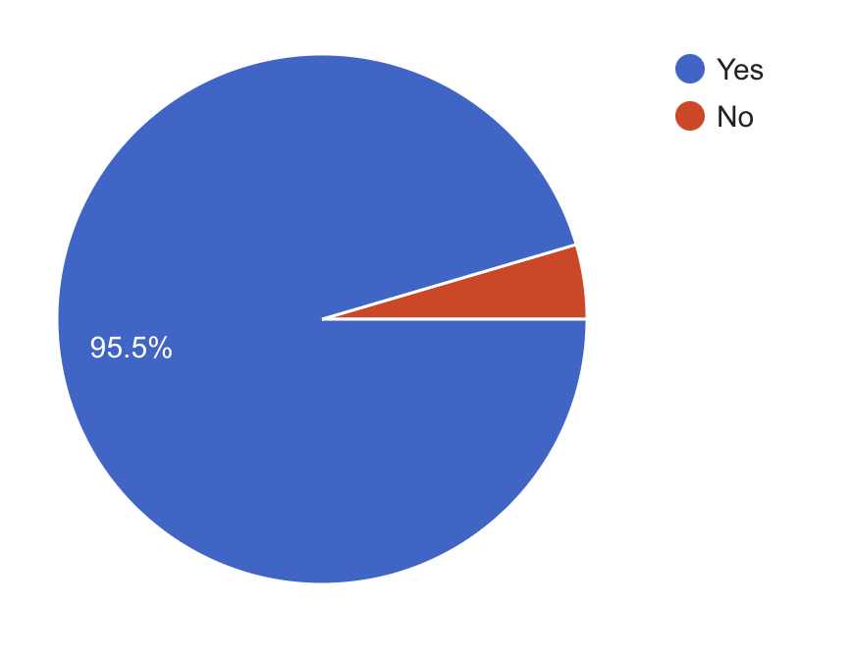
BENEFITS TO THE SCHOOL
Most NOS students take part in competitions while representing and winning for another school, this project would enable them to win while representing their own school’s swim team.
The school’s students answered our survey and the results showed that 95.5% of students participate and win representing other schools.

Slide 6
Benefits to the school
The National Orthodox school only has athletic options for team sports, this makes multiple students dislike the entire idea as they prefer playing individually.
In our survey, we discovered that over half of the school’s students prefer individual sports but are not able to participate in any due to the lack thereof.
This project makes the best individual sport
available for students.

Slide 7
Consequences
Building an indoor pool will be very costly.
It may be a distraction for the students
May cause dangerous and threatening injuries.
Some students have phobias and will be unable to participate in our project.
After constant surveys and research, we concluded that the benefits heavily outweigh the consequences.

Slide 8
Finance
Our team is relying on the school’s main profit to invest in this project.
We will regain all the money spent and more due to the school team participating and winning in competitions.
If the school refuses to cooperate with funding our project, we plan on hosting charity events (bake sales, parties, general donations etc.) to gain all the money needed to build this beneficial projects for students.

Slide 9
Survey link
This is the survey we did to gather all the quantitative data needed for our idea.
https://docs.google.com/forms/d/1gs8g1Q7D3UtFXSQf3YqWvOAaPStebIk3XN92XbD0zKE/edit#responses

