Slide 1
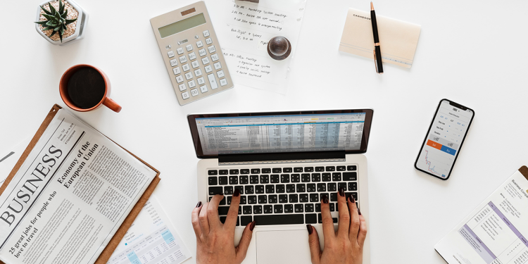
My Business Plan
Created by: Lana Alshafei

Slide 2
What is my business idea?
I am planning on opening a bookstore called “A New Chapter” where I sell all kinds of books for all the bookworms out there!
What is my mission?
I attempt to offer my customers reasonable prices for novels, stories, non-fiction and fiction types of books that they might enjoy.
What is my vision?
For my business to grow and to sell books for all of those keen readers.
What does my name say about my business?
The name of my business “A New Chapter” is created to remind people that there is always a new chapter if you forget about the past, and move on.

Slide 3
Target market & Demographics
My books are available for all customers; children, teenagers and adults of both genders. I will sell my books from home and customers will be able to check my profile with its details on social media such as, Instagram and Facebook
My goal is to be more successful than my competitor “Books2go” which also sells books online. They sell light-weighted books for 6 JODS while for the heavy-weighted books they sell it for 8.5 JODS and 2 JODS for delivery

Slide 4
Financial Information
For children and light-weighted books that contain around 50-150 pages they will be sold for 5 JODS
For heavy-weighted books that contain around 200-350 pages they will be sold for 7 JODS
My source of capital will be the money I saved throughout the years
Predicated profit: -
For the light-weighted books: 5 – 3 = 2 JODS
For the heavy-weighted books: 7– 5= 3 JODS

Slide 5
Owner’s Details
My name is Lana Alshafei, I am 13 years old in the 7th grade, I am adaptable, creative, easy going and I am full of curiosity. My 2 partners, Yasmeen Ejjeh and Yara Naffa, who are also my best friends will be helping me throughout this journey. They will help me take orders, pack them up and deliver them with a smile.

Slide 6
Thank you for reading

