Slide 1
Sports for all.
By George Fakes, and Ziad Qutaishat 8F.

Slide 2
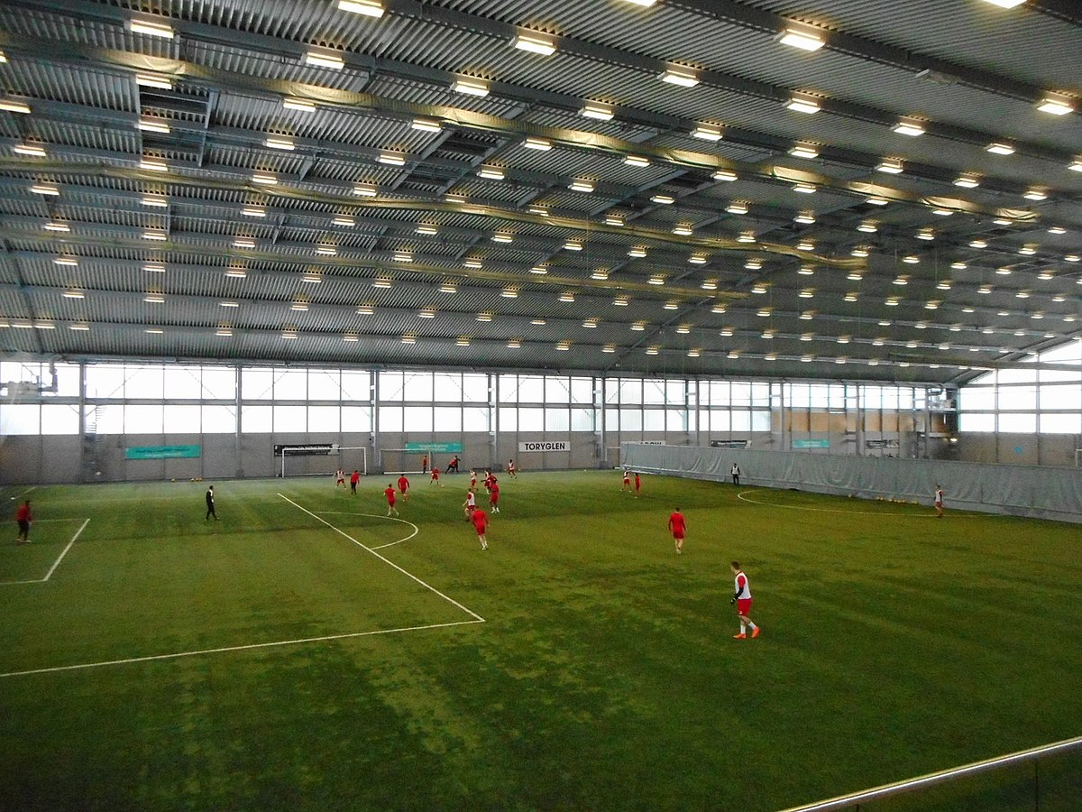
What is our vision?
Our vision is to build an indoor football pitch in the national orthodox school shmeisani.
like this one ->

Slide 3
Advantages of building an indoor football field:
Football would be more accessible during harsh weather conditions (i.e. rain, hail, extreme heat/sunlight).
2 Artificial grass football fields would be more convenient for more flexible training.
It can be rented after school hours or used in tournaments.

Slide 4
Disadvantages of building an indoor football field:
We would run out of space in the school yard.
It’s not cheap to build.

Slide 5
Who would benefit from the extra football pitch?
The school’s little league.
The school’s football team.
Students during P.E classes.
People who are willing to rent a field after school hours.

Slide 6
All students that have done the survey would like an indoor football pitch (as of now)

Slide 7
As of now: 78% of students have a slight feeling that there could be a possibility/probability to build a separate football pitch

Slide 8
Thank you for your time. ☺

