Slide 1
PILATES
By: Jana, Martina, Salma
Date: March 2023
Class: 8E

Slide 2
TABLE OF CONTENTS
01
03
02
Introduction
Causes
Consequences
04
05
06
Course of Action
Finance
Location

Slide 3
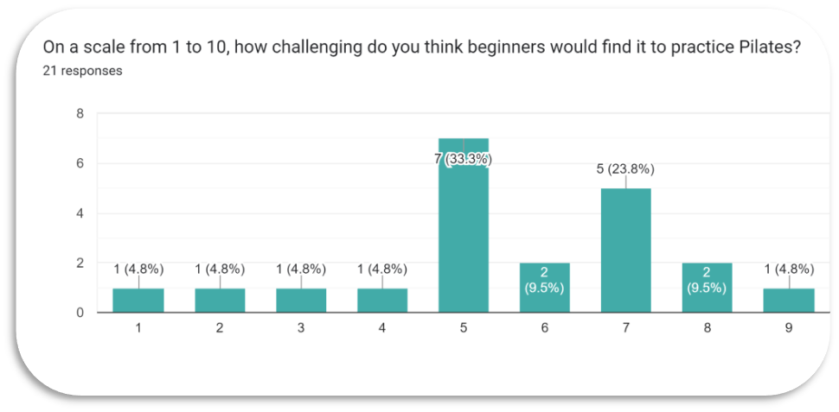
01| Introduction
“BREATHING IS THE FIRST ACT OF LIFE AND LAST. OUR LIFE DEPENDS ON IT.”
-BY JOSEPH PILATES
Pilates was invented in the late 19 hundreds which inspired us to talk about it. It’s a sport which relieves body and muscle tension.We did a survey about it and sent it to many people, which led us to 21 responses with people approving our new idea to add it to school.All the students answers and opinions will be valued.You will see their answers in the upcoming slides as we explain deeply into this topic.

Slide 4
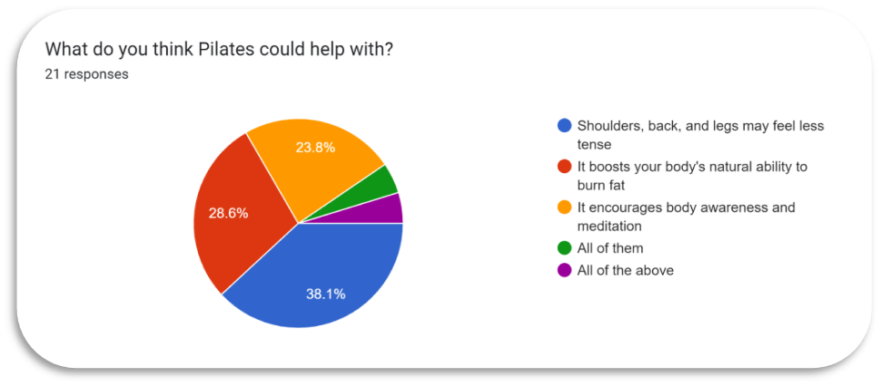
02|Causes

Slide 5
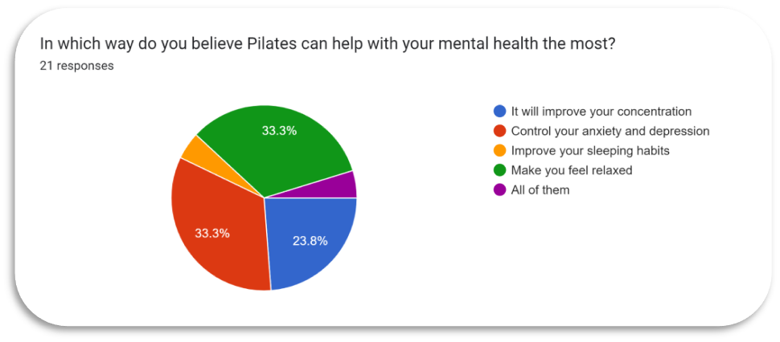

Slide 6
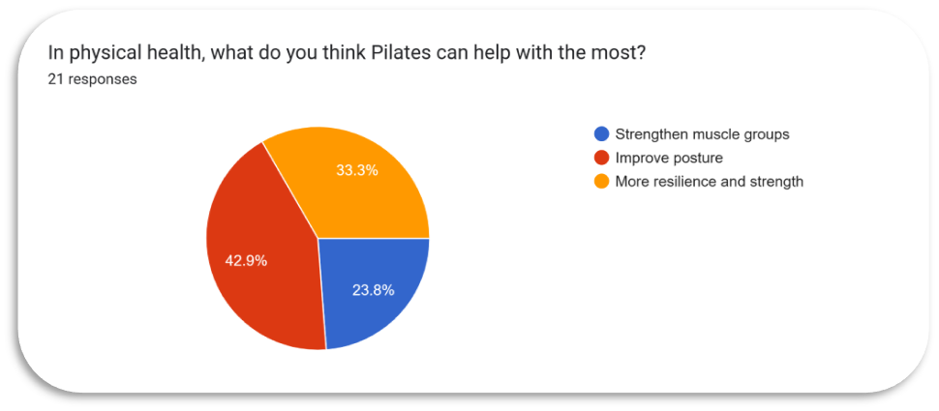
03|Consequence

Slide 7
Body alignment

Slide 9
04|Course of Action
In conclusion, after seeing people's responses to our idea, we think that pilates should be added to our school. Because we are students who were seeking to know more about other students visions regarding our topic. While reviewing the responses, we found that 57% of students wanted pilates to be included in P.E classes. Due to the survey responses, we found out that many of students goals were becoming healthier.A proof to that is that 81% of students wanted a pilates sports area.

Slide 10
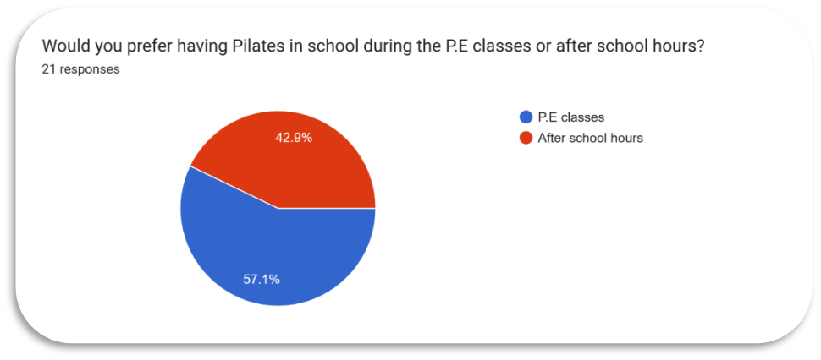

Slide 11
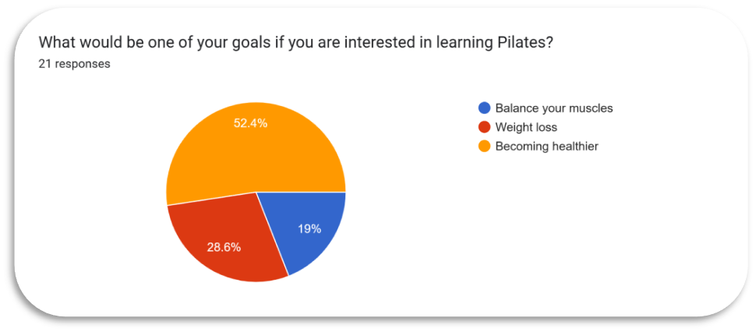

Slide 12
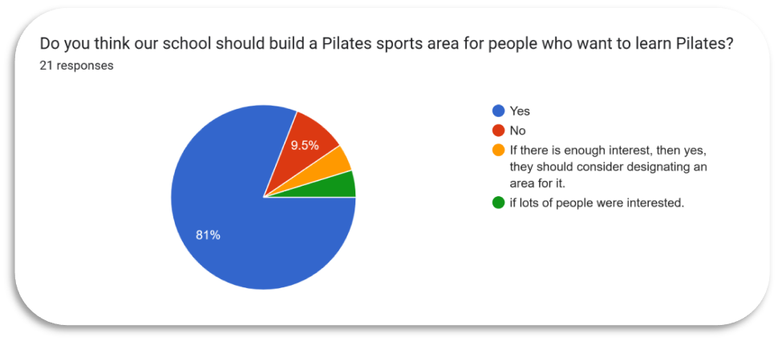

Slide 13
05|Finance
There are many ways in which we could get finance but we found that having the most effective,simple and creative way is to use https://gogetfunding.com/campaigns/?country=jothat is available in Jordan ,this idea can help with finance.

Slide 14
06|Location
The majority of the N.O.S students chose to practice pilates during P.E classes. Although the gym seemed as a good option, we decided having a Pilates sports area.

Slide 15
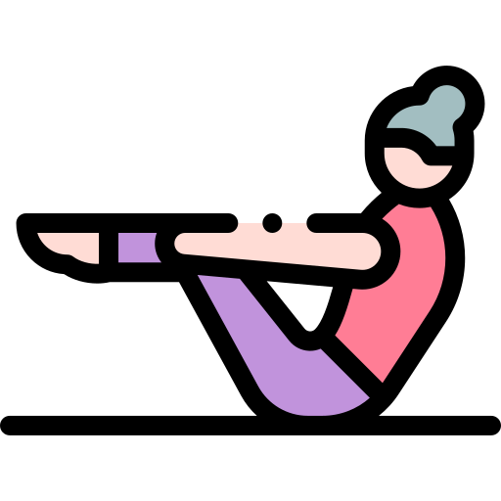
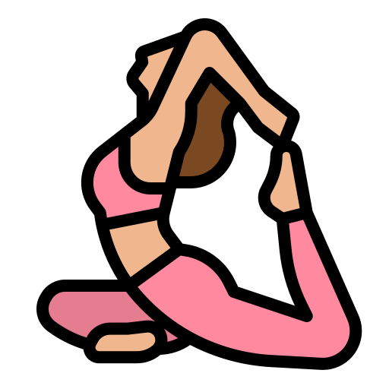
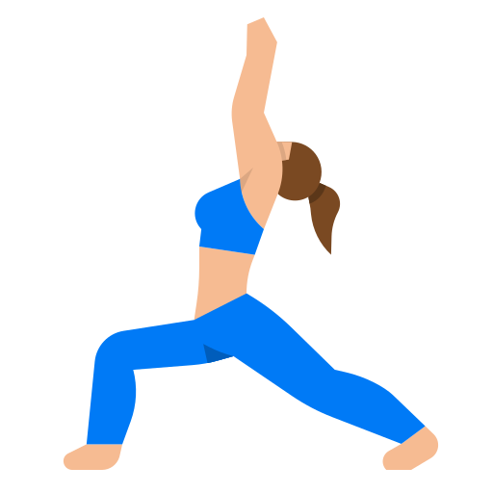
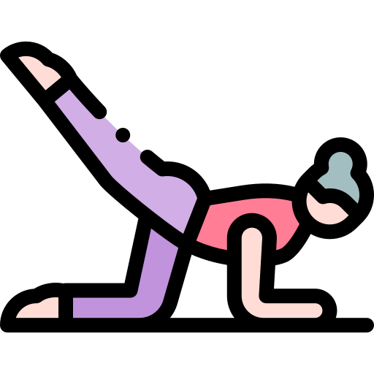
Fun quick game

Slide 16
Your Mind Will Get Fit

Slide 17
Push Ups is a Pilates Exercise

Slide 18
Pilates was Originally Called Contrology

Slide 19
The First Contrology Students Were Men

Slide 20
Sources:
1-https://www.houstonmethodist.org/blog/articles/2022/feb/5-benefits-of-pilates-that-might-convince-you-to-add-it-to-your-workout-regimen/
2-https://health.clevelandclinic.org/everything-you-want-to-know-about-pilates/
3-Practicing Pilates to Improve Mental Health – Mental Health Connecticut (mhconn.org)
4-Pilates - Goals for Beginners | Sheppard Method Pilates (310) 470-2828
5-http://bpilates.ca/2019/10/31/pilates-facts/

Slide 21
https://docs.google.com/forms/d/1l-RRd3wLbr-w_AM2THkkgU3HFUGPOZtjzyJ5krrUCLQ/edit#responses
Here is the link for the Pilates form:

Slide 22
Thank you
*We appreciate all your co-operation in this project

