Slide 1
La reine make-up
Reine Talhami

Slide 2
Business idea
name: La reine make-up
Good or service?: good
This brand would be cruelty free (doesn’t test on animals) and only uses items from nature (vegan)

Slide 3
Our mission & vision
Mission: We are a local company that sells makeup made from nature like fruit peels, leaves, and flowers! We are against hurting animals so everything is cruelty free.
Vision: We hope that our company will expand and we’re seeking to spread our products worldwide starting with the middle east.

Slide 4
The name of our business stands for queen in French and we want women to feel like queens when they use our brand!

Slide 5
Our target market

Slide 6

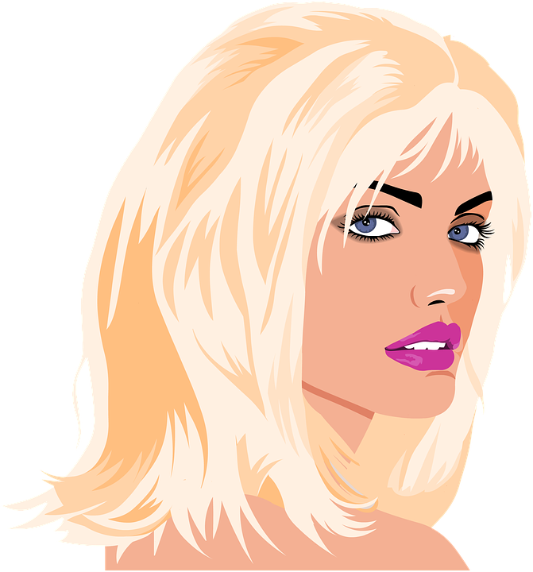

Target market
teenagers
women
Seniors
Our products are suitable for teenagers from ages 13 and up
Teenagers tend to use makeup
We make makeup for women so they can feel really pretty and confident
Make up for seniors is to cover up any wrinkles that they're insecure about

Slide 7
Our competitors
NYX
Maybelline
E.l.f cosmetics
Covergirl
L’oreal Paris

Slide 8
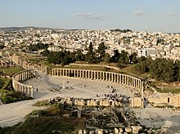
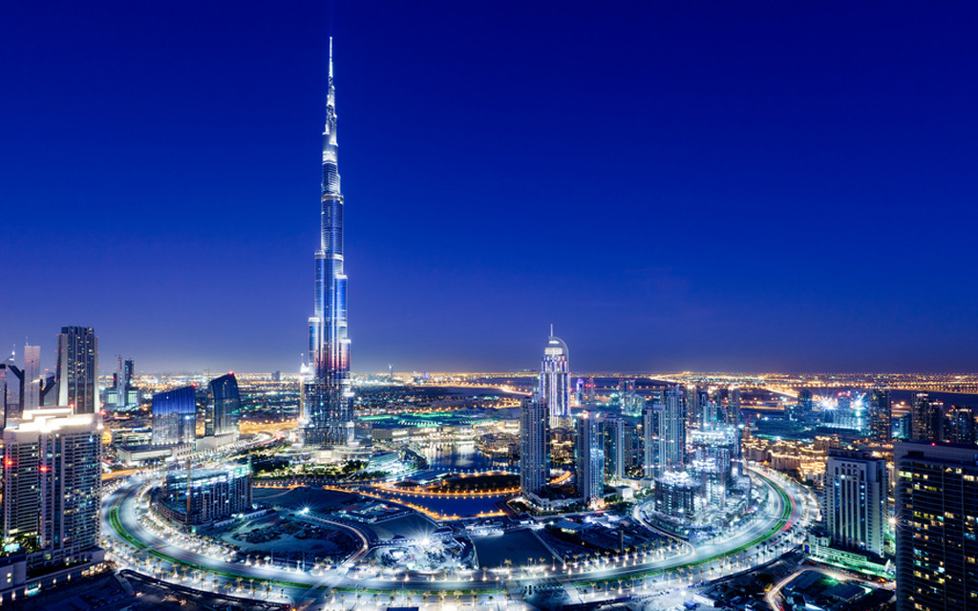
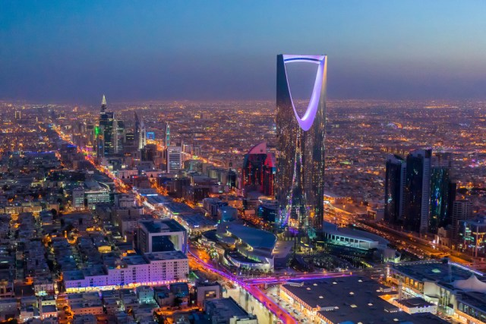
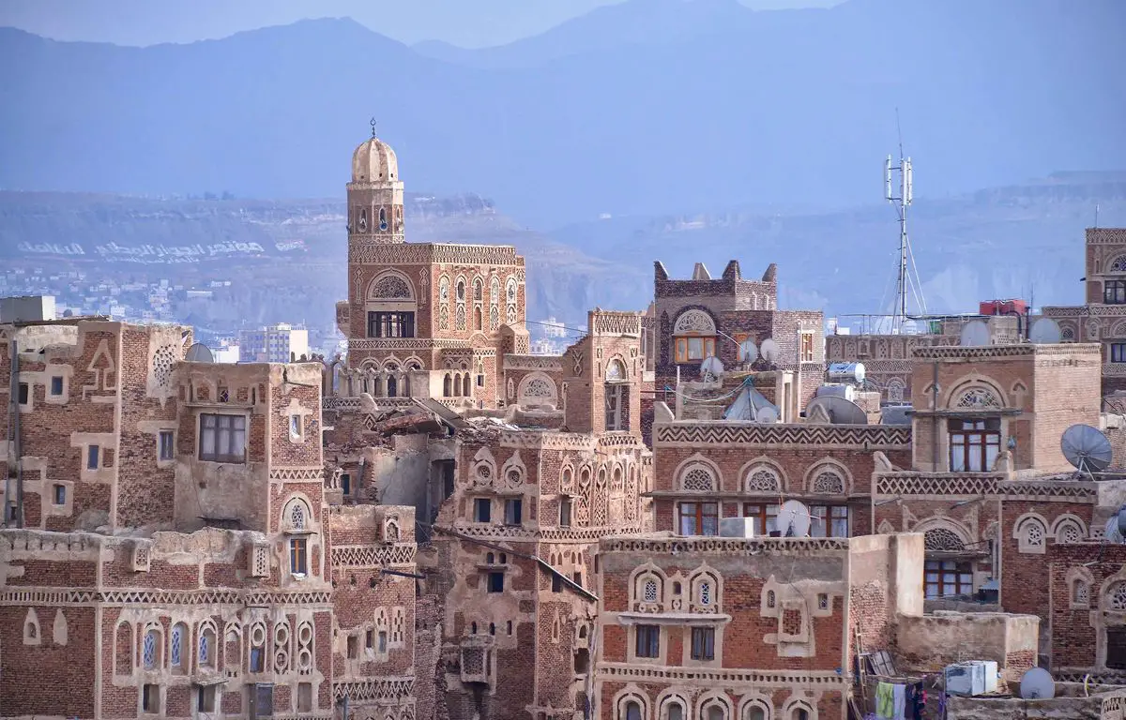
Our locations
Jordan
Dubai
Saudi Arabia
Yemen​

Slide 9
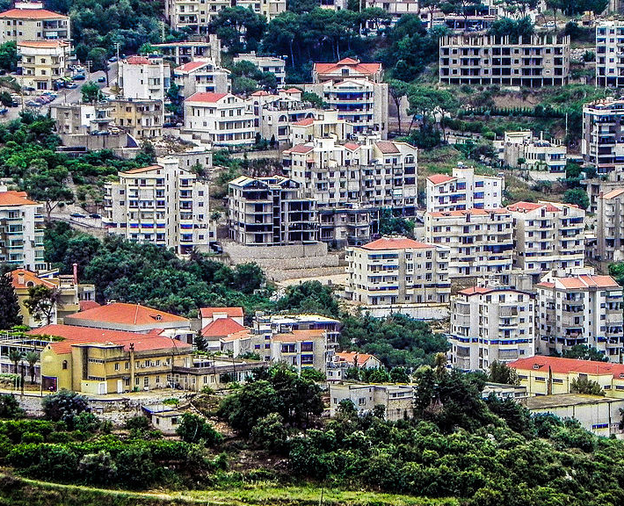
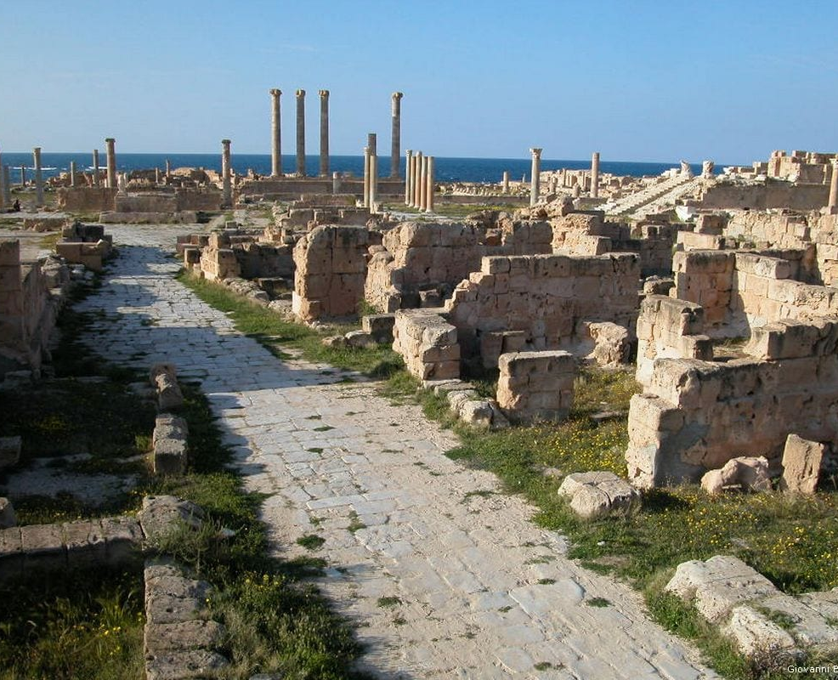
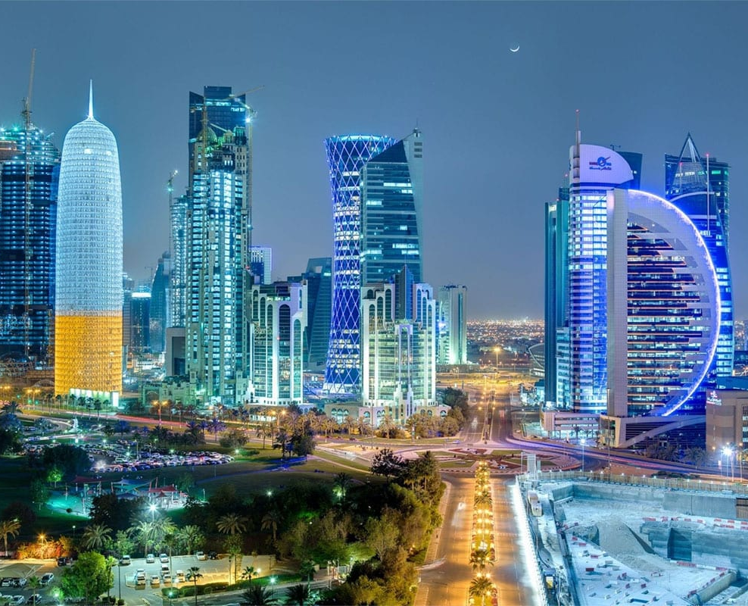
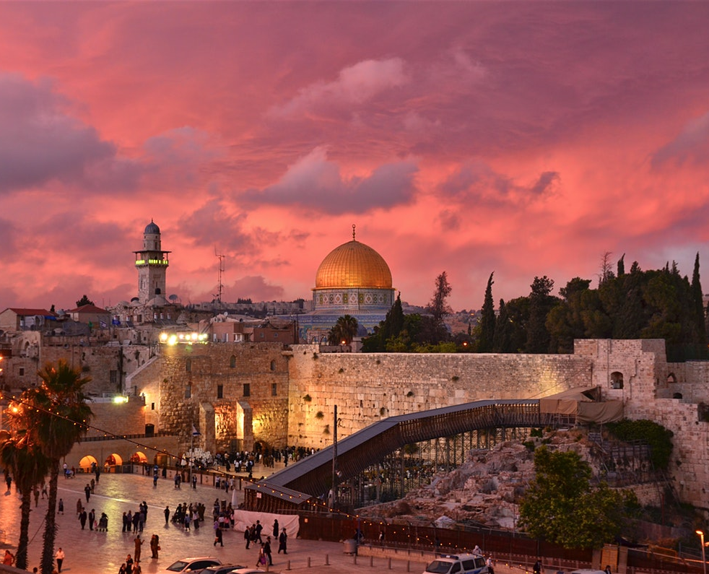
Our extended locations
Jordan
Dubai
Saudi Arabia
Yemen
Lebanon
Libya
Qatar
Palestine

Slide 10
How can you buy our products
Order online
instore
Order online with free delivery!
Come to our store and buy your products!

Slide 11


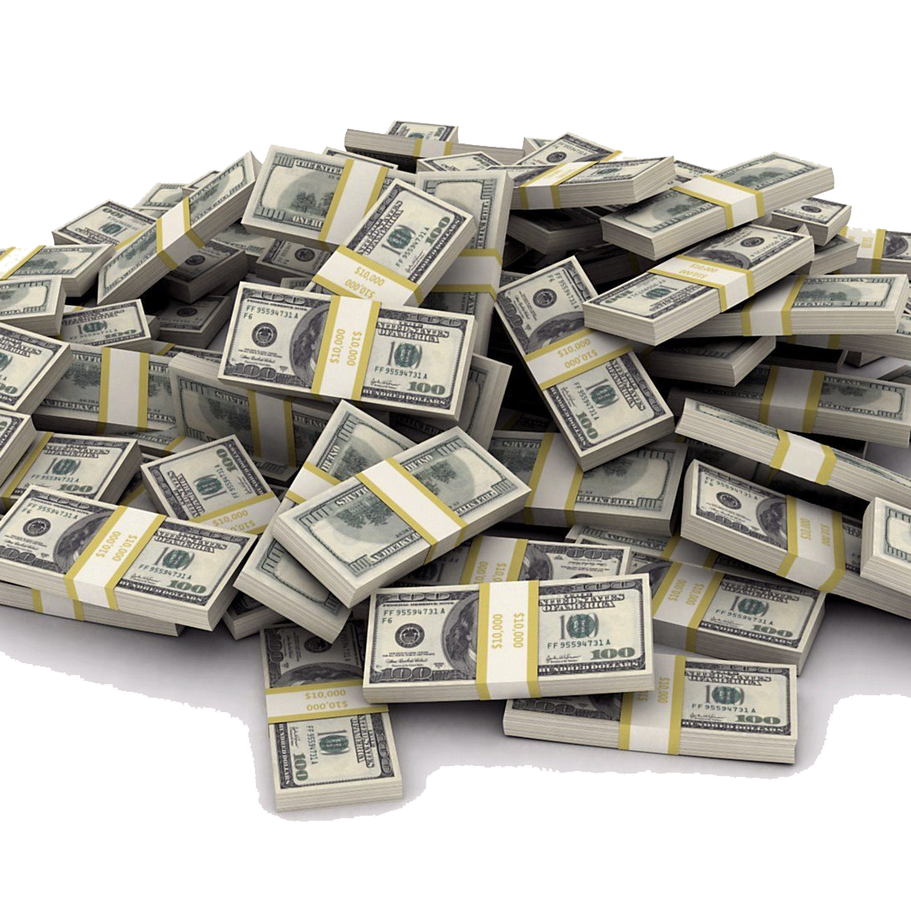
Financial information
capital
How much will we be charging
Predicted profit
Loan from the bank
Selling price would be higher than cost of the product
Selling price-total cost
250,000 jod

Slide 12
THANK YOU
Reine Talhami

