Slide 1
science
By: Sanad amarin

Slide 2
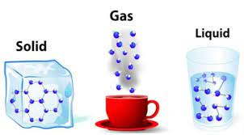
Today we will be talking about
The three states of matter!!!!

Slide 3
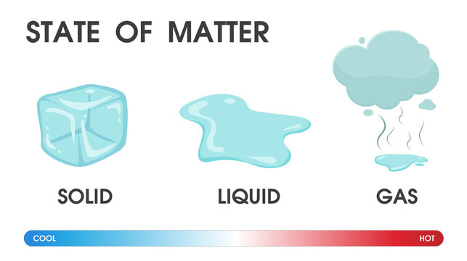
The three states of matter are
Solid
Liquid
gas

Slide 4
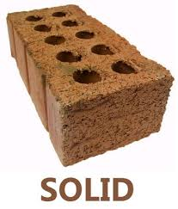
solid
In solid state of matter the particles are closely packed and are being held together by very strong forces. The molecules are not able to move freely however they can vibrate at their fixed positions. so, solids have a stable and definite shape.
https://www.youtube.com/watch?v=QQsybALJoew

Slide 5
liquid
In a liquid state of matter, particles are less tightly packed as compared to solids. Liquids take the shape of the container in which they are kept. Liquids are difficult to compress as particles have less space between them to move.
https://www.youtube.com/watch?v=JQ4WduVp9k4

Slide 6
gas
Gas is the state of matter in which the particles are far apart, fast-moving and not organized in any particular way. Gases are substances that exist in the gaseous state, which is one of the three states of matter.
https://www.youtube.com/watch?v=jmm1J2yI9tk

Slide 7
questions
What are the three states of matter?
In which state of matter are the particles closely packed together
In which state of matter are the particles far apart

