Slide 1
Physical activities in school
Mariana Haddadin and Haya Bataineh 8D

Slide 2
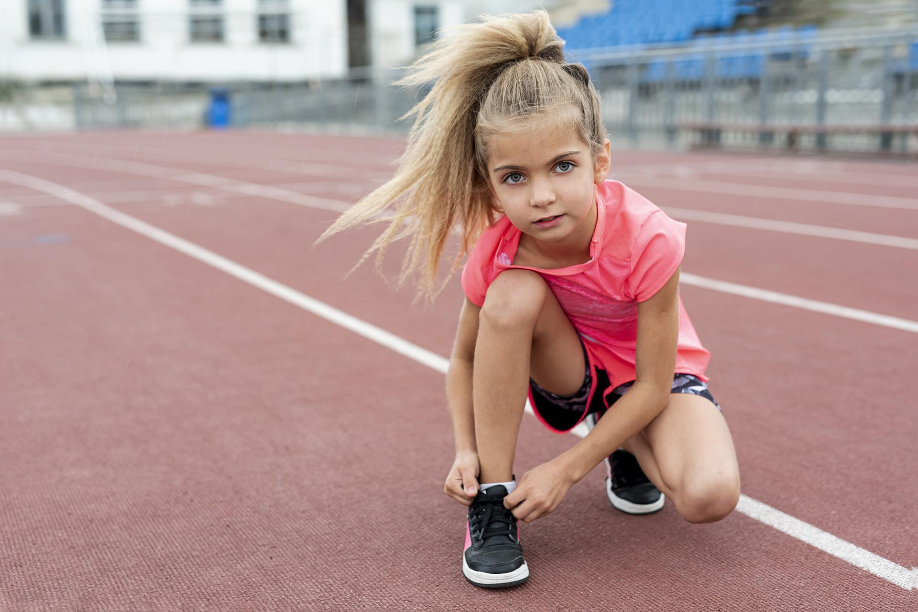
Topic introduction
“Sport is a Preserver of Health”
Hippocrates
Improving sports activities remains an important topic at school under debate. We have interviewed few people to better understand the current activities applied at school and what people think of them, suggestions on how we can further improve these activities, and how these improvement might affect the students overall wellbeing positively or negatively.
The following slides demonstrate actual interviews done at school. In brief, all interviewees agree that there are more advantages than disadvantages when improving sports in school.

Slide 3
What we did
Interviewed
group
We chose to interview 4 people, a physical education teacher, school counselor and two students to represent different opinions.

Slide 4
Conclusion
Our interviews resulted in an agreement of all interviewees on the benefits of adding and improving sports in school with many suggestions including increasing the sports lessons, adding a gym and participating in more tournaments. Encouraging sports at school is vital mainly to enhance the wellbeing of students mentally and physically, and reflect positively on their academic performance and life style as it helps prevent many diseases and most importantly can help us lead a happier and healthier life. Interviewees also thought there might be disadvantages to boosting sports due to some drawbacks they saw such as the possibility of the distraction of some students and drifting away from classes and also some were concerned of the added of extra costs to the school administration.

Slide 5
Interview episodes
01
02
03
Physical education teacher
Student one
School counselor
04
Student two

Slide 6
Physical education teacher
What do you think about physical activities currently applied in the school?
I think it is good and fair but it can definitely be improved
How can we improve it ?
the school still needs some facilities, like an indoor gym for the younger students this gym can also be used to add more space for the equipment.
What are your suggestions on this topic?
To educate students and teachers about the benefits and importance of physical activities to their health, and encourage students to incorporate physical activities in their lifestyle not only in school classes.
we can also try to increase the number of participating of students in physical activity events, adding more physical education classes and make them more fun and have more interactions, not only by plating different sports, but also teach them theory about the topic.
Does Physical Education affect student learning academically?
Yes of course it is, since it increases blood circulation and oxygen supply for the brain which help the students be more focused and more productive.

Slide 7
School counselor
What do you think about physical activities currently applied in the school?
They are good so far but there can be many things that can benefit the students in emotional growth, it is also well known that people who practice sports are healthier and happier.
How can we improve it ?
By focusing on sports during classes that develop strong social bonds and team work.
What are your suggestions on this topic?
To work more on teaching the children to lose, and knowing that if they lose it isn’t the end of their world and be a good sport, the teachers should focus on the strength of the sport of each student, making sure they participate in sport they are good at, to improve their self-esteem
Does Physical Education affect student learning academically?
Of course it does, because if the students are mentally stable and happy they will preform better in all subjects and overall. However some students might skip or be late to some classes due to being in the gym so there are some drawbacks too.

Slide 8
Student one
What do you think about physical activities currently applied in the school?
I think there are multiple sports that are offered in school, and that there is a wide variety of the sports we can play
How can we improve it ?
There should be specific classes for improving skills, and for sport teachers to take physical education more seriously,
Adding a physical education lesson to the week can also help, one of them having to do physical sports and the other is theory lessons helping students understand sports more.
What are your suggestions on this topic?
There should be more classes as physical education doesn't only affect the physical body, but also the mental state of the student, which will be helpful for them during school hours and helps them give better performance.
Does Physical Education affect student learning academically?
Yes definitely because students can get a lot of stress from classes, and physical education relieves that stress especially in exam periods.

Slide 9
Student two
What do you think about physical activities currently applied in the school?
Very good, because they let us have more activities and improve muscles, which is fun and healthy instead of sitting down all day.
How can we improve it ?
Add more physical education lessons and upgrade the stadium to include more sport types, like yoga classes.
What are your suggestions on this topic?
Adding more sport classes can help students in their mental and physical health, giving them a skill, and improves their exercise.
If we can add a underground gym it will be really nice, although there may be a need for extra costs for the maintenance and workers to run the gym.
Does Physical Education affect student learning academically?
Yes because students will learn to have sport spirit and teamwork. Sports also relief stress and minimizes unnecessary leaving of classes or the need to walk around because they already vented their stress away in sports.
Extra sports can also help physical wellbeing especially for overweight students.

Slide 10
Causes
Students are stressed due to exams and homework overload and need interesting activities to relief their stress
Inability of some students to be involved in group sports and inability of some to develop social bonds with their classmates.
Some students are overweight with sedentary life style and need to play more sports for their wellbeing.

Slide 11
Consequences
Advantages
Disadvantages
Regular physical activity can help children improve fitness, reduce and relief symptoms of anxiety, depression, and stress especially during classes and exams, it also reduces the risk of developing health conditions and reduces the risk of being overweight, since it increases blood circulation and oxygen supply for the brain which help the students be more focused.
If a gym is built, students might skip or be late to some classes due to being in the gym, there are also a need for extra costs for the maintenance and workers to run the gym, and for the materials of any other activity, like tele matches, and tournaments.

Slide 12
Finance and costs
The gym equipment costs is about 30 thousand JODs to get all of the treadmills, cross machines, weights, and all the other gym equipment needed.
Suggested school activities wont have extra costs as it will be part of PE classes.
External tournaments’ participation cost will be covered directly by the students who choose to participate.
To secure all the money needed for the gym the school will organize a garage sale, where all student have the option to bring items they don’t use, which can be sold to other students.
The garage sale can take place twice a semester to secure part of the cost, and the rest can be covered by the orthodox educational society.

Slide 13
Thank You!

