Slide 1
Learn Substitution into Expressions and Formulae
⋆｡°✩
⋆｡°✩
⋆｡°✩
By Tia Beiruty and Jana Momani

Slide 2
Note ➡ Each one of you will receive a number. When you hear your number being called, please stand up!

Slide 3
Table of contents
01
02
03
04
Short video
What is substitution?
Quick Game
Check your understanding

Slide 4
01
Short Video

Slide 5

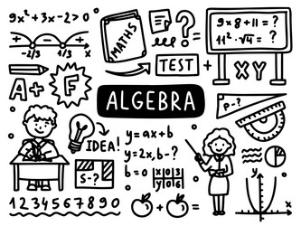
Short Video
https://www.youtube.com/watch?v=7Qxyf-VvnPs

Slide 6
02
Definition of Substitution

Slide 7
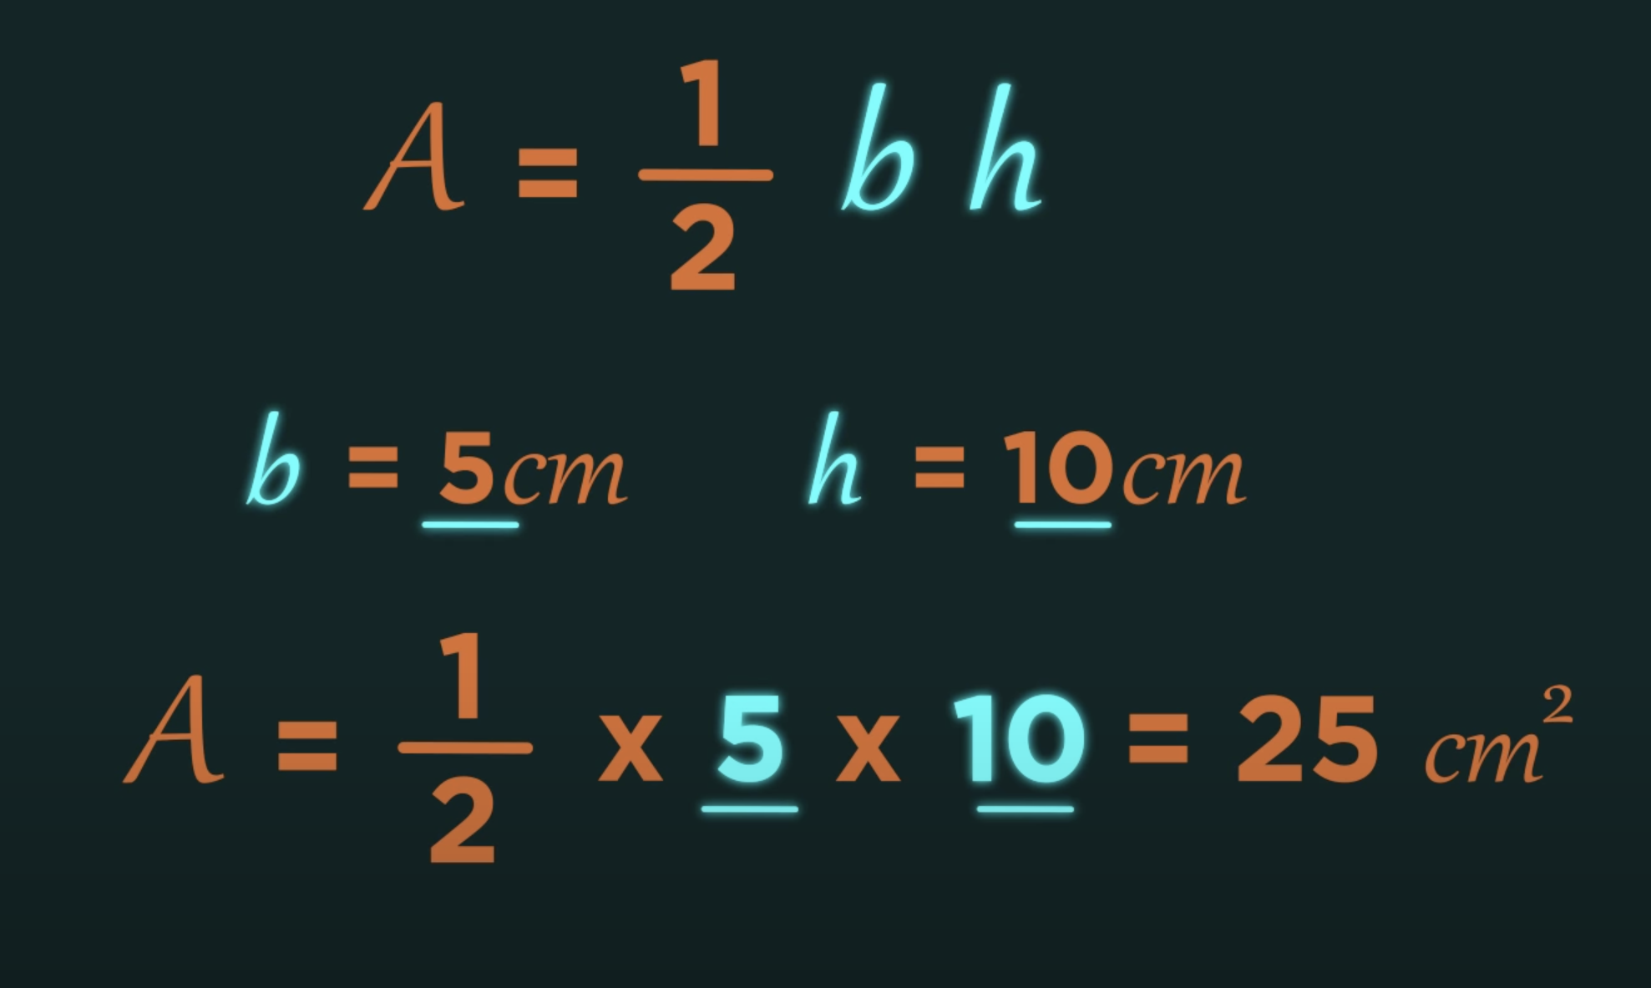
What is Substitution?
The technique of changing an algebraic letter for its value is known as substitution.

Slide 8
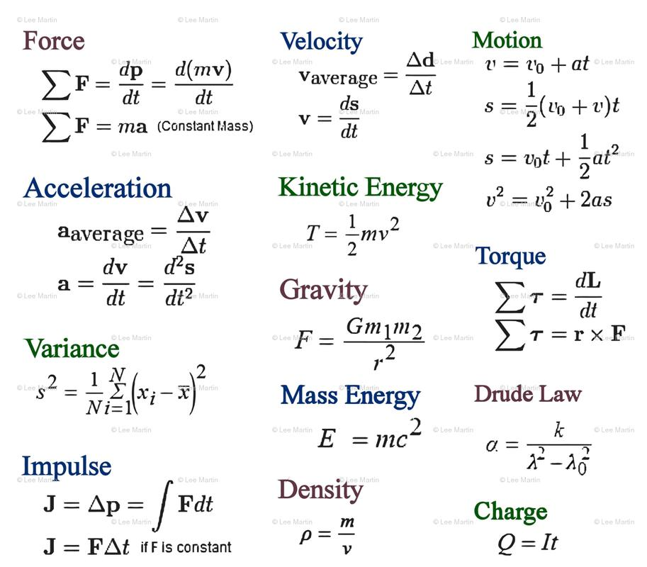
Why do we need substitution?
We use substitution mostly in physics equations ,but it can be used in your daily life for example to calculate your BMI!

Slide 9
03
Quick Game

Slide 10
Let’s start solving questions using a fun and interactive game!
https://www.transum.org/software/SW/Starter_of_the_day/Students/Substitution.asp

Slide 11
04
Check Your Understanding

Slide 12
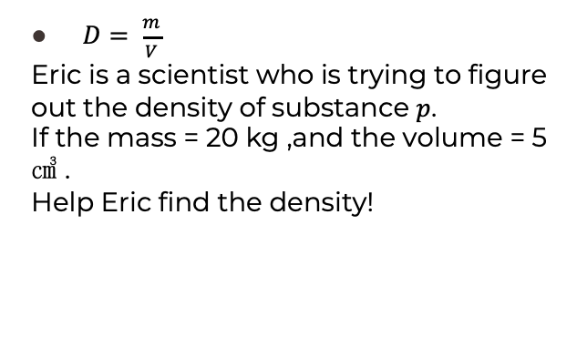
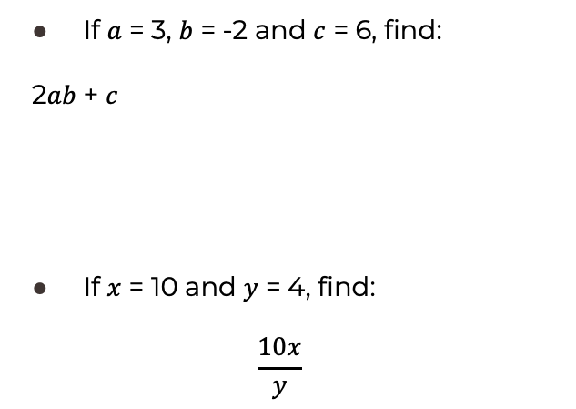
If $a$ = 3, $b$ = -2 and $c$ = 6, find:
2$ab$ + $c$
If $x$ = 10 and $y$ = 4, find:
$$\frac{10x}{y}$$
$D= \frac{m}{V}$
Eric is a scientist who is trying to figure out the density of substance $p$.
If the mass = 20 kg ,and the volume = 5 ㎤ .
Help Eric find the density!

Slide 13
Thanks
Do you have any questions?
tia.albairooti@nos.edu.jo
jana.momani@nos.edu.jo

