Slide 1
Indoor pool
By: Ghassan barghouth and Jad halaseh

Slide 2
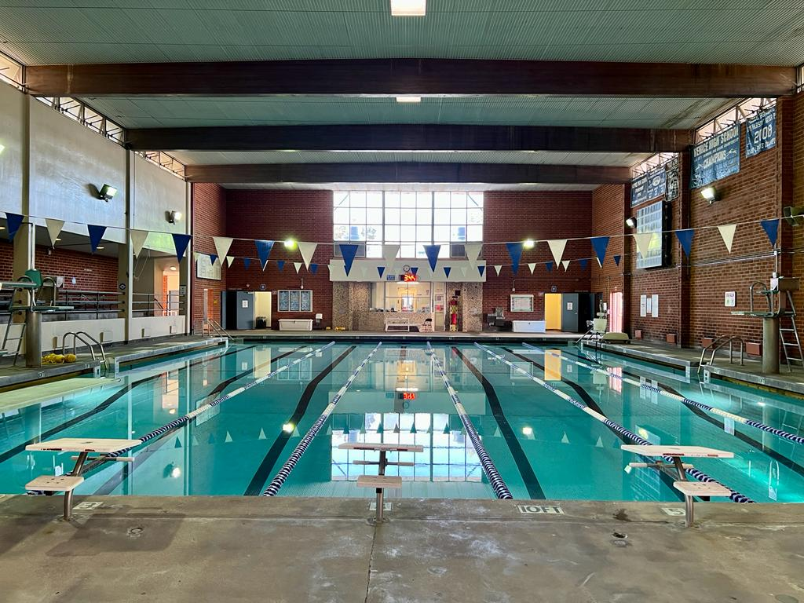
Hello, We decided to make this project to increase activities in school, add new sport opportunities, let students have fun with their friends and reduce obesity
Cool, calm, and quick in the water.

Slide 3
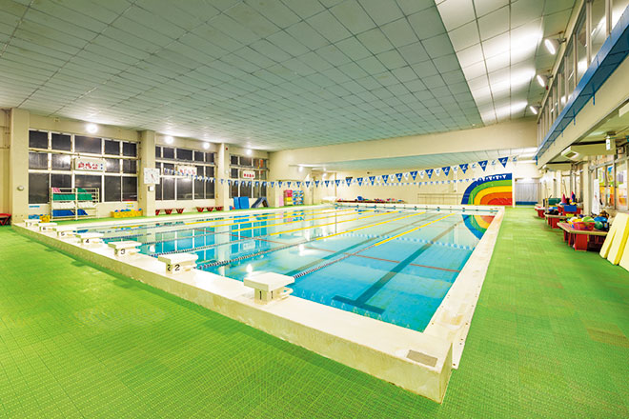
The first swimming goggles were made from tortoise shells. Swimming was first introduced at the Olympics in 1896. The first known record of people swimming dates back to Egyptian drawings from 2500 BC, with stone age paintings in the Cave of Swimmers dating back even further. Benjamin Franklin invented swim fins to help move through the water more efficiently. The oldest known concrete swimming pool was built in Texas in 1915.
Fun Facts

Slide 4
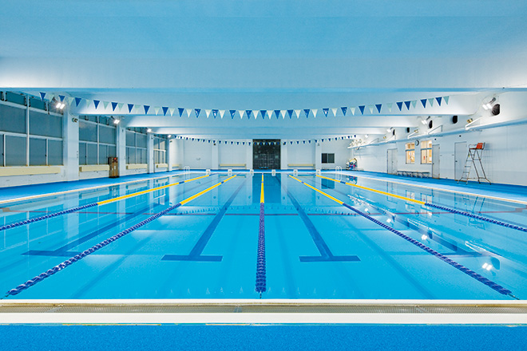
causes
help students be fit.
would both allow exercising and training during winter. gain muscles.
it will be an unusual experience for such a sport to be at school for students to learn.
Students will enjoy p.e classes more
it will give new sports opportunities.

Slide 5
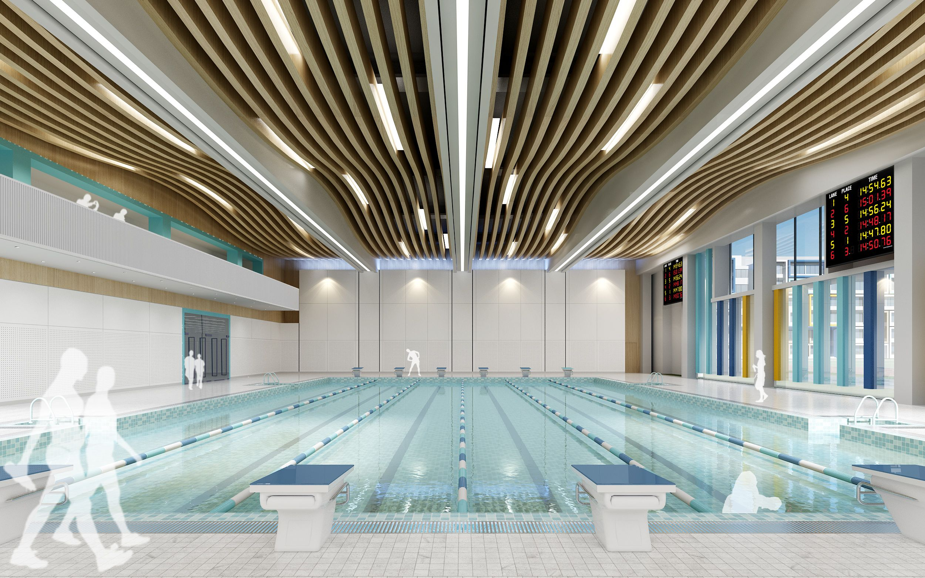
REDUCE ANXIETY HELPS YOU FOCUS IMPROVE MOOD GAIN MUSCLES REDUCE FAT INCREASE FLEXIBILITY WIDENS SHOULDERS IF STUDENTS GET HURT THE SCHOOL WILL BE LIABLE
Consequences

Slide 6
finance
After school paid activities
Events that are paid
Use school funds
You can pay after each session a certain amount of money

Slide 7
replace it with unusable storages in the arena. The school could hire a life guard, Have rescue equipment and a first aid kit nearby. Use artificial grass to prevent slipping.
Location and safety

Slide 8
https://docs.google.com/forms/d/e/1FAIpQLSfOOCuxGIU3a2K73sJr9vNey3DpC3BvjMNllQYRuRMHqm2LHQ/viewform?usp=pp_url
survey

