Slide 1
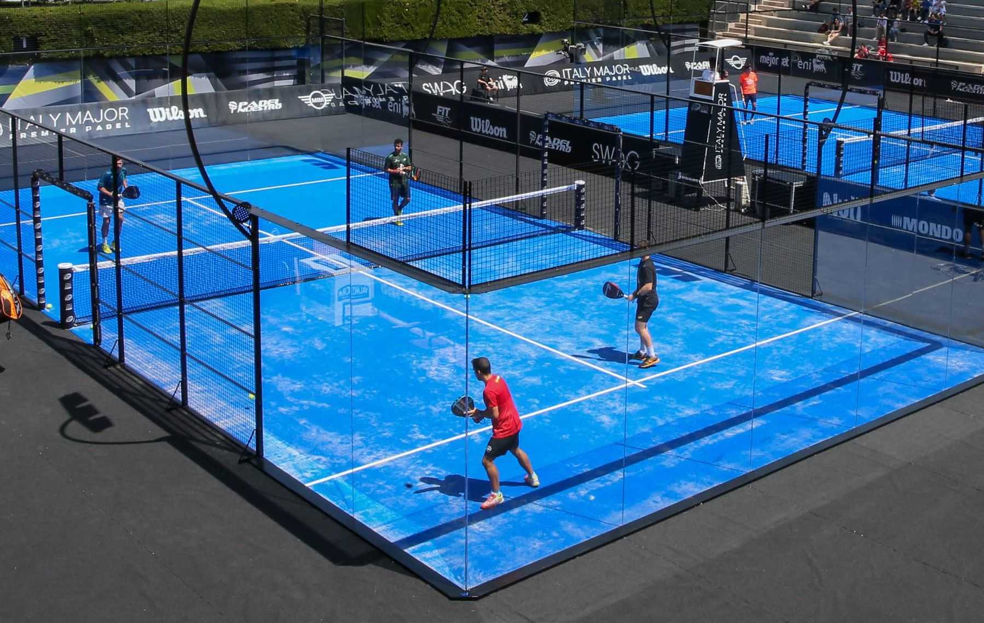
Padel
By: Jordan and Abdallah

Slide 2
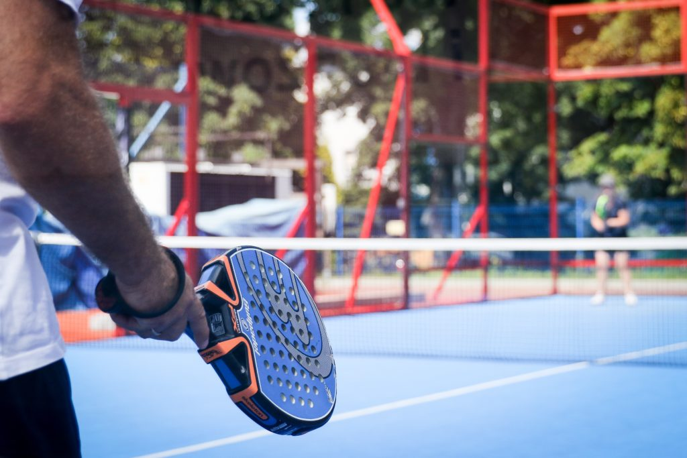
Padel
Padel is a sport that combines action with fun and social interaction. It’s a great sport for players of all ages and skills, as it is both quick and easy to pick up.

Slide 3
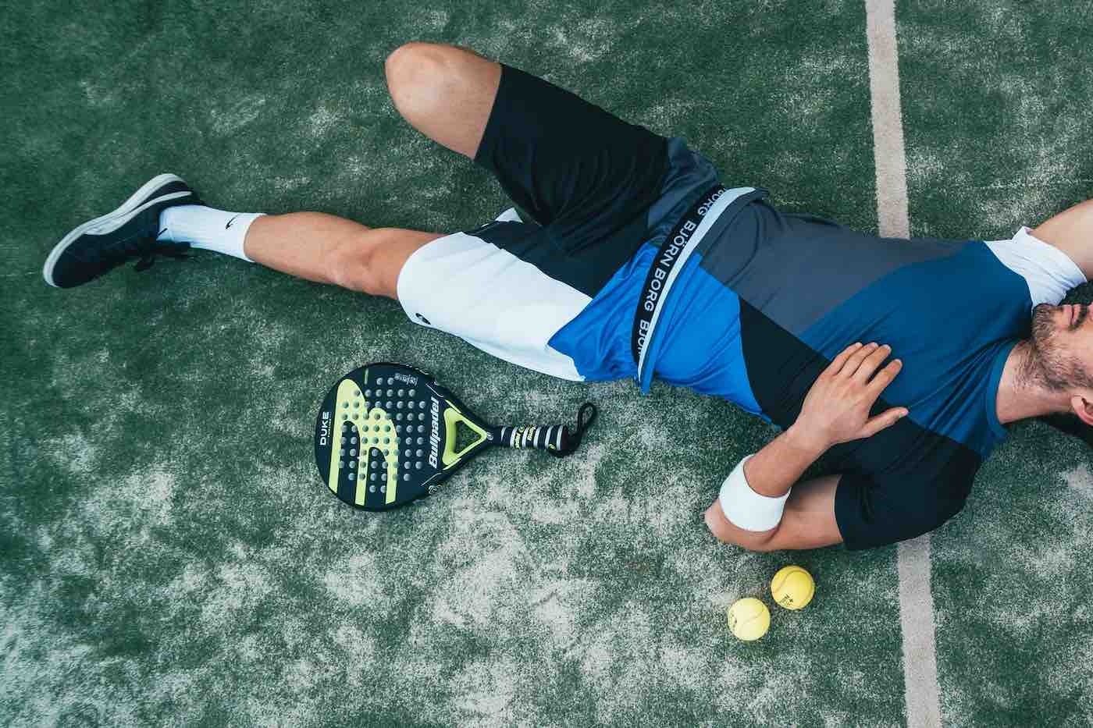
What causes can you get from padel?
Ankle Injuries
Shoulder Injuries
Knee Injuries
Lower Back Sprain
Calf Sprain
Runner's Toe

Slide 4
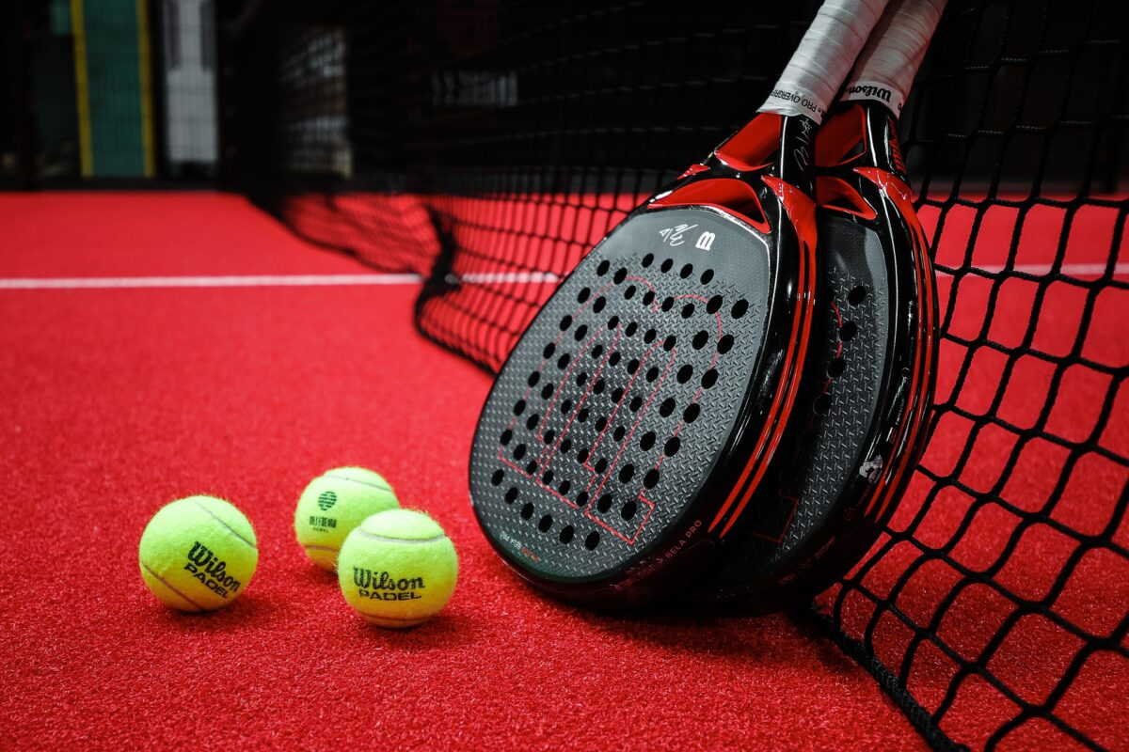
What are the consequences of padel?
This sport can help reduce stress, improve your mood, and boost your energy levels.
Padel is a great workout
Build muscle

Slide 5
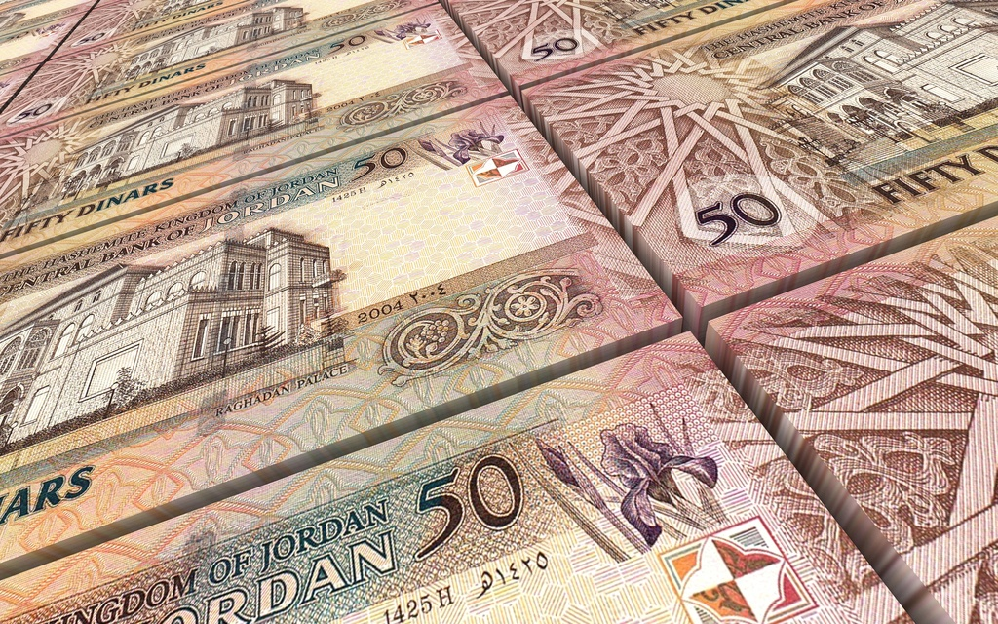
Finance
Depending on the construction team, an indoor padel court building price without groundwork costs between 15,000 and 25,000 euros, 18,885 Jordanian Dinar

Slide 6
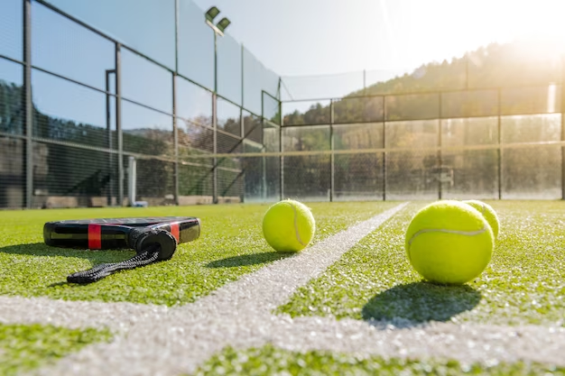
Location of the padel court
Outdoor padel courts are not covered by a roof, hence exposing the court to external factors. This, however, is a minor setback, nothing that would stop you from swinging a padel racket outdoors.

Slide 7
In which country is padel popular?
Padel, a cross between squash and tennis is one of the fastest-growing sports globally and is most popular in Spain.

Slide 8
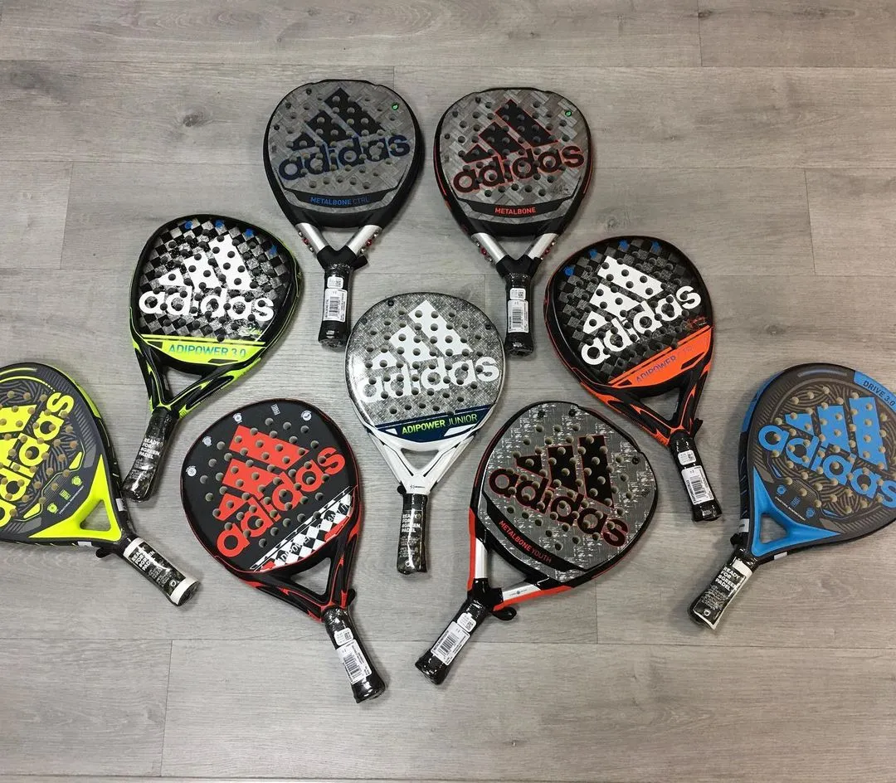
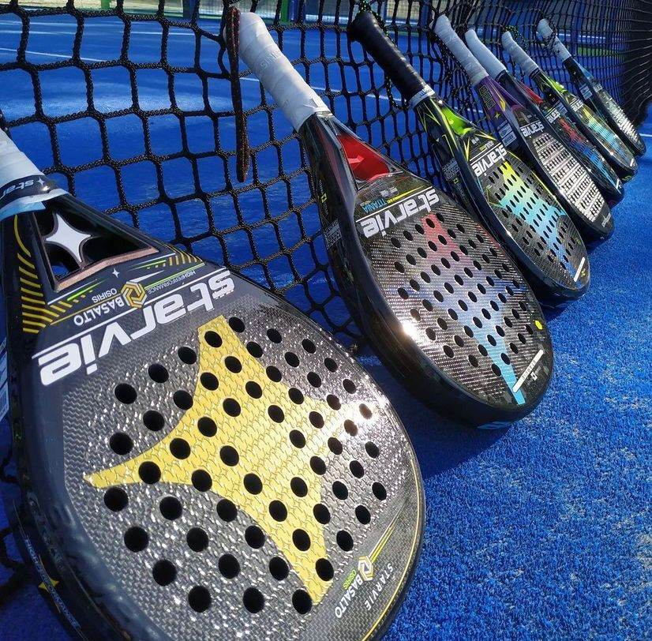
Padel rackets
The fun part about the rackets is that you can customize or buy any racket that you desire.

Slide 9
https://www.head.com/en/sports/padel/about#:~:text=Padel%20is%20a%20mix%20between,turf%20once%20before%20being%20returned.
https://www.stigasports.com/en/explore-stiga-sports/what-is-padel
https://www.thelocal.es/20230119/padel-why-exporting-this-spanish-sport-could-make-you-rich/
https://www.redlinepadel.com/the-many-benefits-of-playing-padel-why-this-sport-is-gaining-popularity/#:~:text=In%20addition%20to%20being%20a,help%20improve%20your%20cognitive%20skills.
https://padelpark-dubai.com/blog/differences-between-indoor-and-outdoor-padel/#:~:text=Padel%20is%20a%20sport%20that%20can%20be%20played%20both%20indoors%20and%20outdoors.

Slide 10
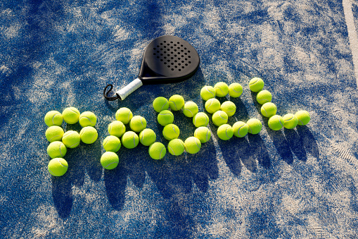
Thank you

