Slide 1
Swimming For All
Hind Habash, Talin Habash and hamzeh nihad

Slide 2
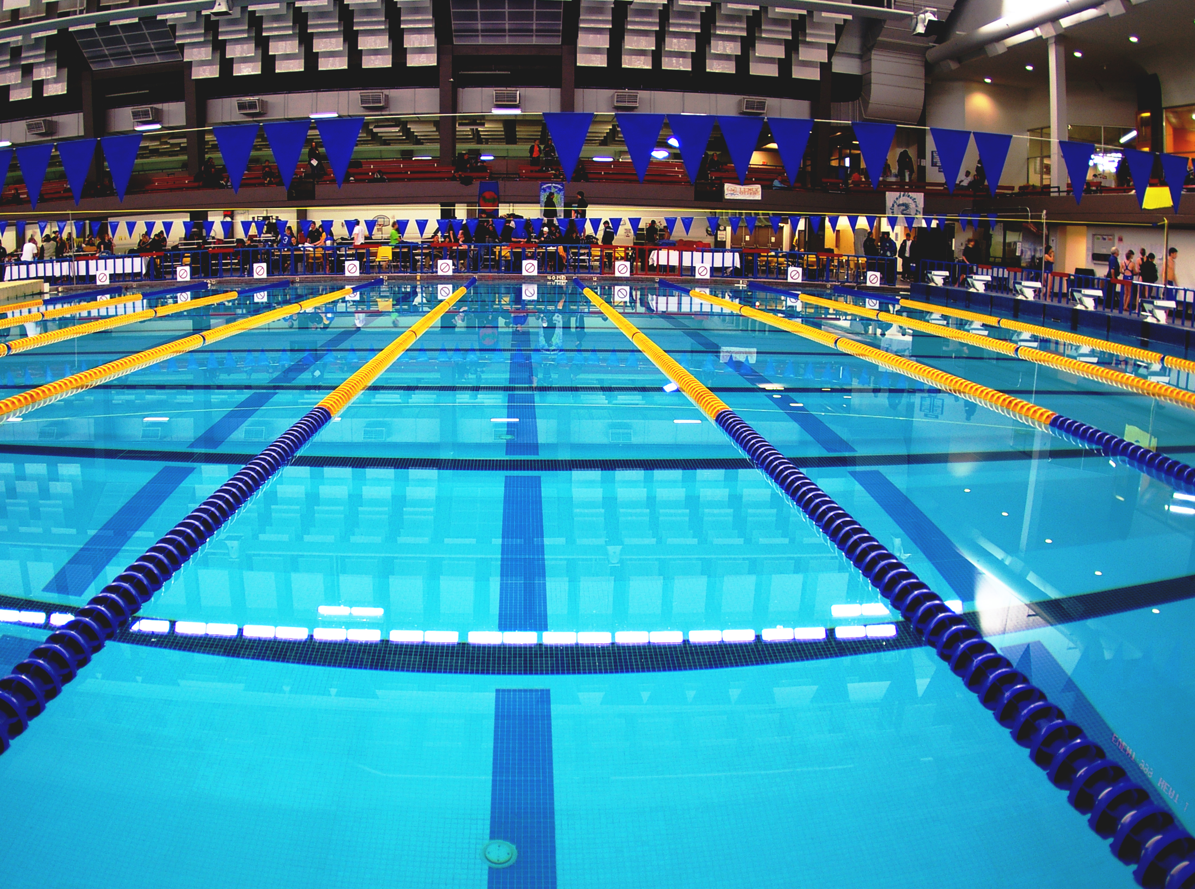
INTRODUCTION
As a group, we have gathered opinions and information on the possibilities, advantages and disadvantages of building a pool in our school. We have worked to change the disadvantages into better ideas which will secure the students safety, education and skill improvement. We hope to make this a project which will be ongoing for future generations.

Slide 3
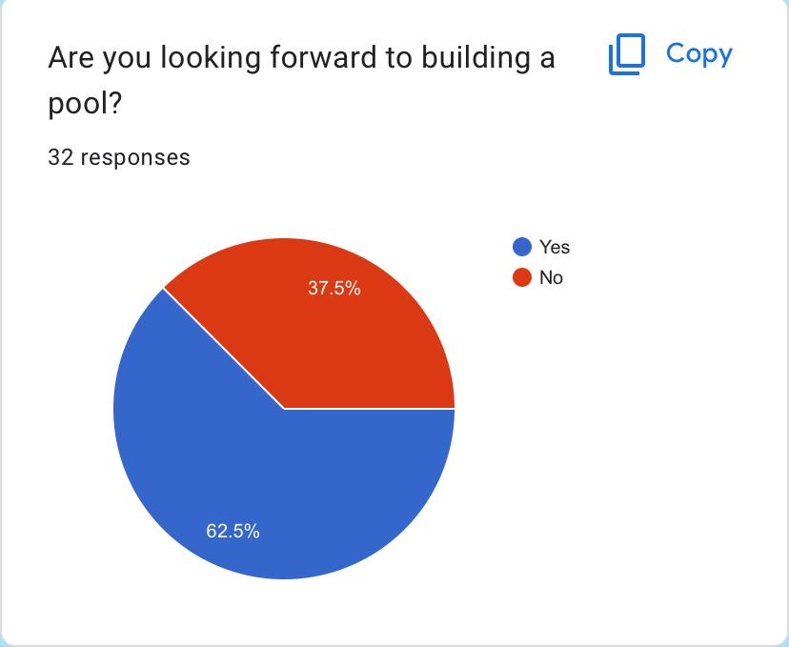
We have made a survey which gave us enough information to know what the students in our school need and want. We have concluded that the majority (over 60%) are willing to attend, support and looking forward to building a pool.

Slide 4
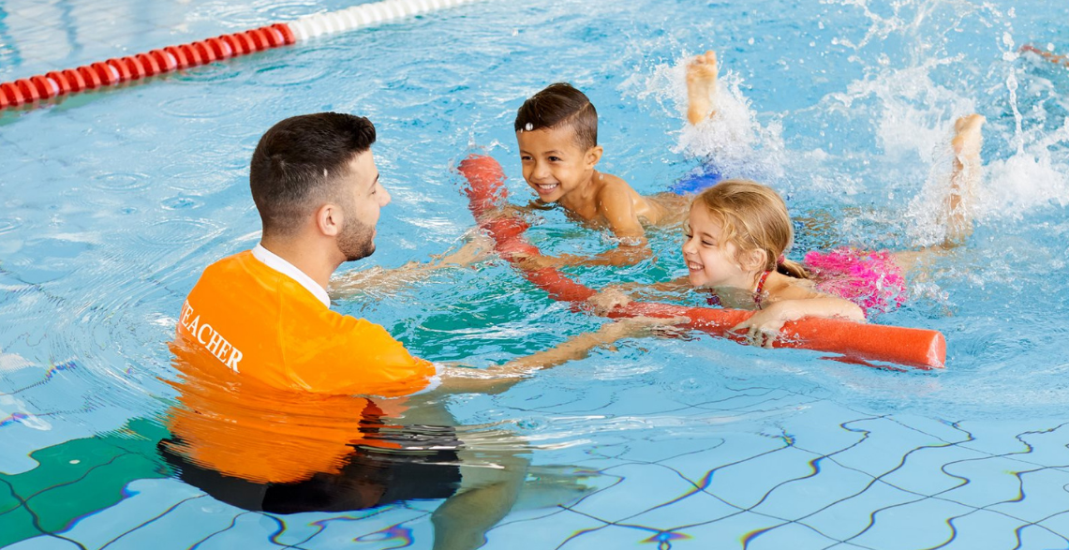
CAUSES
What was the reason for our idea? WE have thought about all of the benefits that students will gain if we made this project true and the effect in the long run.
And the benefits are:
It will help teach kids at a young age how to swim. (avoiding the dangers of drowning in their daily life).
Students will have a larger variety of activities that will boost their health and education.
Building a pool attracts new characters, develops skills, and fulfils needs.

Slide 5
CONSEQUENCES
Swimming will strengthen muscles, which activates muscular imbalances and ultimately helps protect the students from any injuries.
Moreover, swimming will reduce blood pressure, increase muscle mass, improves oxygen and blood to move to the brain, and increases cardiovascular health.
Swimming is crucial for education too. If you stop swimming, you may feel more sluggish or less focused than usual which will lower your attention span during classes.
How will swimming benefit in the long run?

Slide 6
How can we increase pool security?
#1
#2
#3
We can hire security and physical education teachers to watch and help student during the swimming hours.
With good fencing and code gates
Equipment needed for safety is very important. We will add non-slippery surfaces, a good amount of life jackets, ladders and buoys.
There will be STRICT rules and regulations. If not followed, the student will be resulted with a warning. Any student who gets 3 warnings will be banned from pool premises.

Slide 7
LOCATION
In our survey we collected multiple locations where we could build our pool like:
Free space inside the school
Beside the cultural center
In the sports building
Underground gymnasium
After clear thought, we have figured it out!
There is a big, open hall, next to the religion and chess room, which would be perfect for an underground pool. Not only can students swim in the winter but it is perfectly safe for people to enter and exit.

Slide 8
FINANCE
The size, features, and materials utilized in the construction of a new in ground pool can have a significant impact on the cost. A typical pool costs roughly 20,000-25,000 jds on average.
Due to the requirement for durability and safety features, swimming pools for schools would probably lie on the upper end of this pricing range.
The budget must to include for continuing maintenance expenditures like chemicals, filtration, and metry repairs & replacements in addition to the upfront building costs.
The school will be collecting money for this project by:
Donations
Sponsors
Fees (each students will pay a sum of money at the beginning of the school year for monthly swimming)
Summer teaching lessons and summer schools

Slide 9
This project will definitely be a costly project, yet it would be totally worth executing. The school provides 30,000 jds for sports (support), thus with constant support and work, the school will be able to buy and build a pool for future generations in 6 years.
OUR AIM

Slide 10
RESOURCES:-
https://docs.google.com/forms/d/e/1FAIpQLSdbqK2JrvJg1aSop2rWdIUMxlU_SumU3hqpUOzjcCu86Jxdqw/viewform?usp=sf_link
https://www.betterhealth.vic.gov.au/health/healthyliving/swimming-health-benefits
https://www.be-safe.org/10-ways-to-improve-your-swimming-pool-safety/
https://www.quora.com/What-is-the-budget-to-make-a-swimming-pool-for-school

Slide 11
THANK YOU

