Slide 1

Indoor football pitch
By:Eliana Barghouth, Yasmeen Al Salman, Maya Atawi

Slide 2
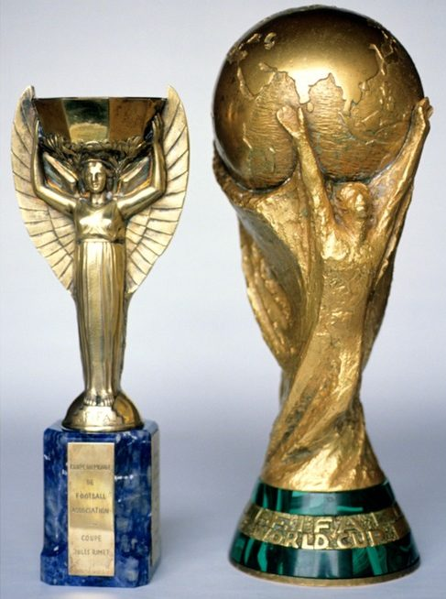
Fun facts about football
World cup started on 1930. 13 countries played. And Uruguay won over Argentina by 4:2.
Hector Castro was the star player of the tournament in 1930.
In 2022 Argentina won France in the world cup by 4-2.
Lional Messi won the golden ball and was the star player of the tournament 2022.
Kylian Mbappe won the golden shoes in 2022.
Brazil got the most wins in the world cups.
Pele was the best player of all time, He took the 1958 FIFA
World Cup by storm aged 17, Pele won three World Cups and
scored 1,281 goals in 1,363 games.
Unfortunately Pele died in 29 of December 2022.

Slide 3
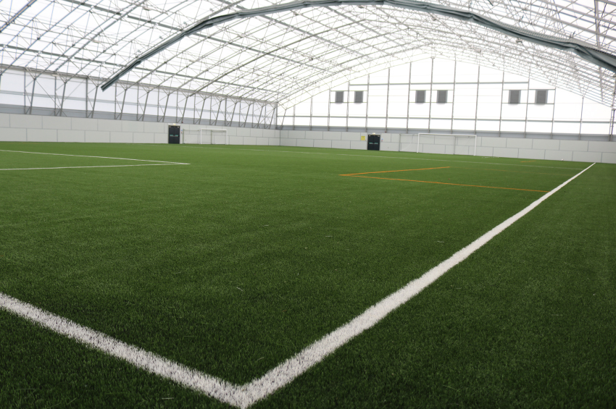
"Today I will do what others won't, so tomorrow I can accomplish what others cant!"
The reason why we want to build an indoor football court is because it helps students preform and enhance their hobbies at any time without worrying about weather conditions. There's a wide variety of advantages that come with building this indoor football court and one of them is, you get to replenish and revive the school reputation by having a better sports team. It also might be the solution to a problem that many students have which is missing a PE lesson due to again weather problems.

Slide 4
Location and safety
We are going to be building a second floor in the indoor basketball court. It will be the same width and almost same length.
Less injuries by using soft grass and to protect the light from getting hit and broken from the ball, so we are going to be using a very thick net, we are going to put it on top of the court. Also we are going to hire a security guard for the safety and to make sure the court doesn’t get damaged when people rent it.

Slide 5
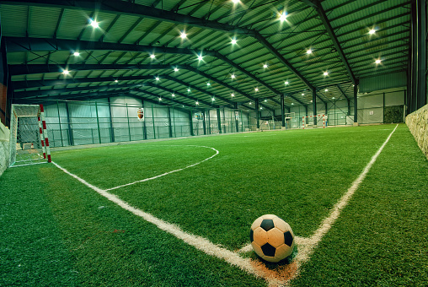
Reasons for choosing this project
Weather problems; the ability to train when there are storms or any type of weather problems that could interrupt training.
Better school teams; it helps improve the reputation of the school.
Less fights between classes, it helps people share the pitch instead of fighting for it
Better time management, it helps teachers combine classes together.

Slide 6
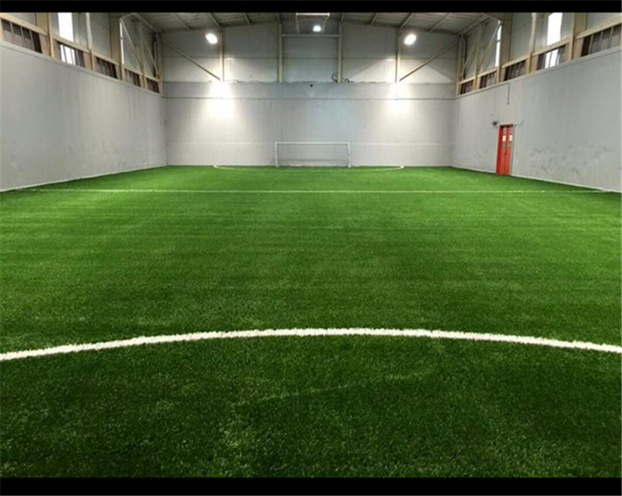
The consequence of having an indoor pitch
More space for playing football.
Less fights will happen.
Great way to improve technical ability in areas such as close control and decision making.
More play time for students.
If it rains we will have a pitch to be able to play on and have fun without worrying.

Slide 7
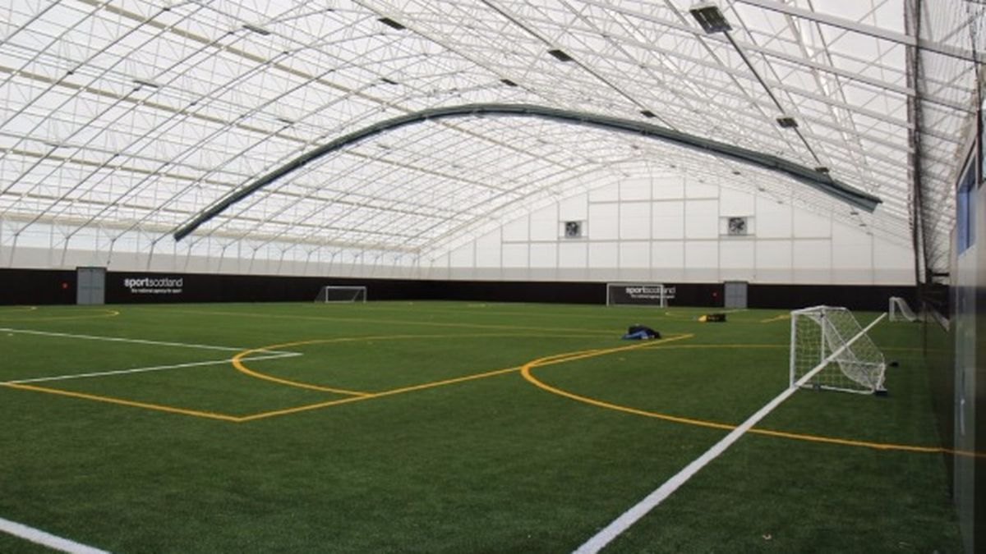
Ways we are using to raise money for the indoor football pitch
Collaborate with other schools : we can arrange matches in this pitch and well have each school pay a fee for playing in this field with an agreement to do so before collaboration.
after school clubs: we can have our school clubs rent the pitch after hours at any given time to discuss any further plans for their clubs etc. (there will be rules and boundaries their not aloud to cross and night guards in case of emergency).
allow people from outside and inside the school play in the field with exception that people outside the school are to pay a fee before entering.
let school students rent the court for sports reasons.
use the court for birthday celebrations with a payment fee for the material used and for the services in relation to the party.

Slide 8
Survey
https://docs.google.com/forms/d/e/1FAIpQLSeWlbCJuSu6UEL_xNGvsNuOpU5mIFUr8CzBWsjYHl-_7qlt3w/viewform?usp=sf_link

