Slide 1
Proposal for a Gym in NOS
By :Rajai El Ghoury and Sanad Al Halasa

Slide 2
introduction
“If when you look in the mirror you don’t see the perfect version of yourself, you better see the hardest working version of yourself” – Chris Bumstead
We wanted to add a gym in the National Orthodox School because we want the whole school to improve physically and socialize more. We made an interview with 1 P.E teacher and 4 students form grade 8.They all liked the idea which encouraged us more to propose for the school to add a gym .They had efficient ideas and helped us decide how and where we will build the gym.

Slide 3
What are the causes of having a gym?
Students and teachers that:
Want to become in good health
Want to become stronger
Want to improve themselves
Want to enjoy their time
Want to socialize more

Slide 4
What are the consequences of having a gym?
Students and teachers can:
Get in a good physical health
Prevents obesity
Get stronger
Spend more time improving themselves
Socialize more
Their energy and discipline can increase

Slide 5
Who is allowed to use the gym?
Grades 4-12, teachers ,staff and outsiders that are respectful and polite.

Slide 6
WHEN CAN STUDENTS OR TEACHERS USE THE GYM?
Students can use the gym in P.E classes, breaks or after school.
Teachers can use the gym when they don’t have a class to teach or after school.
And staff can use the gym when they don’t have work to do or also after school.

Slide 7
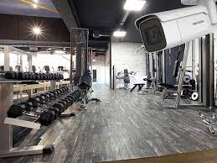
How will the gym be monitored or organized?
The school can hire people / trainers to help students, teachers and outsiders use the gym in the right way, and the gym can be monitored by cameras placed around it.

Slide 8
How can the school get money to build the gym?
The school can raise an athlete contests that you have to pay to enter or any general activities which you have to pay to access or interact. Moreover, if students are desperate to get the gym sooner, they can give the school some money to help build the gym sooner.

Slide 9
How can the school profit from the gym?
Students and outsiders need to pay to access the gym.
Teachers and staff will have free access because they work for the school.
-------------------------- | Outsiders | Students
1 Month | 30JD | 15JD
3 Months | 75JD | 36JD
1 Year | 200JD | 132JD

Slide 10
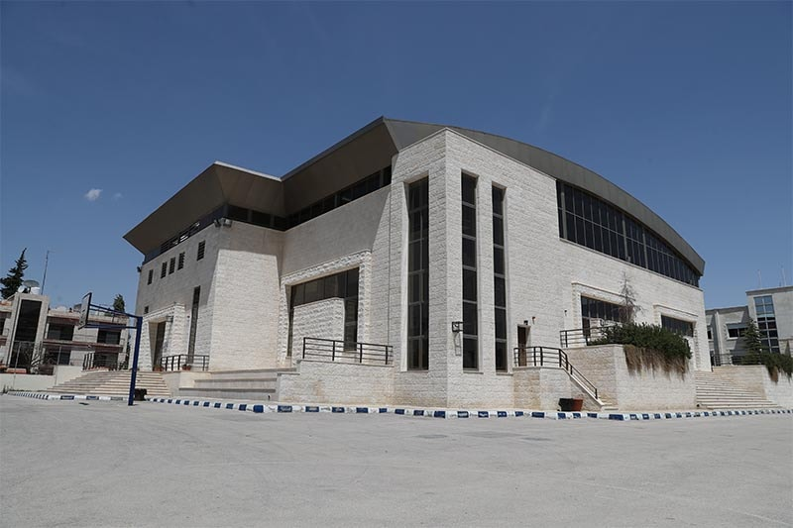
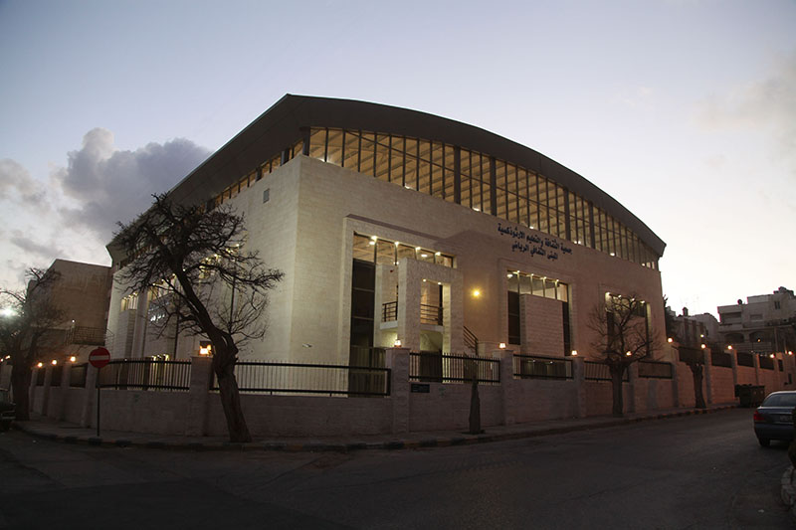
Where we plan to build the gym?
Second floor arena or under the arena.

