Slide 1
FILL FALAFEL
Done by; Nizar billeh

Slide 2
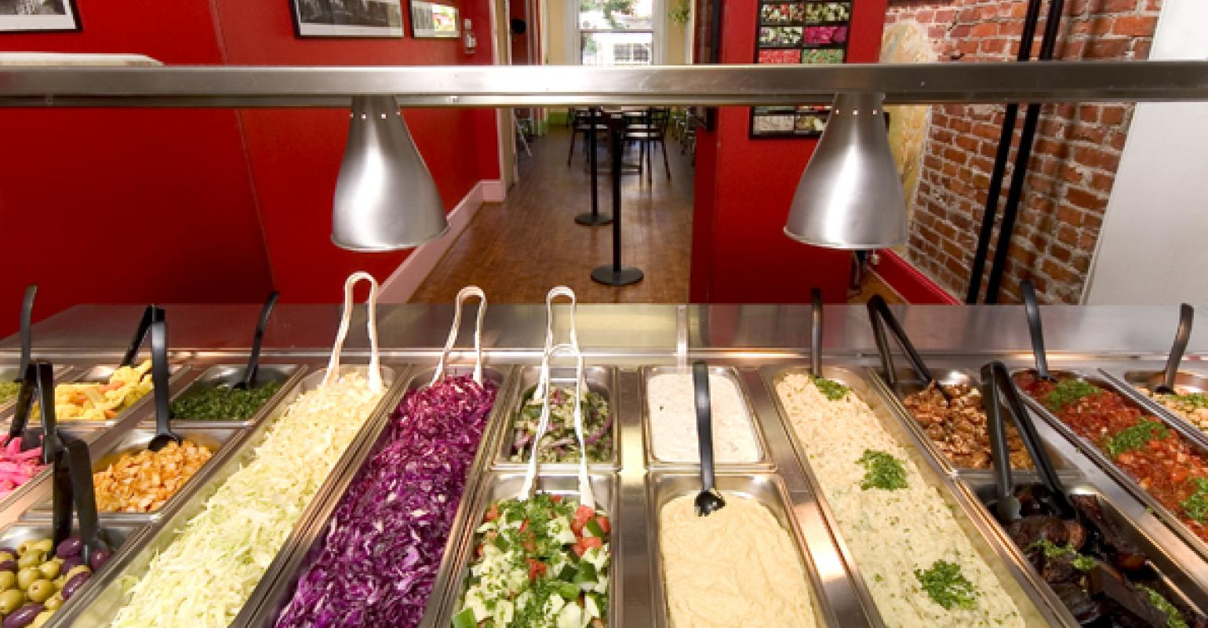
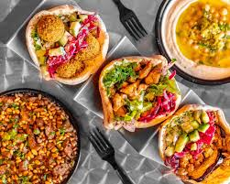
My Business idea
My idea is making a falafel restaurant and it’s a good and I chose the name FILL FALAFEL because its uniqe
I think that a lot of people like falafel since its traditional Arabic breakfast and my idea will be to make your own falafel store

Slide 3

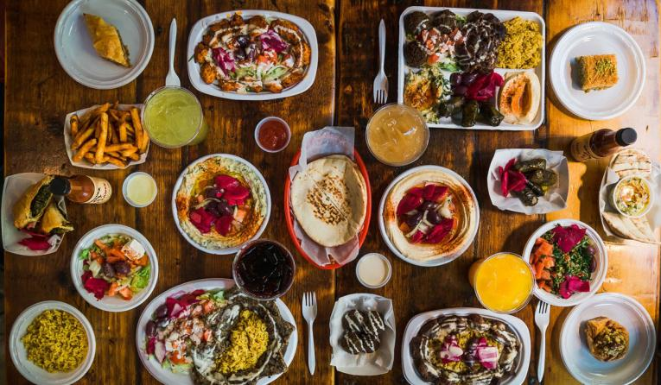
Target market & Demographics
Most of my customers would be families and all ages since they all like falafel and a Arabic cusine
Other than that my competitors will be Hamada,Hashim and abu Jbara resturants

Slide 4
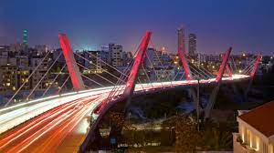
location
My place will be located in abdoun since it’s a very famous place and everyone would be able to see it and approach it

Slide 5
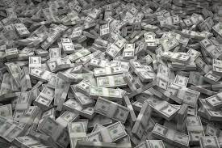
Financial Information
Our plan is using the family savings and make a very good and uniqe place

Slide 6
prices
My place would charge depending on how much u put in your sandwich
One falafel sandwich with toppings is half jod
Extra falafel in sandwich 10 cents more
My competitors prices are higher than mine since you don’t make your own sandwich the sandwich the sandwich is 57 cents without extra toppings

Slide 7
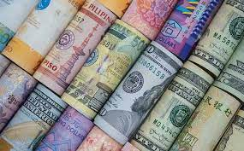
profit
If the store gets famous I will get medium quantity of money

Slide 8
What im gonna do with the profit money
Im gonna save them up and open more branches of the falafel store so it could be more successful

