Slide 1
Business plan
BY Mustafa

Slide 2
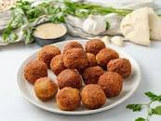
Business idea
MY idea is to sell falafel ,it is a good , I would have new ideas , THE name abo foula it is easy to pronounce and foula means falafel so it is related to what are we selling

Slide 3
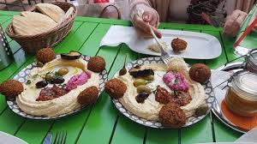
Target market & demographics
Our customers will be to consume our product with any age kids , teenagers , men and woman , our competitors are abu jbara and 7amada , it will be in <wasat al balad> we most of the people that come from another country's visit plus that the product can be delivered

Slide 4
Financial information
I will charge for each produce 0.35 and my competitors charge if 50 , selling price is 0.70 – total cost 0.30

Slide 5
Owner details
Mustafa atoum <> bron in 11/2/2000 <> 23 years old <> networth 2million dollars <> have a lot of business around the world

Slide 6
I will upgrade the business and improve it and the extra money I will donate it

