Slide 1
Swimming pool in school
Made by joelle and angelina

Slide 2
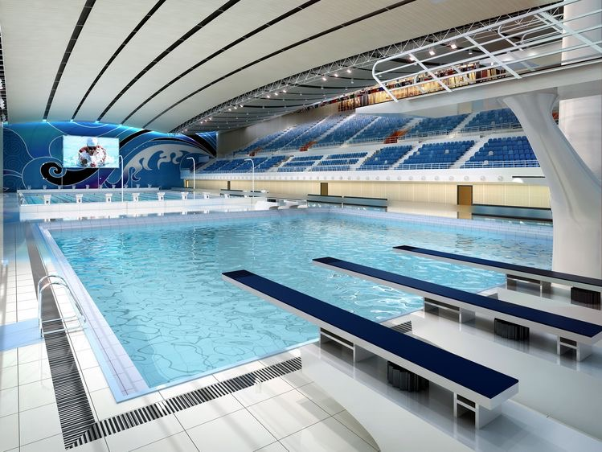
What we are planning to do to increase the sports activity in school.
Based on the results of our survey, 79% of students think that we should add a pool to our school. This could raise the amount of people that play sports in school or sports in general.

Slide 3
Why?
Having a pool could be beneficial in many different ways, other than raising sports activities it could get new people to try and put different sports and have better opportunities, as well it would be a fun activity for student to enjoy. Moreover, it could also interest students that already know how to swim and want to be part of a school team.

Slide 4
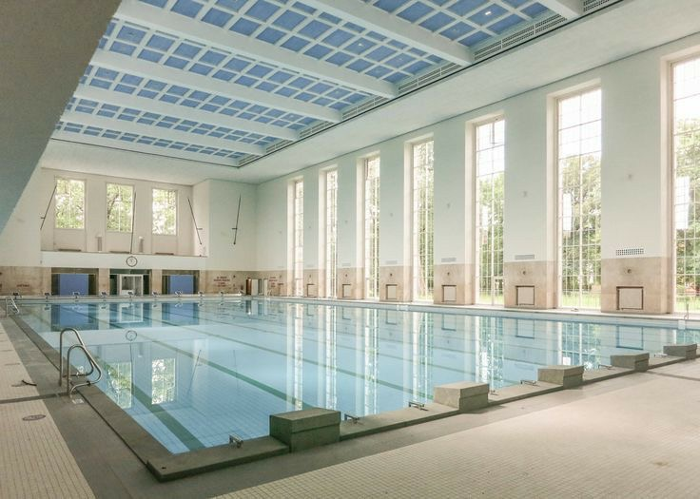
Negative outcomes of having a pool in our school
We had a survey and this is what some of the students think are the negative out outcomes of having a pool is:
29.5% think it would be expensive.
21.7% think it could lead to students having injuries
38.8% think students can drown
10.0% think that thje pool would get dirty,and because of dome peoples lack of hygene

Slide 5
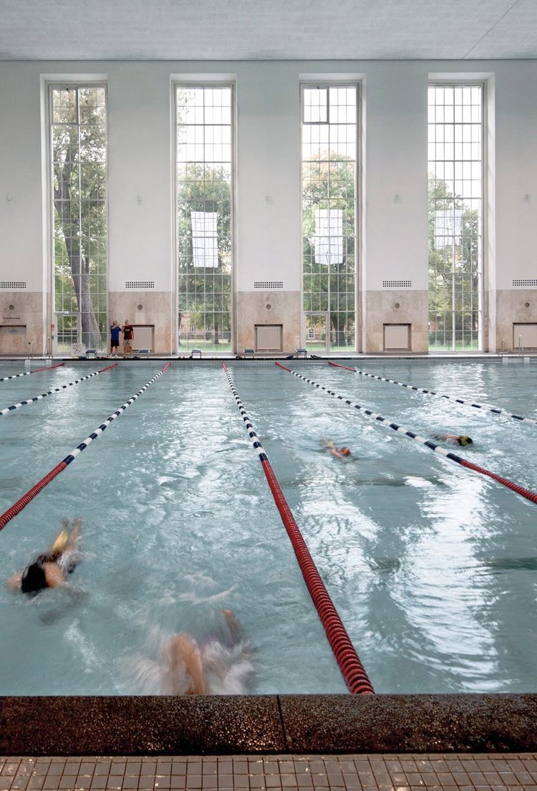
solutions
Injuries:the school coulkd hire a doctor especially for the pool
Drowning: if we were to put a pool we would need the right amount of guidance,for example hiring life gaurds and security for the pool.
Hygene: the school could build showers and have workers to clean the pool

Slide 6
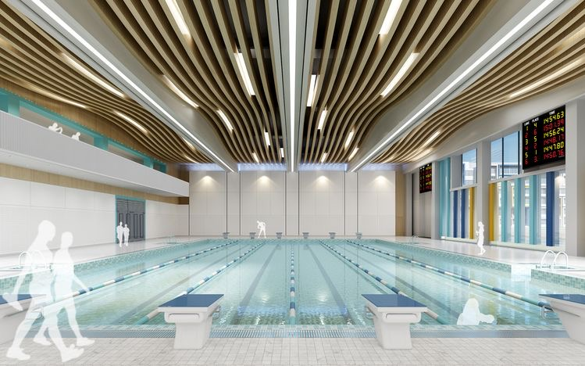
How will we get the money in order to build the pool?
We can have activities in order to raise money:
Bake sale
Garage sale
Plays

Slide 7
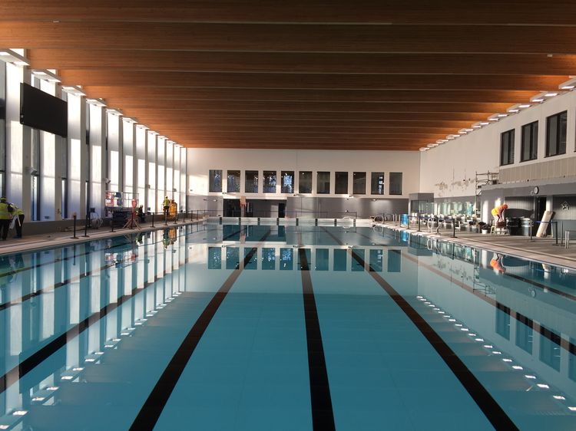
Were would the pool be located?
They could place the pool under the indoor arena there is a lot of space to have a pool and showers built in.

Slide 8
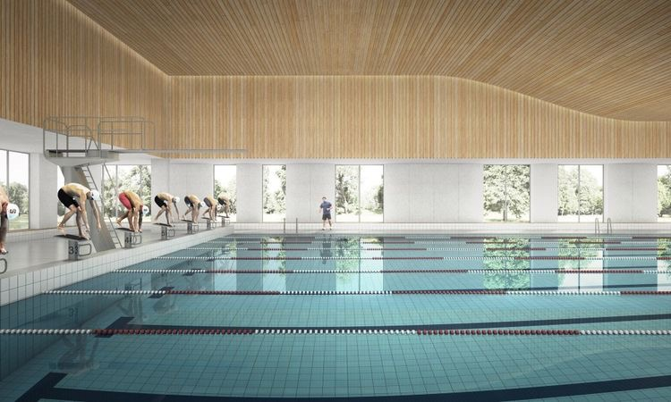
Our Survey
https://docs.google.com/forms/d/e/1FAIpQLSeHUiWqOSX7Y5ul4wTartOKTgMpqvcAmVOPq56PaNZzjTxbUw/viewform?fbclid=PAAabUYHYbKV1B21ef_dPkuqo8hH5LOlh2CFJBx2LjLarHjCqnhG0xhjKlgPE

