Slide 1
Zeina khraim
7 cs c

Slide 2
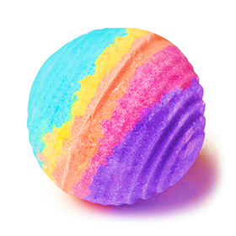
What is a bath bomb?
business idea
A bath bomb is a circular object fabricated by the tangible combination of citric acid, corn starch, Epsom salt, water, food flavoring, essential oils, and food dyes.
Bath bombs are manipulated into baths to stir and fizz up an exquisite sense of relaxation.

Slide 3
Our special
business idea
Our special bath bombs are handmade, with all natural ingredients, could be customized upon customers’ preferences of color and odor.

Slide 4
Our Vision 1. To be the most successful company in the beauty field 2. To help people care for their skin
business idea

Slide 5
Our Mission
business idea
Offering the customer a noteworthy self care product.

Slide 6
Our costumers
target market & demographics
For all the family, kids, teenagers, parents & grandparents

Slide 7
Our competitors
target market & demographics
Bath and body shops

Slide 8
our location
target market & demographics
Made at home and to be sold online

Slide 9
Sources of capital
financial information
Personal savings as a start and then from our profit

Slide 10
Our price and the competitors price
financial information
Our price: 3-5 JD (small-large)
Competitors price: 4-7 JD (small-large)

Slide 11
Predicated profit
financial information
Size of bath bomb | Cost per piece | Selling price per piece | Profit per piece
Small | 1.00 JD | 3.00 JD | 2.00 JD
Large | 2.00 JD | 5.00 JD | 3.00 JD

Slide 12
Zeina khraim you can contact us online “bath and waves” pages or via WhatsApp
owners details

Slide 13
This is only the start… when our business grows, we will invest more in other handmade beauty products and save the money for education and entertainment, as well
what next

