Slide 1
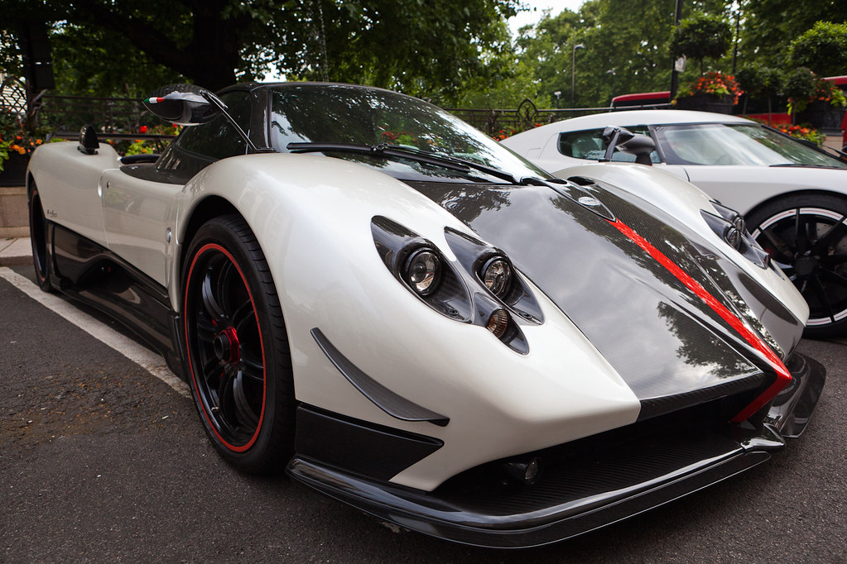
3K’s
Car Dealership

Slide 2
Business idea
To sell cars.
It’s a service.
Because vehicles are necessary in peoples life so they could be able to transport.
The business name is easy to pronounce and unique.

Slide 3
Target market & Demographics
Adults with license.
Hippo motor group.
Germany Jordan
Cars can be deliver or bought at the dealership.

Slide 4
Financial Information
Start a Gofundme and tell the people the reason until I have enough money.
How much I would charge would depend on which car.
Also depends.

