Slide 1
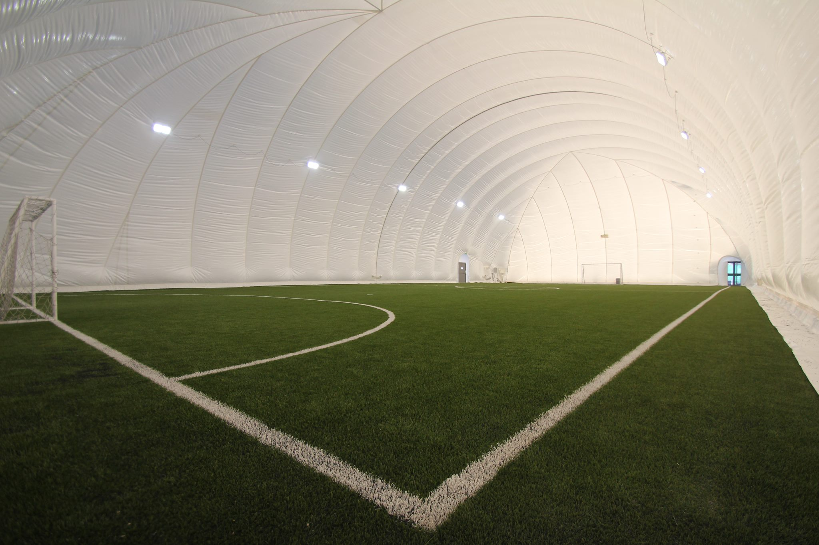
Access to sports (inside football field )
Made by saif fashho and Michael qsous
Audience : stage 1-12 ages 6-18

Slide 2
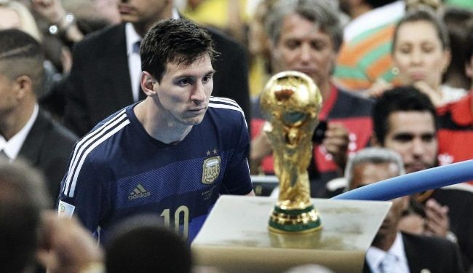
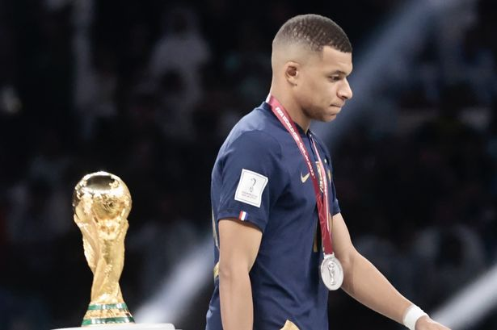
Can you be a footballer??
Did you ever dream to be a footballer??
Many youngsters want to be a footballer ,but with the lack of football equipment in our school , many dreams get shattered.
Many students want an inside football field
But would the school allow it ?

Slide 3
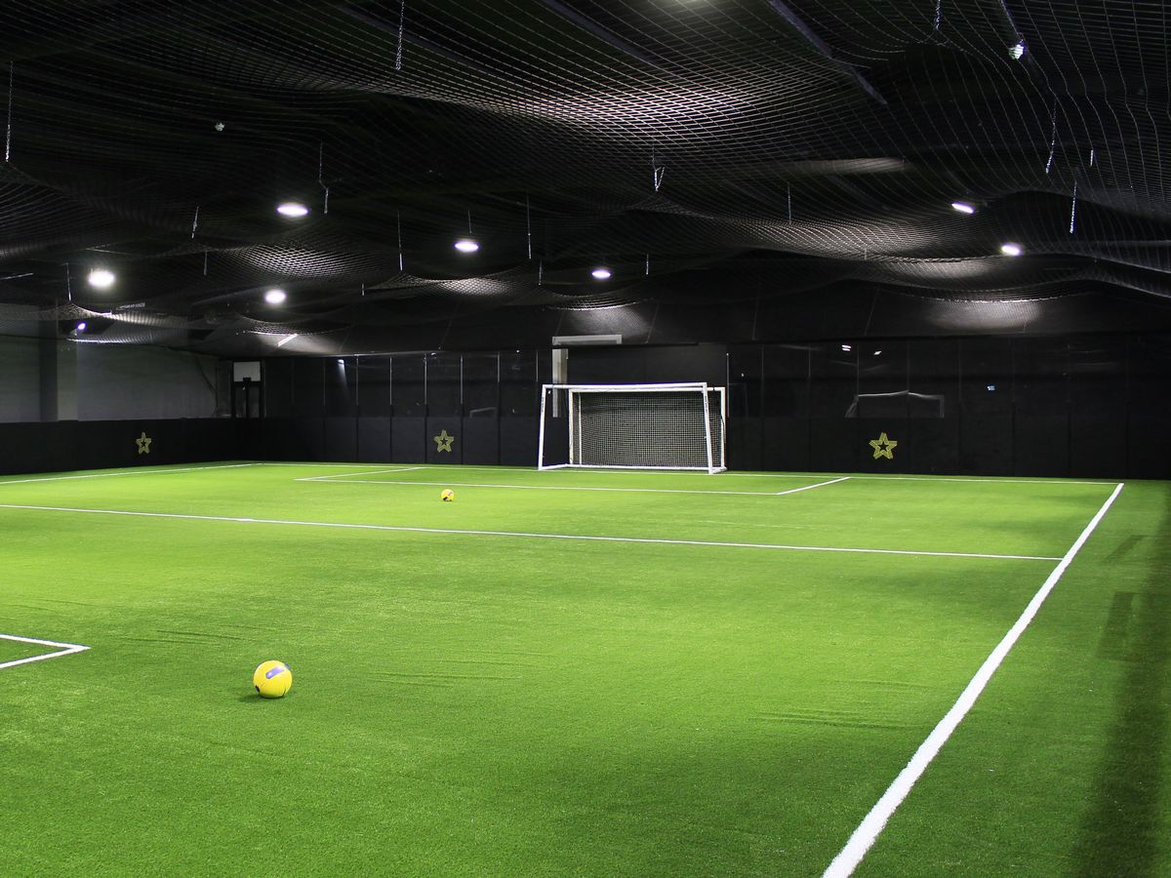
Causes of an inside football field
The causes of making a inside pitch is that it will make many students grateful, entertained and encouraged to play football because our city lacks football equipments .

Slide 4
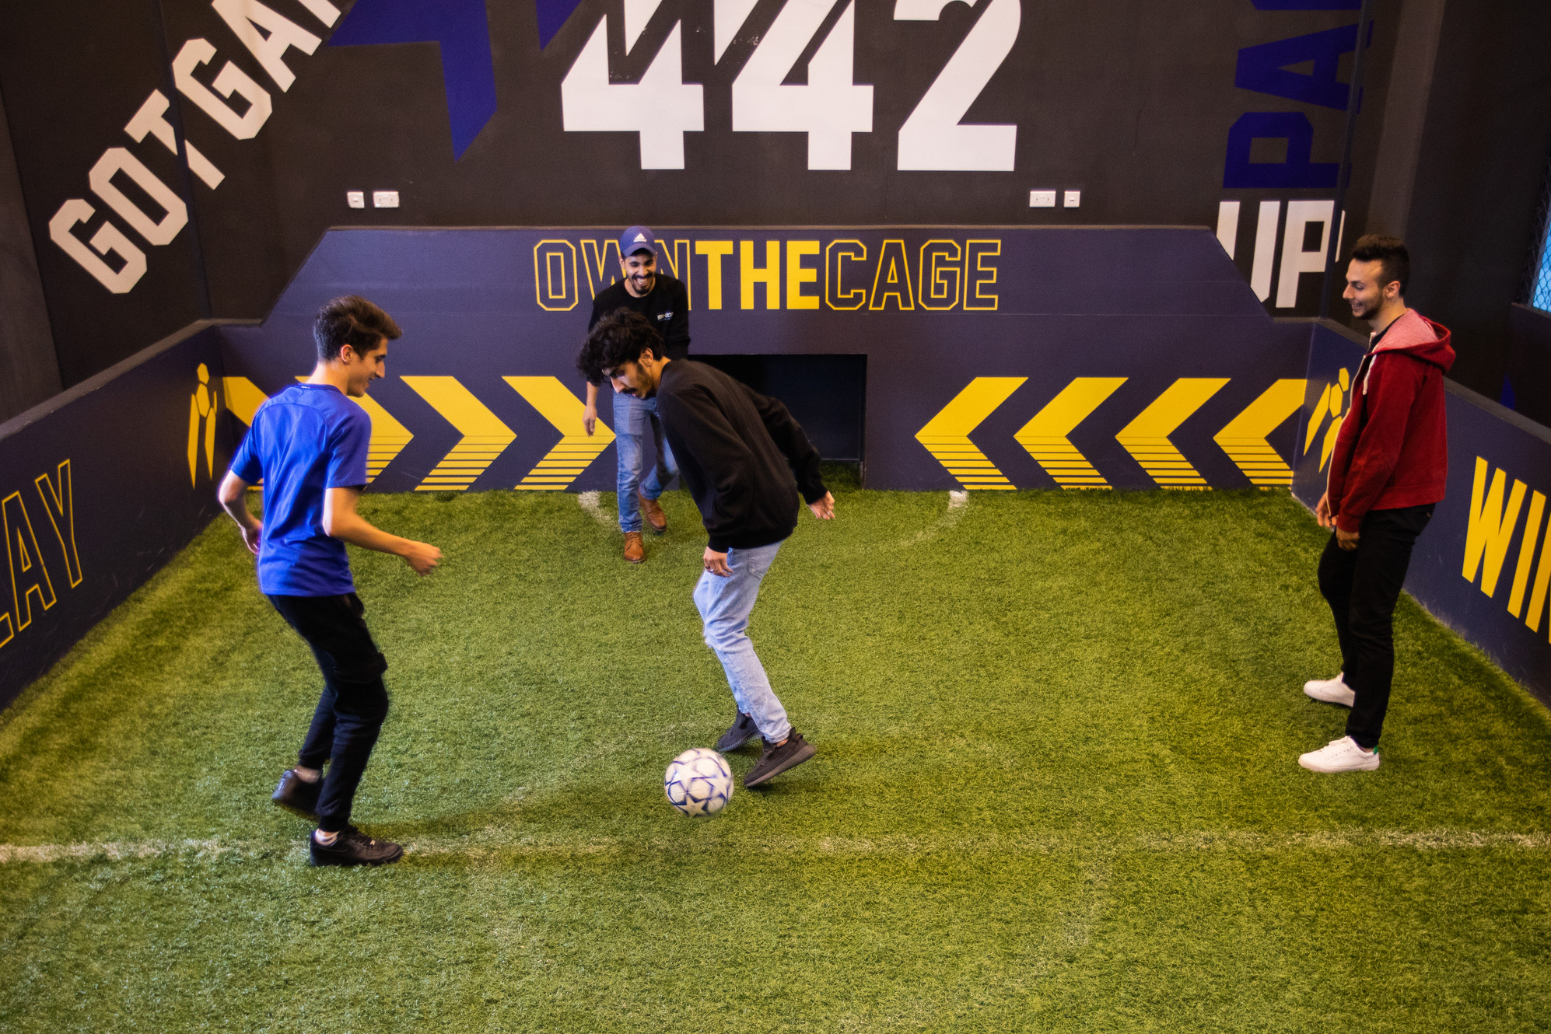
What are the effects of an inside football pitch ?
If our school will make an inside pitch our school may lack a lot of money, moreover it will limit our space and it will contain us and many other viruses which will make us get sick.

Slide 5
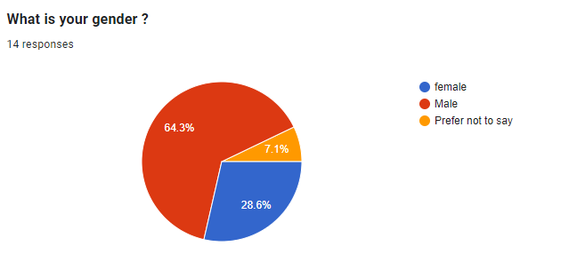
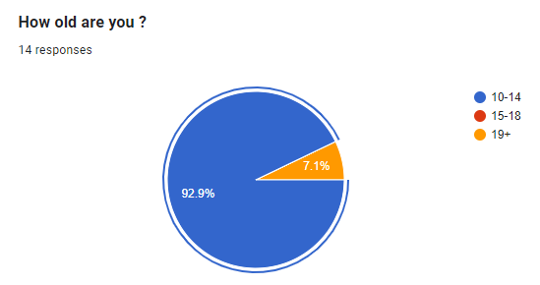

Slide 6
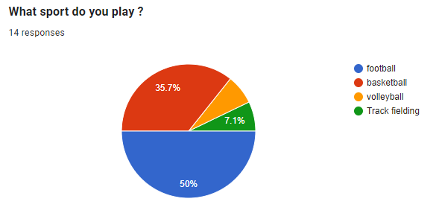
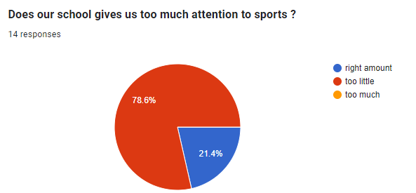

Slide 7
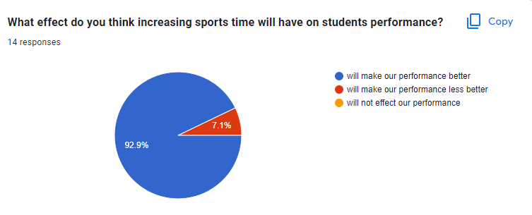
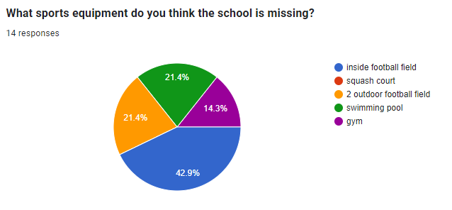

Slide 8
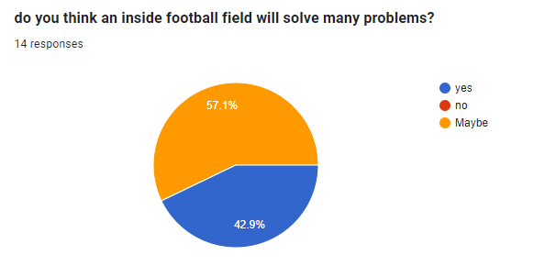
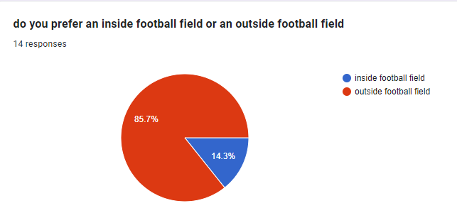

Slide 9
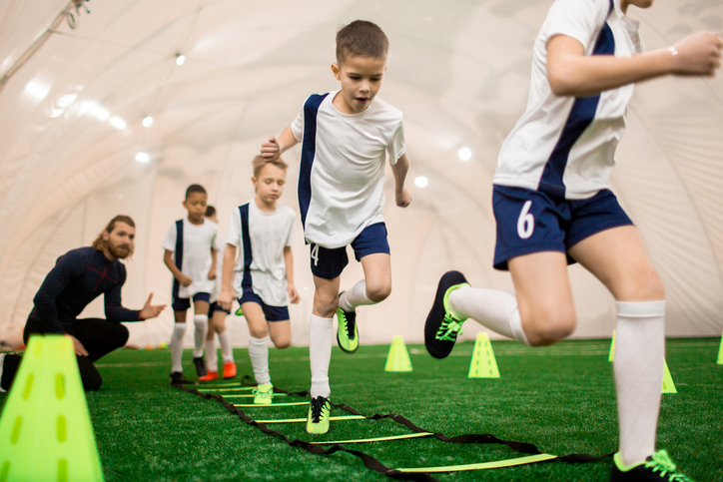
what are the benefits of an inside football field? ( according to students answers)
will help us in our health
Hot weather
Less problems and fights
you can still play football and keep our exercise up even if its cold raining or snowing outside
Many repeated the reason of bad weather

Slide 10
what are the disadvantages of an inside football field
it will be very expensive
Would break a lot of stuff
Lack of oxygen if you play in it for a long time
Cost and time to make it
It will Limited space
When the sun hits you it gives you vitamins. Inside there isn't a sun

Slide 11
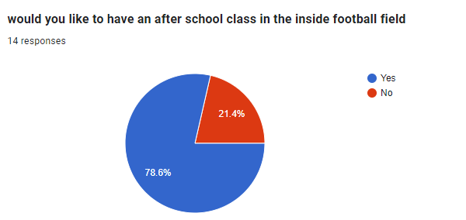
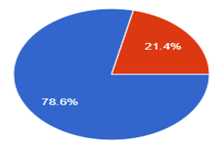
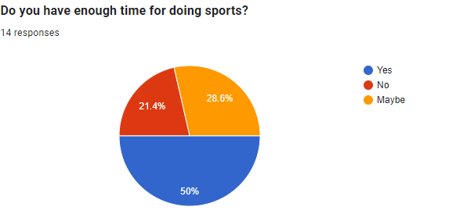
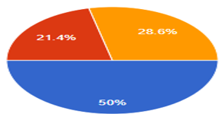

Slide 12
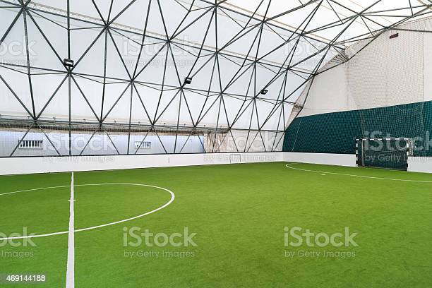
Finance
Fake grass = 1jd per meter for the whole field we need 100 by 50 meters = 500*100=5000*1= 5000jd plus taxes =5000+20=5020jds
Paint=15jd per liter for the whole field we need 5liter =5*15=75jd plus taxes =75+15=90jd
1 goal= 130jd for the whole field we need 2 goals =2*130=260jd plus taxes 260+25=285
Cover= 1500jd for the whole field we need 1500jd plus taxes=1500+500=2000jd
Over all 5020+90+285+2000=7395jd

Slide 13
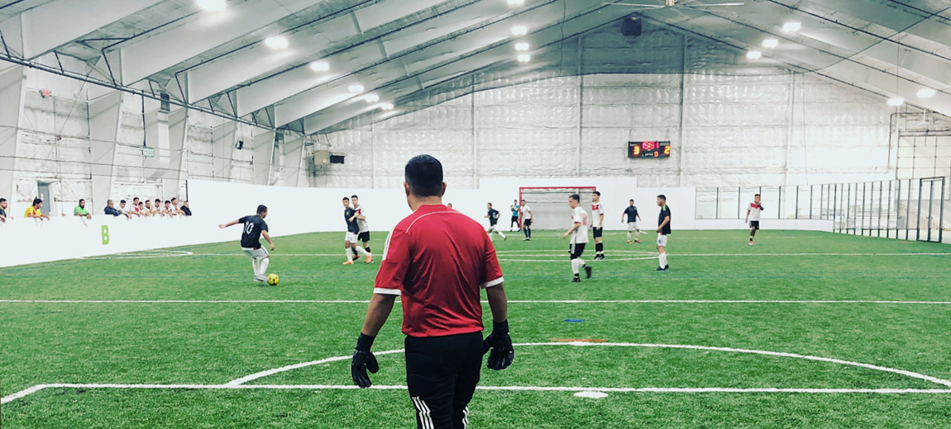
How would the school repay it?
First the school can pay for it from our money that we pay annually
They can repay for it by making it for rent after school hours for example footballers can rent it for a specific hour and play in it. further more they can make tournaments in it .

Slide 14
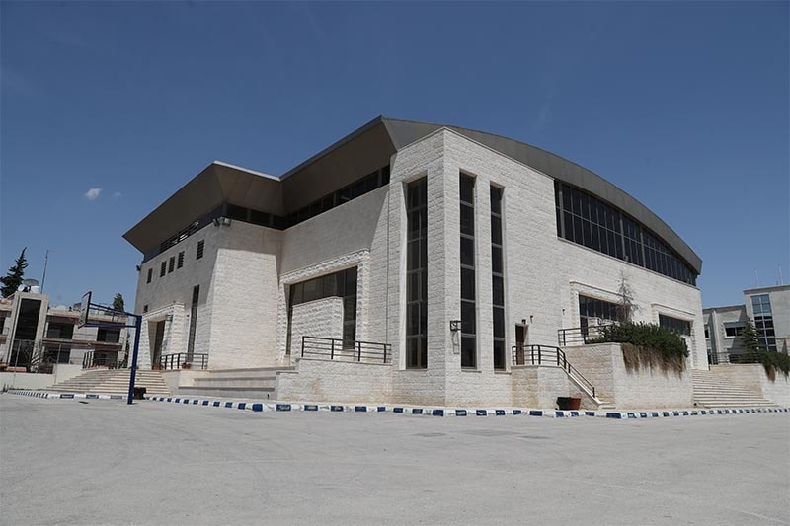
location
Our school can put the stadium in the arena next to the basketball court
THEY CAN Expand it by making the football field next to it using the cover

Slide 15
citations
https://www.google.com/search?q=inside+football+field&source=lnms&tbm=isch&sa=X&ved=2ahUKEwix4by3x5_9AhW5RaQEHTxCCSQQ_AUoAXoECAEQAw&biw=1366&bih=612&dpr=1&safe=active&ssui=on
https://docs.google.com/forms/d/1L69mzpg-mrFr-pEEk8qya1z7kJmssqguJAOZKR8EnFg/edit

Slide 16
Thank you for listening

