Slide 1
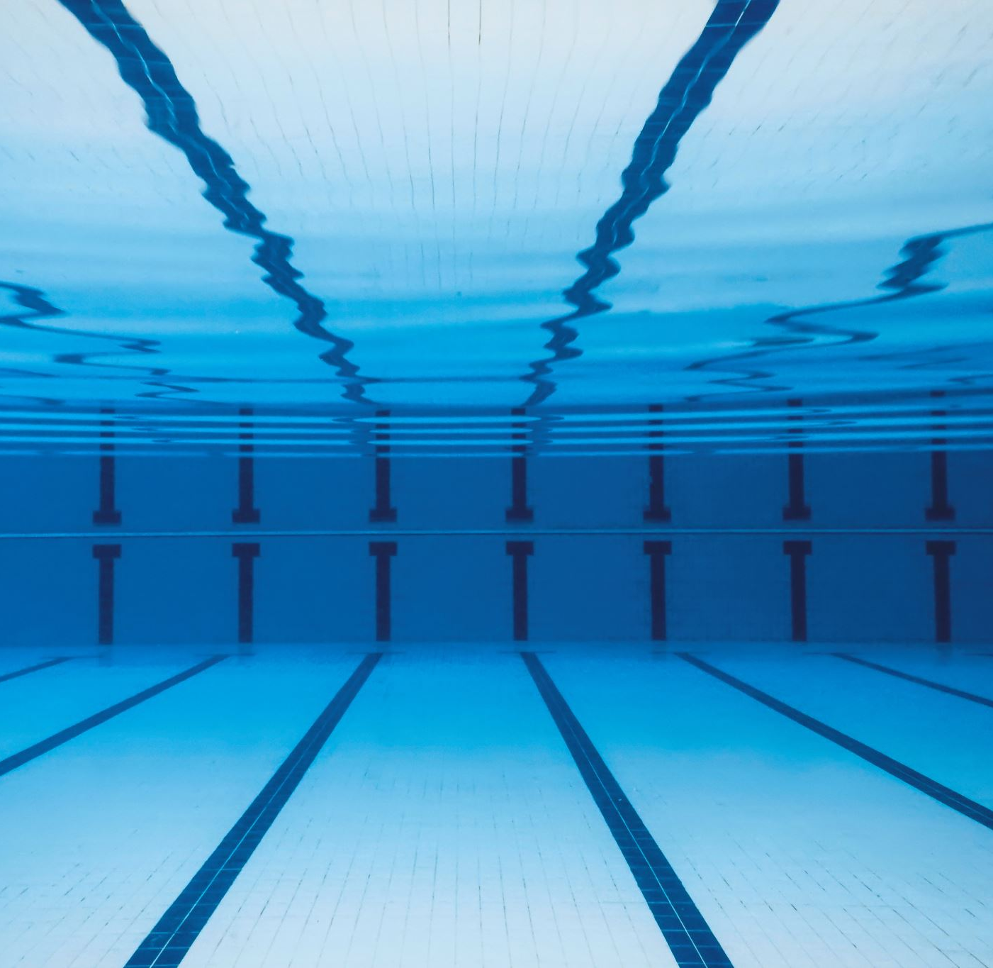
Indoor swimming pool
Christina Al-Sharqawi & Leen Ghosheh

Slide 2
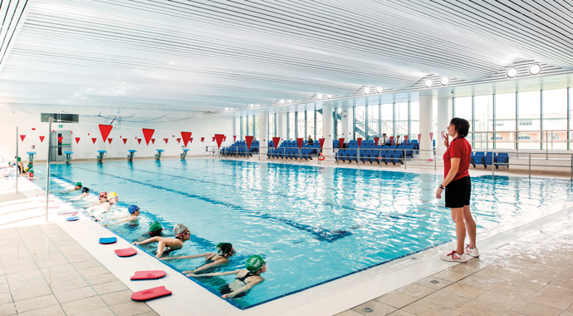
Introduction
Have you ever wanted to swim but it’s winter and you’re at school? We must see if the school will agree to build an indoor swimming pool. We will discuss in the upcoming slides the advantages, disadvantages, how much it will cost and how the school will be able to pay for it.

Slide 3
Benefits of and indoor swimming pool
There are several benefits of having an indoor swimming pool and some of them are:
Swimming in cold weather.
Playing water games such as competitive swimming.
Teaching students how to swim from an early age so that they can be safe around bodies of water.
Swimming works most of the body muscles, so it’s a great exercise.

Slide 4
Disadvantages of an indoor swimming pool:
There are some disadvantages for an indoor swimming pool which might be a reason for the school not to approve, some of which are:
High initial cost
High maintenance costs
Students might get injured or drown

Slide 5
Consequences
Swimming is an excellent form of exercise. But like many activities, swimming in a pool has its downside.
Swimming in chlorinated pools, particularly indoor pools, might put kids at higher risk for developing respiratory illnesses, including asthma and hay fever.
In addition, there is evidence that disinfectant by-products–formed when chlorinated water is mixed with microorganisms, human body fluids, cosmetics, and sunscreen–can damage your DNA and increase your risk of cancer.

Slide 6
Finance
We can organize a sports event where students can pay to participate in, in addition to selling food and drinks to raise more money.
The school should be able to cover the cost of the swimming pool in less than 1 year.
Approximately, the pool will cost around $40,000-$70,000.
Each student might donate $20 or more according to their financial ability.

Slide 7
Location
The indoor swimming pool could be in the basketball court, or we can close a rooftop and build it there.

Slide 8
Time Frame
This project should take about 2 years to be completed and open for students to use.

