Slide 1
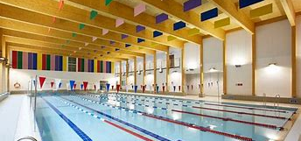
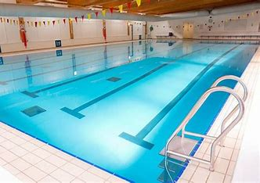
Pool
by: Fahed, Sanad

Slide 2
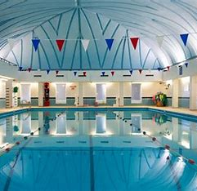
Introduction
Water activities give young children the chance to learn useful skills and healthy behaviors. Whether it is given as an athletic activity or is part of the daily schedule, a swimming pool is a very helpful asset for students' physical and mental health. As a result, they are becoming more common at all levels of schooling, from kindergarten to college.

Slide 3
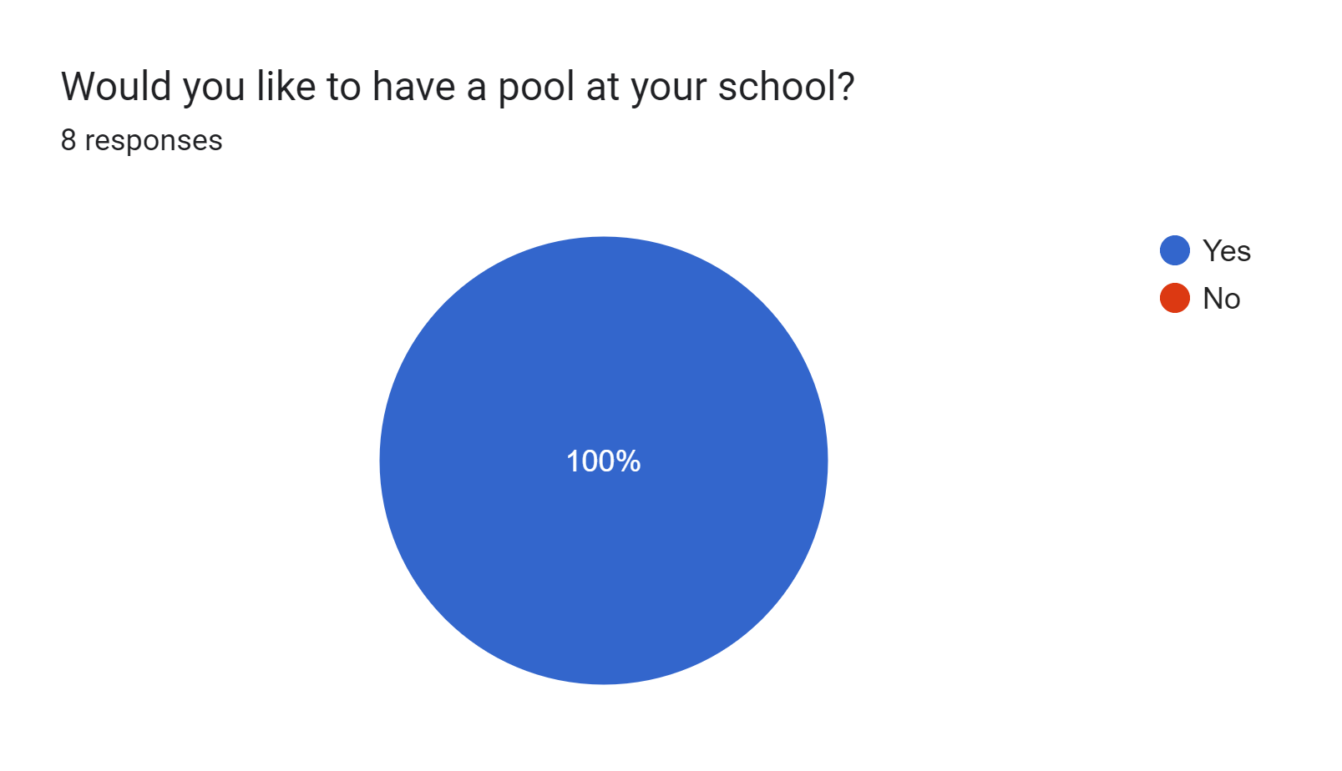
Reasons why we want to have a pool at our school
We want to build a pool for many reasons:
1.To motivate students into trying out this sport.
2.To increase students' physical strength.
3.To allow students to have fun.

Slide 4
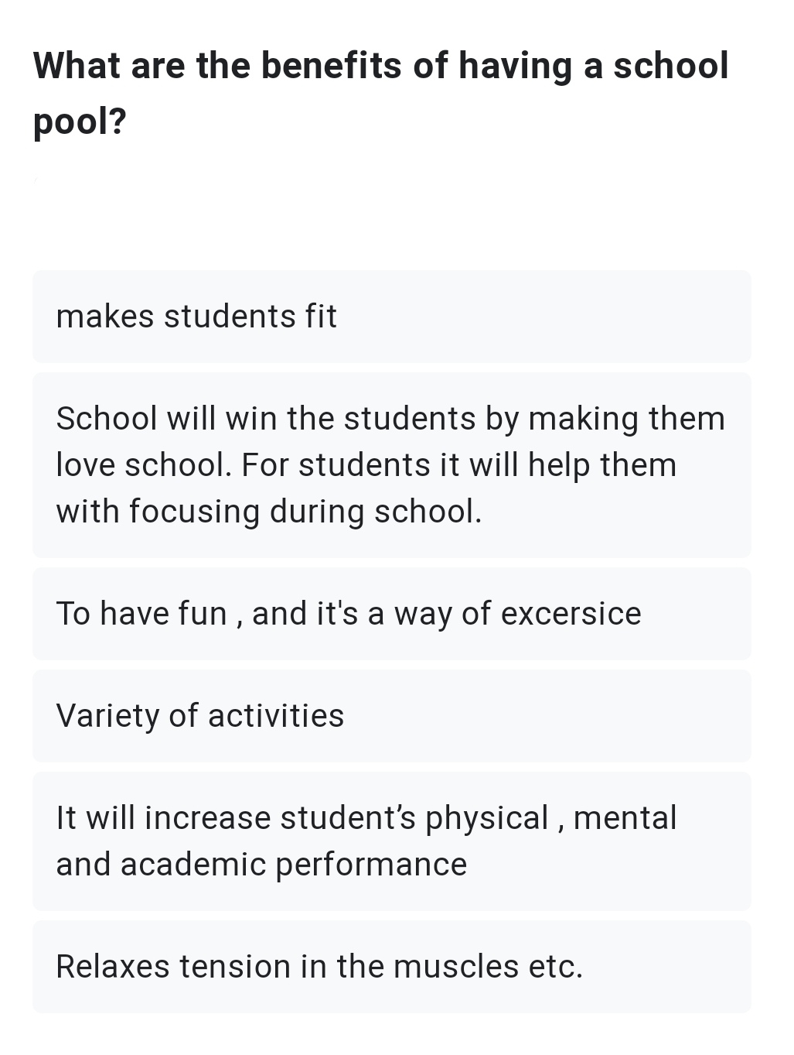
The consequences (benefits) of having a school pool
1.Learning to swim
2. athletic Training
3.Helps in relaxing muscles

Slide 5
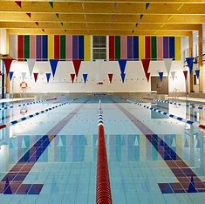
Solutions to the finance of building the pool
Solution 1: adding an entry fee.
Solution 2: doing an activity such as a trip or a theatre visit that costs money to get enough capital for building the pool.

Slide 6
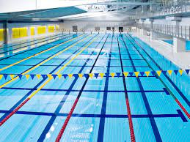
Location
Beside the basketball court.

