Slide 1
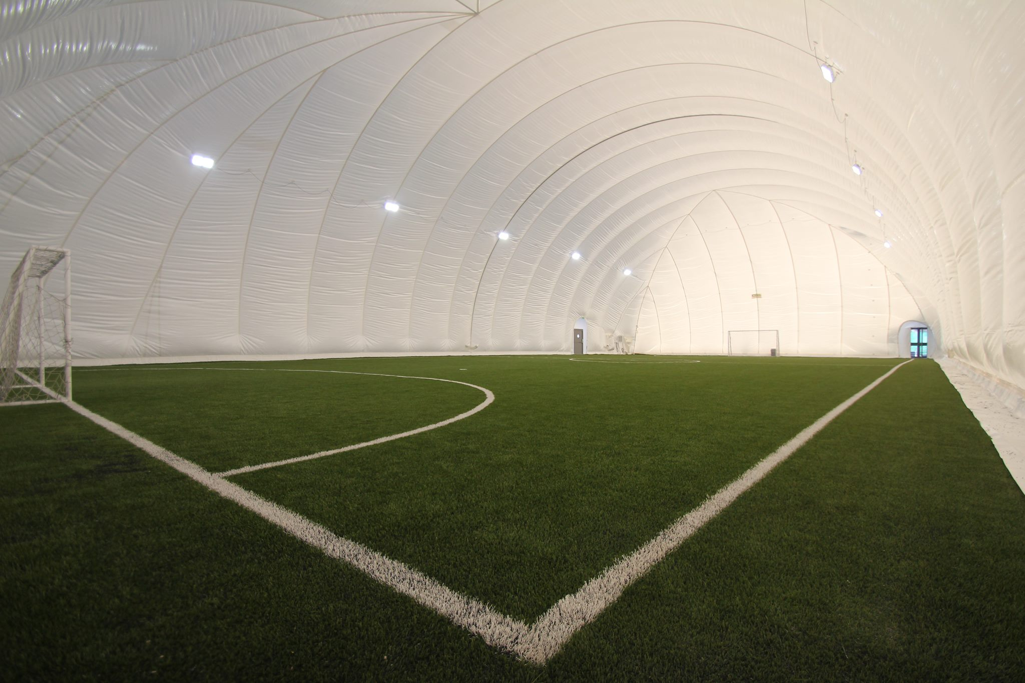
Indoor football court
By: Sinan Shawareb and Amir Almomaiz

Slide 2
Introduction
An indoor football field is a specialized sport with a novel court where they play a fundamental role in the game's development
this study aims to provide information about the importance of having an indoor football court
the results of the study which we have made through a survey are desplayed in the following slides where the major responses concured that its necessary to have an indoor football court at the School

Slide 3
Age
The age group of the participants were split into two major grouprs first group: from 10-15 years old and the second group for above 21 years old

Slide 4
Gender
Ten people has participated in this survey where 7 of them were male and the rest were female

Slide 5
As part of the survey we noticed that the favourite sport for 70% of the participants is football and the rest prefer basketball and tennis
Favourite Sport

Slide 6
The survey showed that most of the participants exercise twice a week
Number of exercises per week

Slide 7
The survey shows that 60% of the participants prefer indoor exercises
Preferred indoor vs. outdoor exercises

Slide 8
6 participants indicated that the missing indoor facilities is a football court while the rest suggested to have a swimming pool and gym equipment
The missing facilities in the School

Slide 9
The participants indicated that the cost of building the football court would range betwwen JOD 10,000 up to JOD 20,000
The expected cost of the indoor football court

Slide 10
The participants indicated that the requuired duration to complete the the football court would range betwwen six months to one year
The expected duration to build the indoor football court

Slide 11
The participants agreed that building such indoor sport facility would impact the students health positivly
Impact of the indoor football area on student health

Slide 12
70% of the participants agreed that having an indoor football would enhance the school ranking among other schools
Impact on school rancking

Slide 13
Some of the participants think that the school may rent the indoort facility to the public to make revenues while other opnion thought its not a good idea
The school may rent the indoor sport facility to the public

Slide 14
Finance
We will be able to afford this by making the membership fees of the little league higher and expand it to include the sixth graders

Slide 15
The End of study

