Slide 1
Telematches
Done by: Christine hanania and qais haddad.

Slide 2
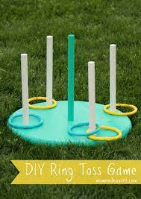
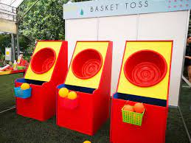
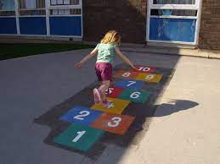
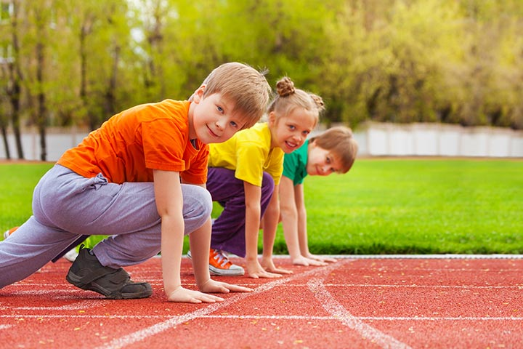
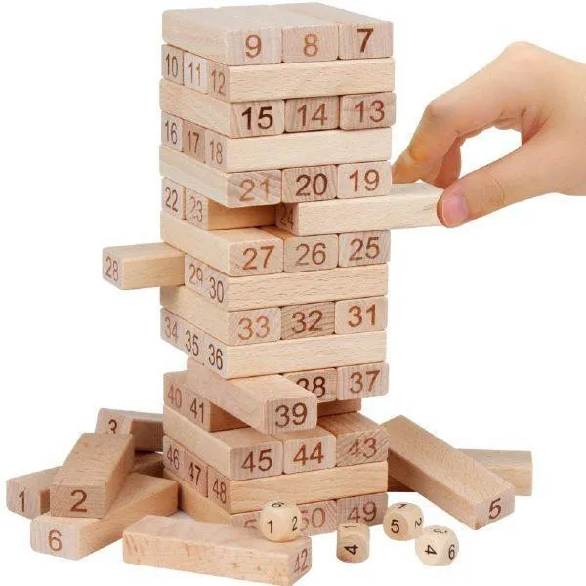
Telematches
What do you think of having a telematch every month?? To answer this we have collected information about doing a telematch to benefit the students physical health and let them enjoy something in a healthy way during school hours. Having a telematch every month encourage the student to do sports but in a fun way.

Slide 3
Causes of telematches
In order to answer this we collected data from the survey the students filled:
1-Students will concentrate more in classes.
2-They will enjoy school hours.
3-It will let students to do sport but in a fun way.
4-It will benefit students health.
5-It will let students commmuinicate with other students and make new friends.
6-This will let students less stressful to relax and not be stressed the whole day.

Slide 4
Consequences of telematches:
In the consequences we will talk about two sides the positive side and the negative side:
Positive side
Negative side
CONTINUE

Slide 5
Positive side:
back
1-It will encourage students to come to school.
2-Students will do sport but in a fun way.
3-Students will sleep early so they come to school so early.
4-They will have a healthy lifestyle.
5-If students are stressed while doing their daily homework or studying for exams they can play a telematch so they release their stress.
6-It will let students move more and allows them to exercise.

Slide 6
Negative side:
back
1-Students may get injured while playing.
2-Students may get in a fight during the telematch.
3-The telematches may be boring for some students.
4-Some students may feel pressured to play games that may not want to.
5-When someone gives us instructions we may sometimes resist and not want to hear them.
6-Students may cheat during telematche games.

Slide 7
Where and when
We decided to do the telematch on the first Monday of every month in the break time at the football field.
In case bad weather we will held it in the indoor court.

Slide 8
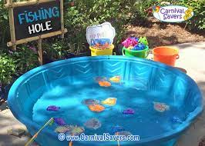
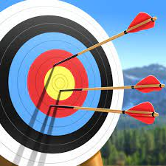
Finance:
We decided that we will allow the students to donate from 5jd to 10jd, and the money they collect, they go and buy the stuff needed for the telematch.

Slide 9
Resources:
1- https://ww w.momendeavors.com/diy-ring-toss-game/
2- https://www.carnivalworld.sg/carnival-game-booth-rental-singapore/basket-ball-toss-game-rental/
3- https://www.momjunction.com/articles/running-games-for-kids_00469783/
4- https://www.lazada.com.ph/products/wooden-stacking-board-game-tower-wooden-building-blocks-educational-games-for-kids-i3243470717.html
5- https://edumarkingplaygrounddesigns.com/blog/benefits-playing-hopscotch
6- https://www.dreamstime.com/negative-stamp-round-grunge-sign-image136944306
7- https://every-foods.com/en
8- https://first-femme.com/collections/off-white
9- https://mondayonline.co.uk/
10- https://www.alamy.com/stock-photo-the-word-month-written-in-tile-letters-isolated-on-a-white-background-126881132.html
11- https://www.carnivalsavers.com/pages/free-game-ideas/fishing-hole.html
12-https://20thcenturyvideogames.com/index.php?action=vermodelos&tipo=2&sistema=Tele-Match
13- https://play.google.com/store/apps/details?id=com.cg.archery&hl=en_US&gl=US&pli=1
14- https://teambuilding.com/blog/disadvantages-of-team-building
15- https://allfreethankyounotes.com/thank-you-gifs/

