Slide 1
Golf Course In the National Orthodox School
By: Pilar Habash and Sulaf Al-Ayyoub

Slide 2
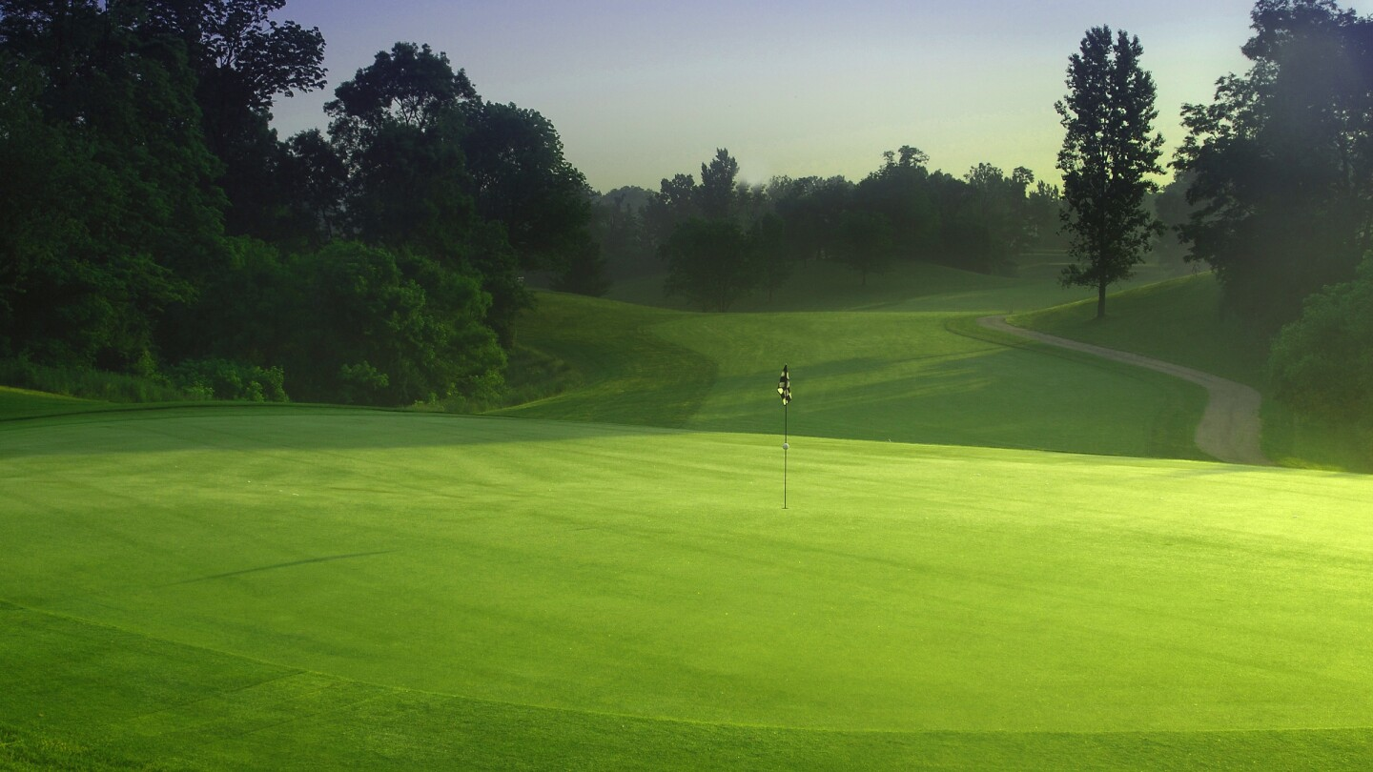
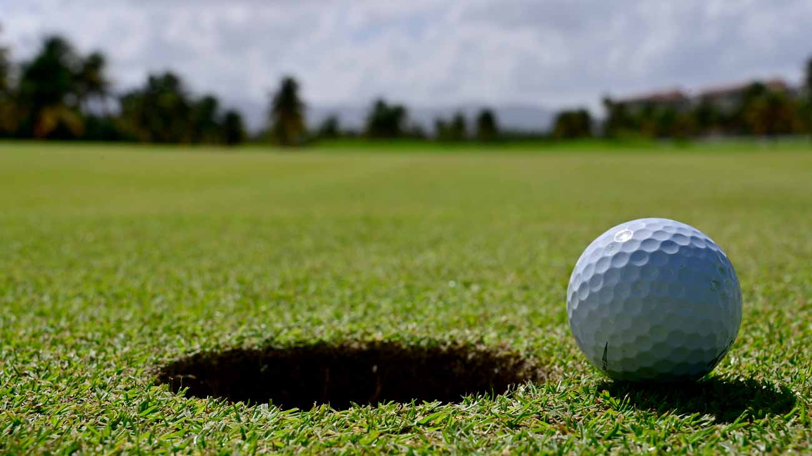
Introduction !
After interviewing Students and doing research we have planned on introducing a brand-new idea of installing a golf course to be played in the National Orthodox school.

Slide 3
Why did we Choose to have a Golf Course in NOS ?
We choose to have a Golf Court to enhance the students mental Concentration while focusing on the Target, And it’s a new change than the usual sports played ( basketball, football etc.). Nevertheless, It is a unique sport for students to enjoy and especially for those who have interest in golfing.

Slide 4
What are the advantages of the golf course
ADVANTAGES:
Enhancing Mental Concentration and Precisions
Hand-eye coordination
Calm, and prepares them for the next classes ( By relaxation and refreshing the brain)

Slide 5
The Consequences
1. Students might not play with it seriously and wont handle it responsibly
2. Equipment’s might be missing
3. Real Grass has to be constantly mowed and taken care of.

Slide 6
Solutions For Consequences
Solution for Consequence number( 1) :
Students are obligated to play with maturity. Super Vision is provided and Permission has to be taken to play.
Solution for Consequence number (2):
Supervision will be provided. Plus, Sensors will be attached to the equipment to decrease the rate of the equipment's missing.
Solution for Consequence number (3):
Fake grass will be used.

Slide 7
Costs of equipment
20 balls : 4JDs
Cost of 6 golf bats : 12 JDs
Fake grass: 10JDs
Other decorative equipment: ranging from 8-10 JDs
TOTAL: 34 - 36JDs

Slide 8
Prices
For students and teachers:
1 round: 0.15 JD
5 rounds: 0.75 JD
For Schools or people to buy:
30 min : 5 JD
1 hour: 10 JD

Slide 9
INTERVIEW VIDEO
https://youtu.be/PRZzQbSLcT8

Slide 10
THANK YOU

