Slide 1
How an indoor swimming pool benefits the school
Nadine, Zaina r

Slide 2
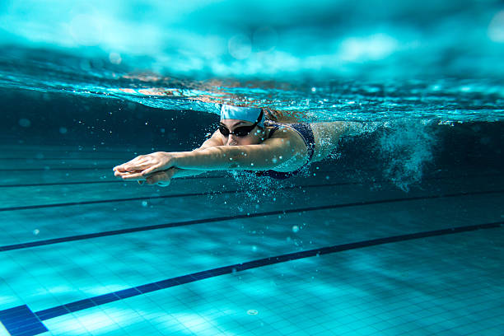
Introduction
In this presentation we are going to talk about making indoor swimming pools in the school. These pools come in different sizes and designs that are used for various purposes. Swimming is an exercise which is useful for therapy and as an exercise for the physical handicapped people. It’s also taught for life saving purposes.

Slide 3
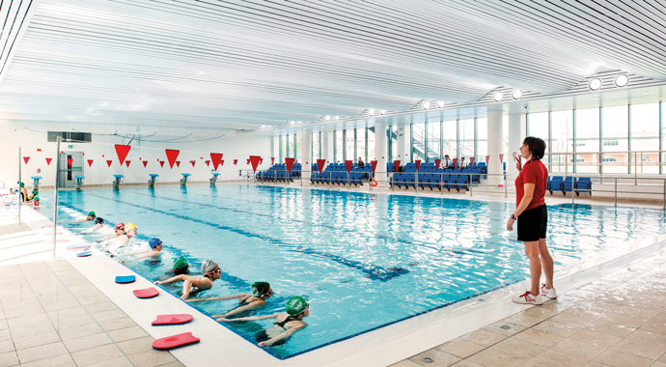
The causes of an indoor swimming pool
HAVING AN INDOOR SWIMMING POOL IN THE SCHOOL:
Will let you enjoy even on these days that are rainy and cloudy
No need to worry about freezing waters
opportunities to get fit and improve your health

Slide 4
The advantages of having an indoor swimming pool
1.An indoor pool brings along various water sports activities that can be entertained throughout the year, without stressing over unfavorable conditions.
2.Whether you are a beginner or a pro swimmer, an indoor swimming pool in the national orthodox school enables each student to appreciate water exercises and physical training classes.
3.Opportunities to get fit and improve your health.
4.More control over temperature.
5.Swimming is a great exercise.
6.It raises strong swimmers.
7.Protection from sunburn.

Slide 5
The Disadvantage of having an indoor swimming pool
1.Swimming pools can be dangerous around children and this who don’t know how to swim.
2.higher initial costs.
3.the cost of heating (the indoor swimming pools need a higher investment that raise the energy costs , we’re as the water in the outside will get warmed by the sun )
4.humidity (the water vapor from a swimming pool affects the moisture in the air which is less of a problem when we go outside )

Slide 6
Solutions
1.Studies show that swimming can be a powerful tool to manage depression symptoms.
2.Regular swimming has been shown to improve memory, cognitive function, immune
response and mood.
3.There will be lifeguards and coaches.
4.For humidity you need to use a special equipments to control the humidity levels
For the higher initial costs .
5.Indoor swimming pools pump should run for at least 6 to 8 hours each day.
6.using solar power to heat the swimming pool and save the costs of energy.

Slide 7
Finance \location
Location:
location should be assigned according to an agreement between the schools administration and the designing company and the civil defense department in order to make sure that the building will meet the standards of safety and efficiency and the maximum benefit for all parts without affecting other facilities in the school.
Finance:
this project should be funded by multiple partners the main partner should be the school helped by local and international companies working in the field of children health and well-being

Slide 8
Resources
https://www.britannica.com/sports/swimming-sport
https://openaire.com/indoor-swimming-pool-cost/
https://www.compass-pools.co.uk/learning-centre/news/7-reasons-to-invest-in-an-indoor-swimming-pool/
https://www.mymove.com/home-inspiration/outdoor/the-pros-and-cons-owning-a-swimming-pool-home/
https://reliefpools.com/what-pros-cons-indoor-swimming-pool/
https://aquaregiame.com/flow-solutions/swimming-pool-solution

