Slide 1
Exercise & students academic performance
By: Hala Abu Baida & Tania Awwad
Grade:8(C)
Teacher: Yasmeen Qadoumi

Slide 2
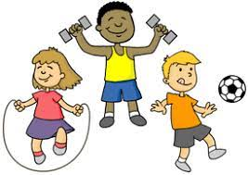
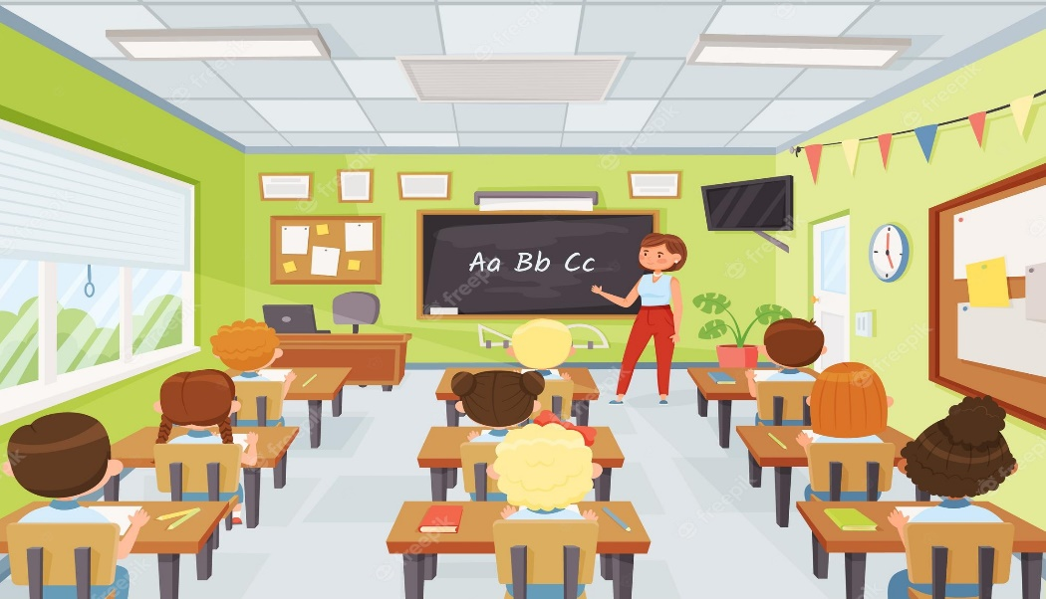
Did you know that exercise improves students problem solving skills and academic performance?
Exercise is an enormous factor affecting students health, general well-being and grades, but they are often lethargic (or inactive) in class, that’s a major setback for their concentration in the classroom, thus we have decided to come up with a solution.

Slide 3
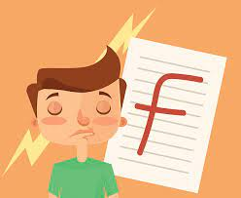
Why are we taking this course of action?
1-students are not attentive in class.
2-students are failing their exams more often.
3-students well-being is endangered by the lack of movement or physical activities.

Slide 4
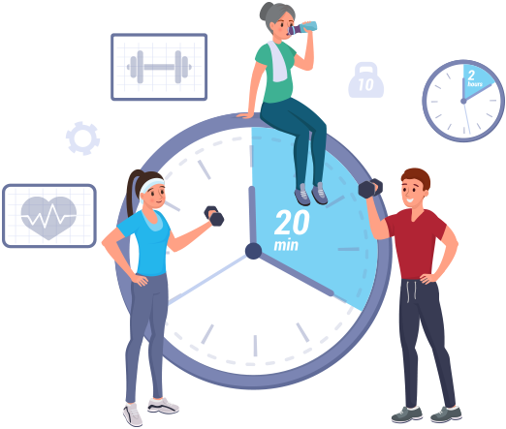
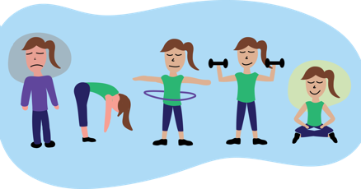
What are we doing?
The course of action we are taking is the organization of a 20 minute exercise in the beginning of the first class everyday that improves the students energy level, health and attentiveness in class.
The exercises we intend to include in this short activity are going to be professionally advised and specialized according to students sport preferences.

Slide 5
What are the effects of this course of action?
Students are more attentive in class.
Students academic performance improves.
Students immunity will be increased.(exercise improves immunity)
Students will be more energetic.

Slide 6
Financials
We thought this proposal was very suitable considering that it wont require any money, so providing financial aid won’t be an issue.

Slide 7
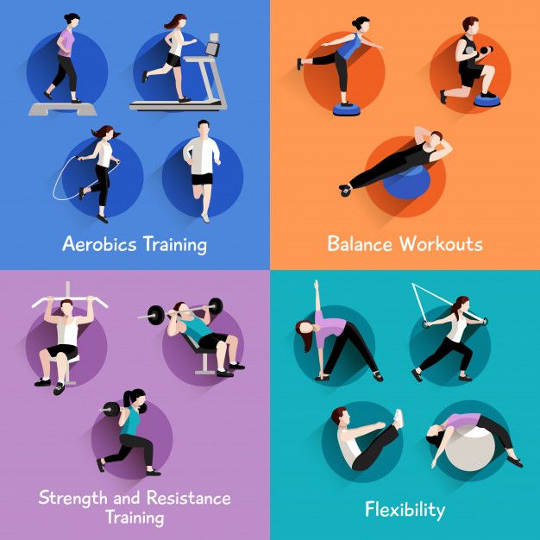
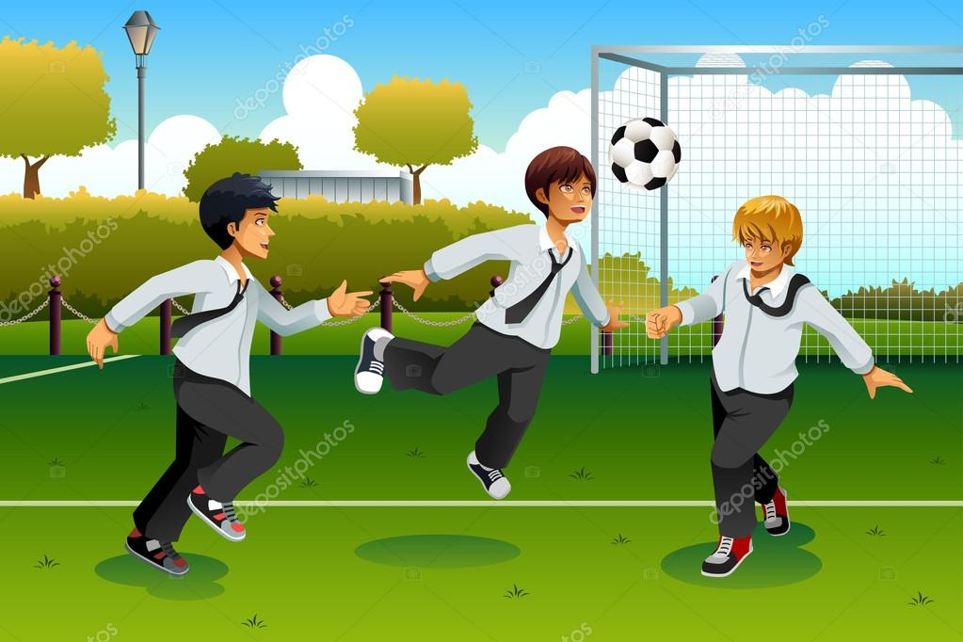
Data collected
We urge the board of administration of the school to take this into consideration knowing that 1 out of 3 students do not exercise at all putting their health at risk.
The results of the interviews we conducted show that the majority of students prefer playing basketball and football over other sports that is why as said before we are taking their preferences into consideration and making the exercises suitable for the preferred sports.

Slide 8
Thanks for listening

