Slide 1
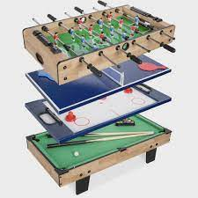
Physical activity room
Study, play, get happy
by: Sanad amarin & fares arida
Notes:
sanad

Slide 2
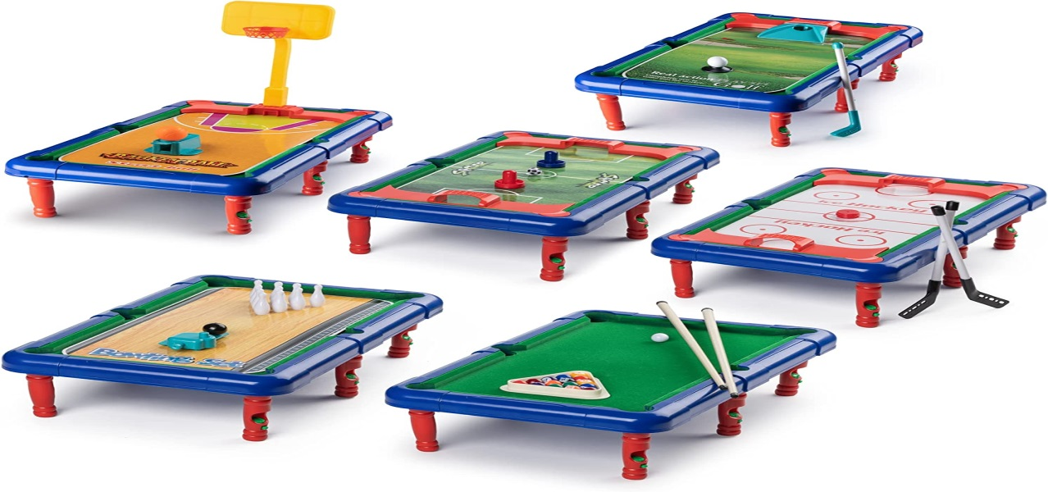
introduction
After a long while of thinking about how to increase students drive, performance, stamina and thinking power my partner and I came up with the idea for the and so we conducted a survey. and here are the results:
Notes:
sanad

Slide 3
what is this physical activities room ?
We noticed that the places students can relax in are lacking. so we introduce the physical activities room .
The physical activities room is a room which has all sorts of physical activities like a pool table, air hockey, foosball table, tennis table and Comfortable couches.
Notes:
fares

Slide 4
Notes:
f

Slide 5
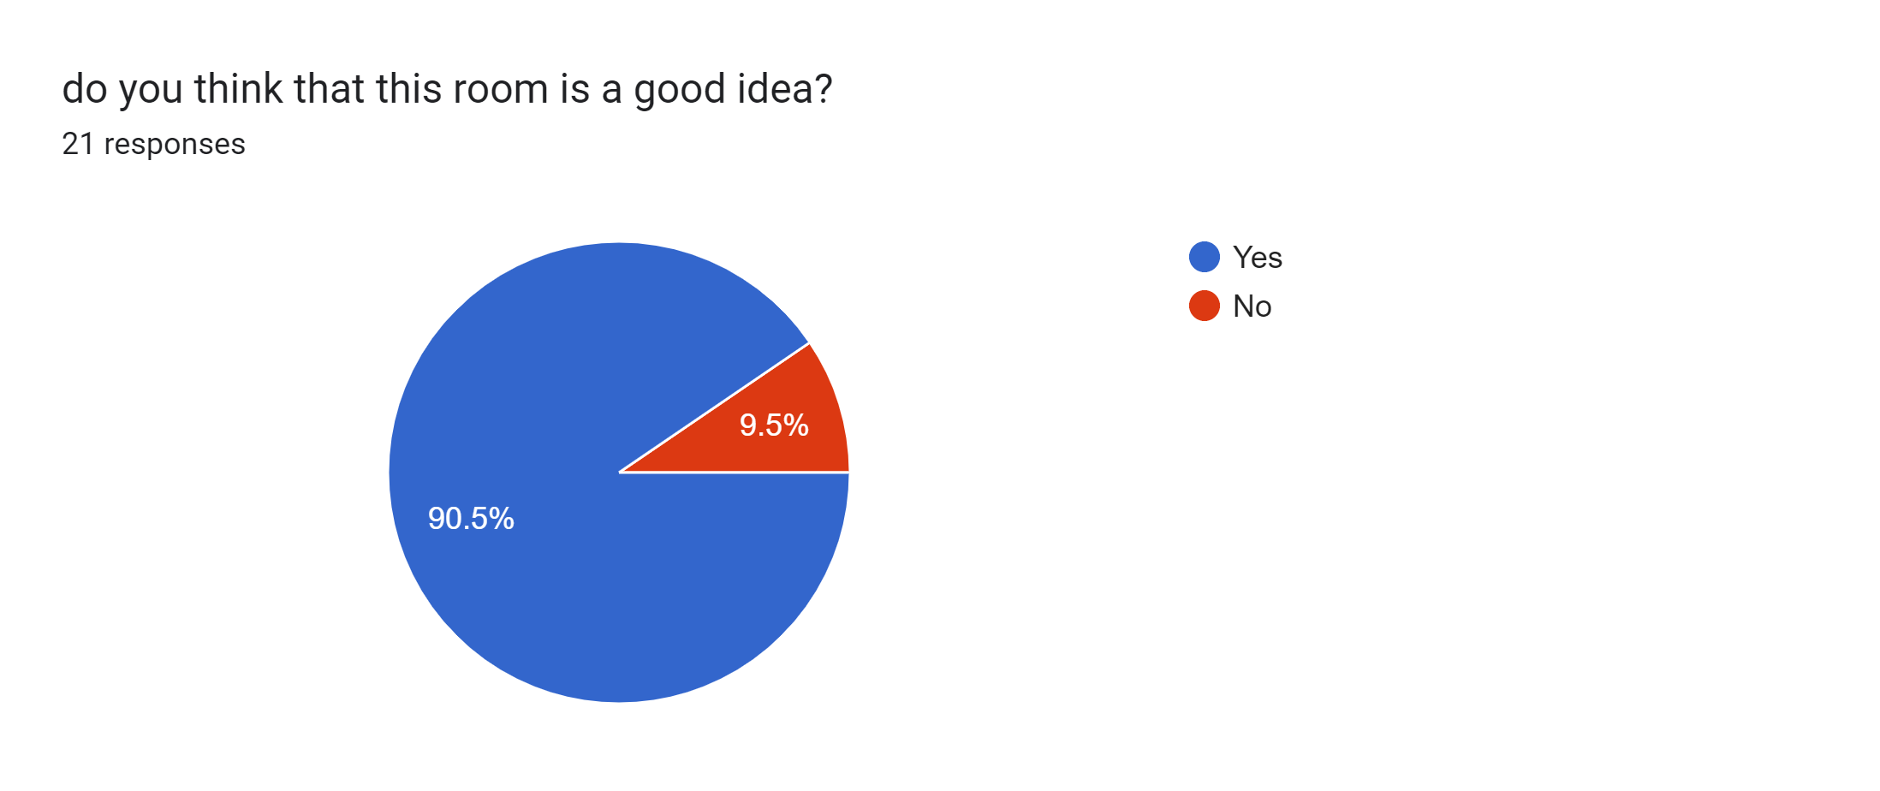
Why do we need this room?
Notes:
s

Slide 6
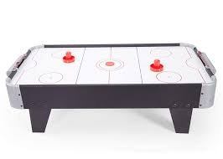
Air hockey
a game in which players attempt to knock a plastic disc into their opponent's goal across a specially designed table that produces a cushion of air to reduce friction.
Notes:
sanad

Slide 7
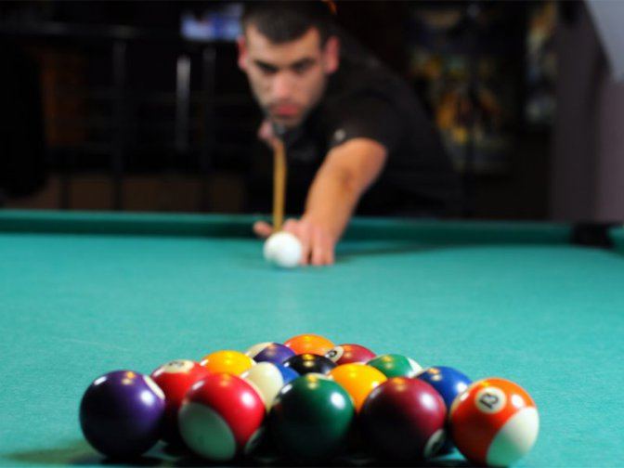
billiards
a game for two people, played on a billiard table, in which three balls are struck with cues into pockets round the edge of the table, with points scored by cannons, pocketing an object ball, or cannoning the cue ball into a pocket.
Notes:
f

Slide 8
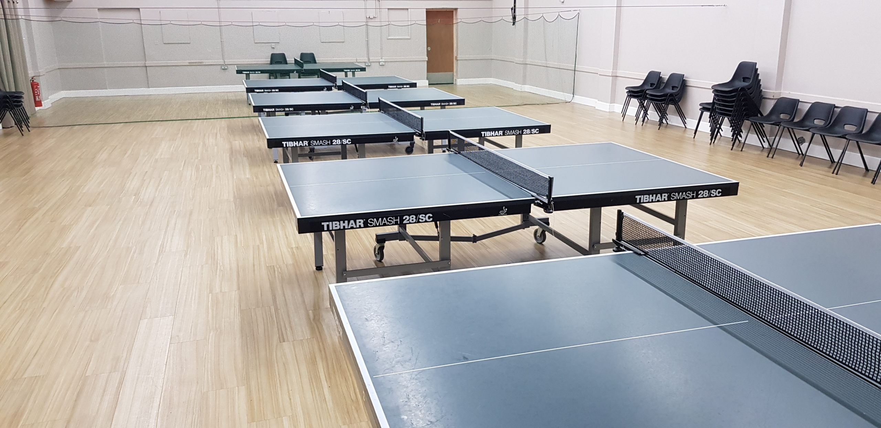
Table tennis
Table tennis is a game played inside by two or four people. The players stand at each end of a table which has a low net across the middle and hit a small light ball over the net, using small bats.
Notes:
f

Slide 9
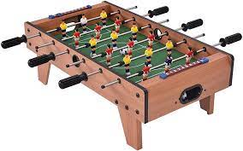
Foosball
A table game resembling soccer in which the ball is moved by manipulating rods to which small figures of players are attached. called also table soccer.
Notes:
s

Slide 10
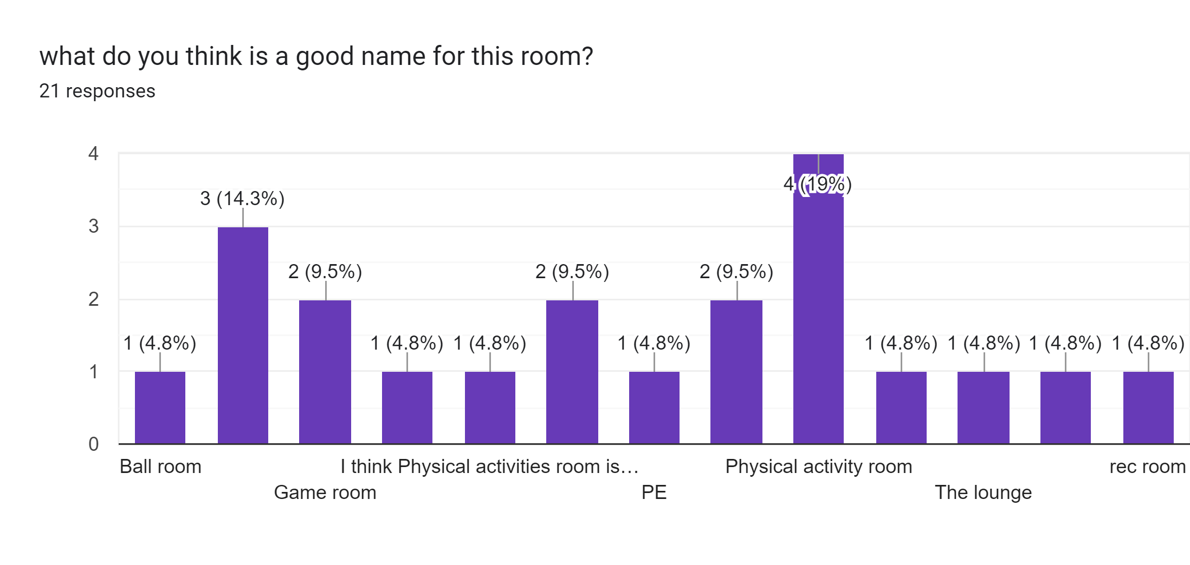
Notes:
s

Slide 11
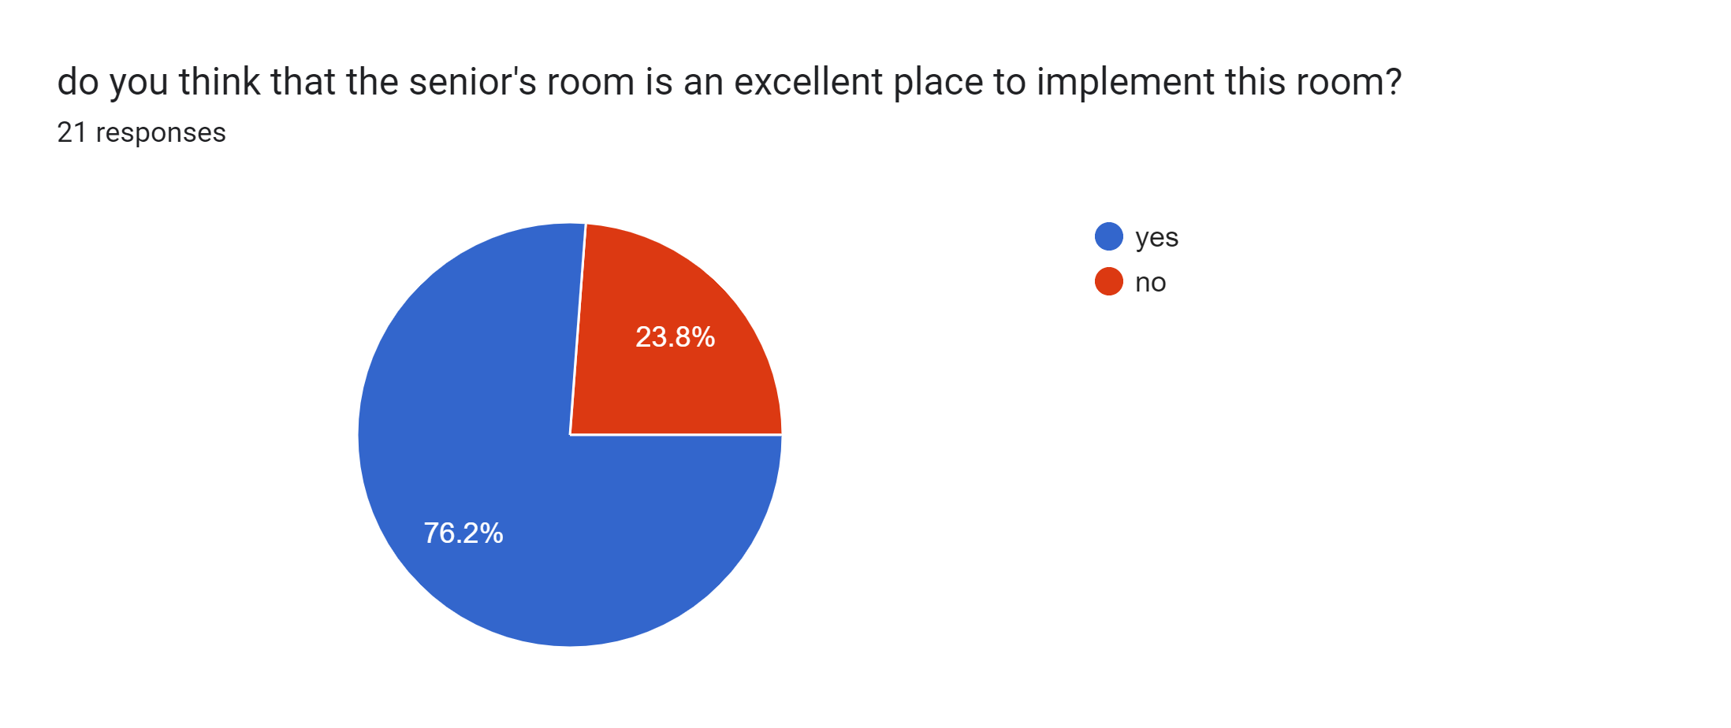
Notes:
f

Slide 12
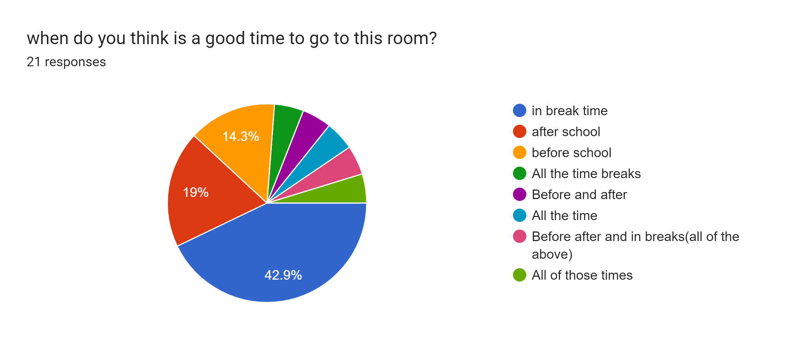
Notes:
f

Slide 13
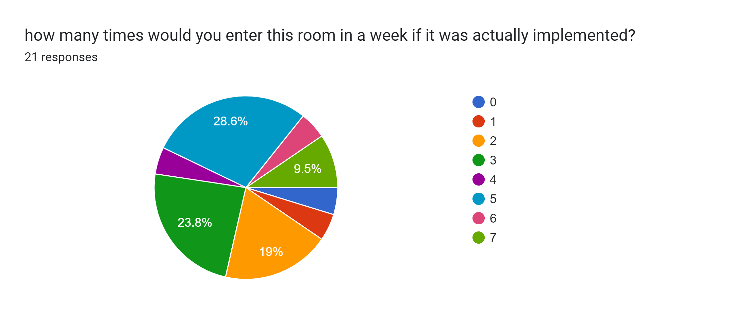
Notes:
s

Slide 14
Advantages of the physical activities room:
Air hockey
improved hand-eye coordination, increased cardiovascular endurance, and stress relief.
Table tennis
improvements in hand-eye coordination, mental acuity, reflexes, balance, leg, arm, and core strength, and aerobic fitness
Foosball
The game keeps you active and prevents your joints from being static As you continue playing, your reaction times and reflexes will be much faster.
billiard
build arms, back, and leg strength; improve their body flexibility; and improve their balance.
Notes:
s

Slide 15
disadvantages of the physical activities room:
Students may get distracted by thinking about the physical activities room.
Students may skip classes to go to the physical activities room.
Students might misuse the equipment for physical harm.
Notes:
f

Slide 16
Notes:
f

Slide 17
Results from the survey we did (https://docs.google.com/forms/d/1DbV5rOdNV_AIudC2zSUgmDrugQnn0nkNO3bA6kQK17o/edit?pli=1#responses )
https://aandcbilliardsandbarstools.com/health-benefits-of-playing-billiards/
https://bargames101.com/21-foosball-tips-techniques-improve-game/
https://www.mdpi.com/2673-8392/2/3/107?type=check_update&version=1
https://food.unl.edu/article/physical-activity-adults
https://www.ncbi.nlm.nih.gov/pmc/articles/PMC3062100/

