Slide 1
Adding swimming pools to NOS
By: Jana Haddad, Mario

Slide 2
Introduction
Stay chill and take a swim
We concluded from our extensive research that the majority of pupils would favor having a swimming pool and an after-school training club. We are here to make sure that after hearing about this idea to build a swimming pool to aid in student entertainment and boost their hobbies, after seeing the pool and safety you will 100% be convinced. We will provide life guards any many other survival help to assure everyone will swim without any risks.

Slide 3
Importance of swimming
Boost your cardiovascular system.
Take care of your health.
Strengthen your muscles.
High health impact, low body impact.
Increase your flexibility.
Boost your mood and relieve stress.
Get a better night's sleep.
Work out without being out of pocket.

Slide 4
Disadvantages of swimming
Not everyone knows how to swim
Not 100% sanitary
Could be dangerous
Not everyone likes to swim
People with special diseases could drown, get injured.

Slide 5
Ways of over comming any disadvantages
We will provide lessons and floaties
We will add chlorine every 2 days to assure the pool is as sanitary it could get without causing skin irration because of too much chlorine.
We will hire a life guard to assure noone gets hurt.
Swimming is optional no everyone has to participate.
People with special diseases can take 5 minuets or longer to rest to assure all students swim without any risks.

Slide 6
How much it will cost
The cost will between $40,000 and $200,000 to build an indoor pool and if u want to hire someone to clean it every month it will cost 90-170$ a month and 1,000 -2,000 per year
we will raise money in bake sales ,fundraiser, and after school activities

Slide 7
Here are the results for the servey

Slide 8
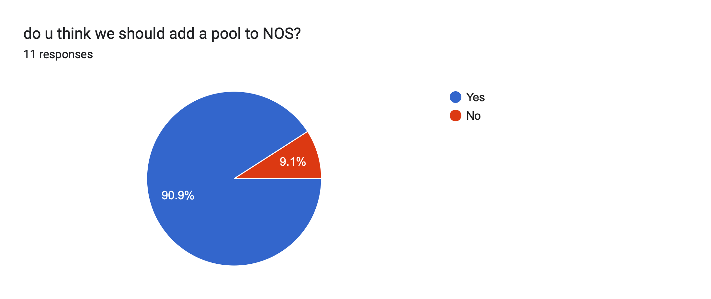

Slide 9
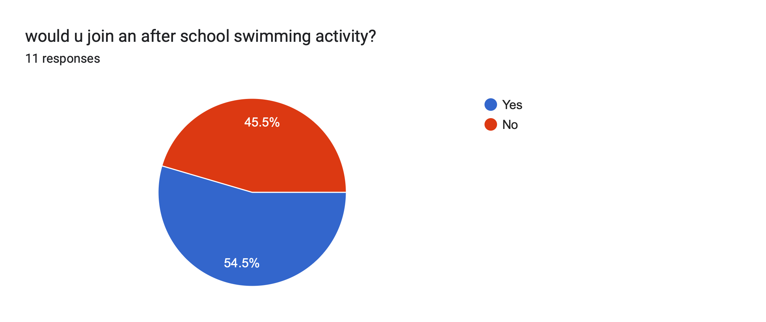

Slide 10
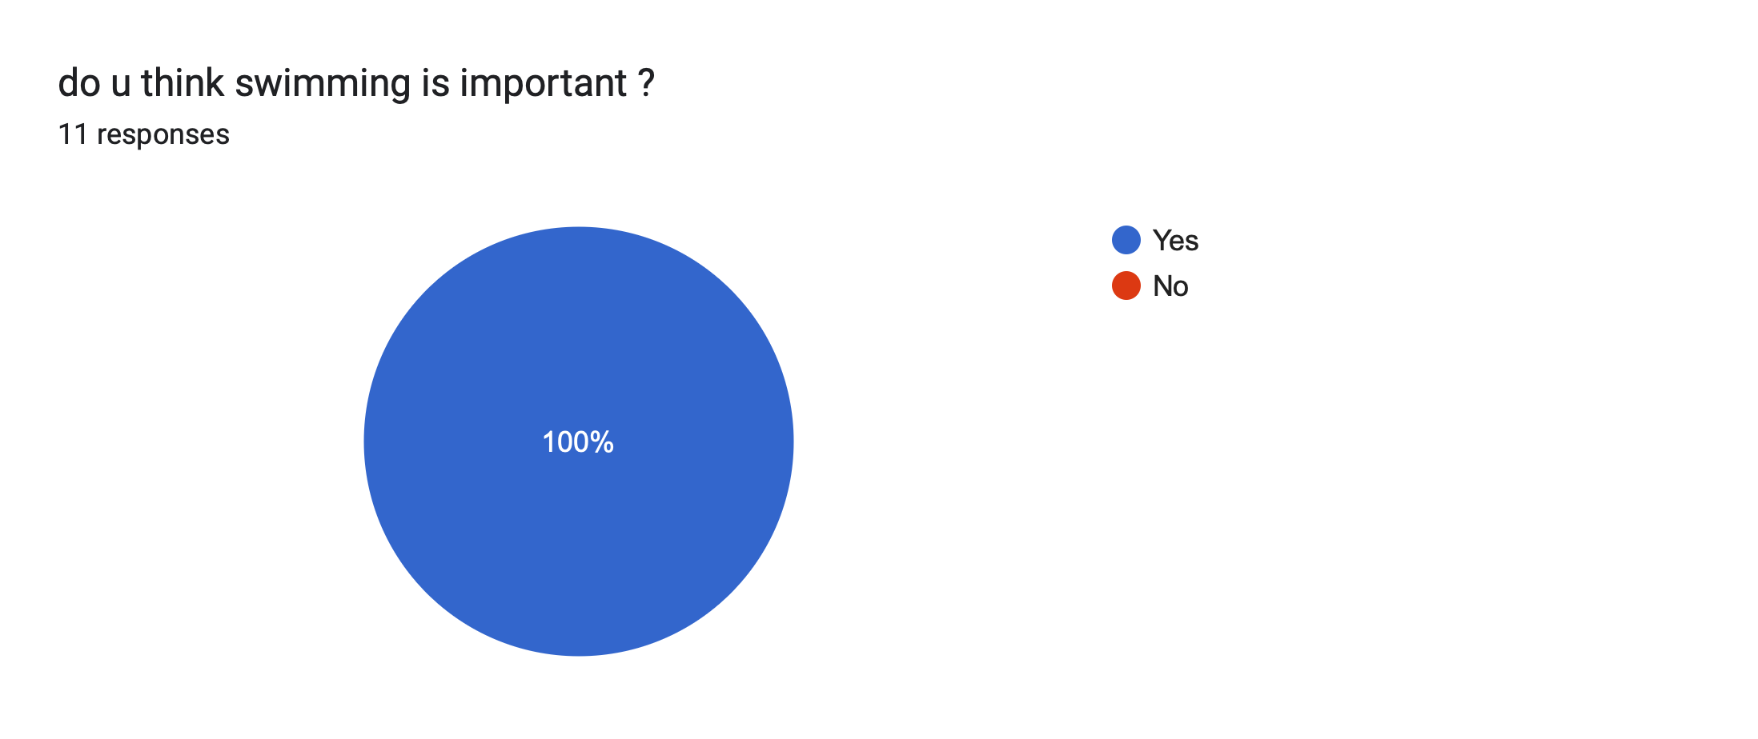

Slide 11


Slide 12
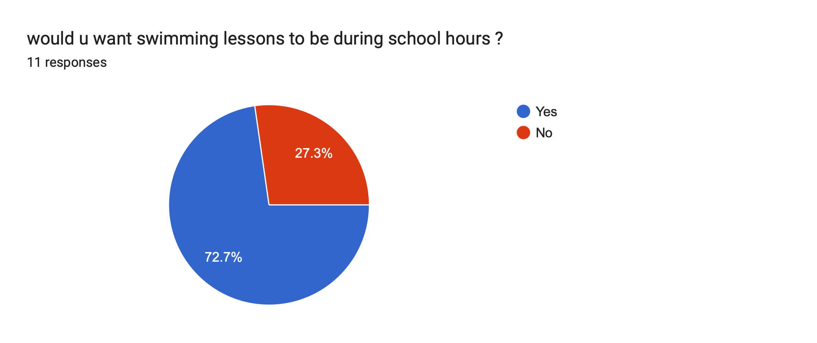

Slide 13
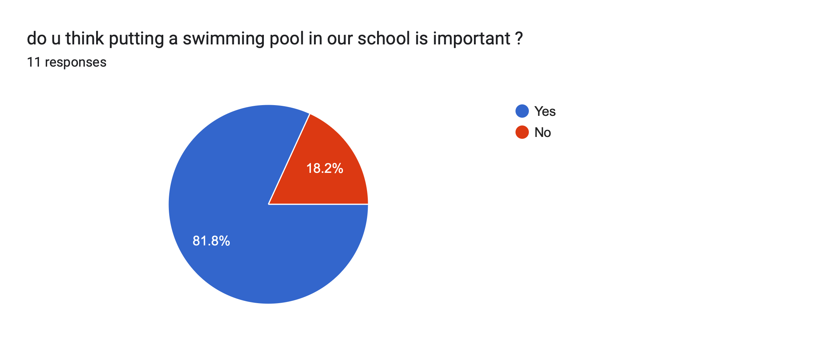

Slide 14


Slide 15
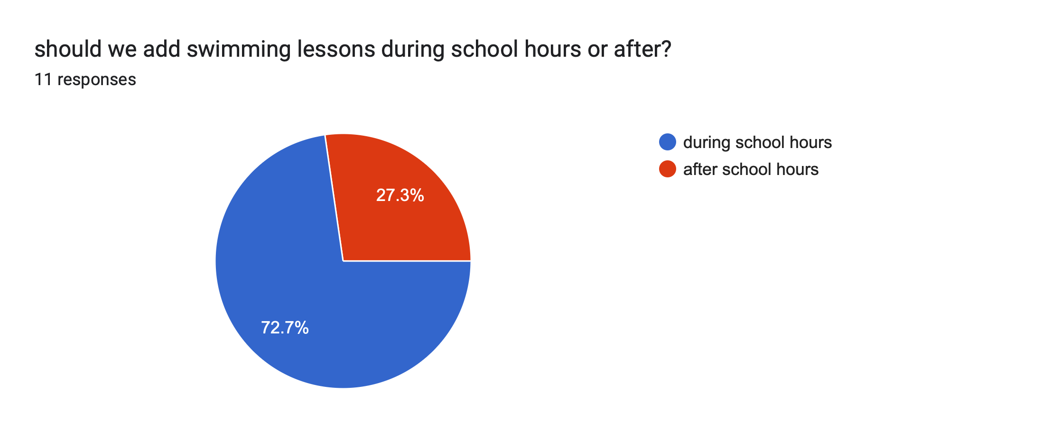

Slide 16
Conclusion
After all this information I think it is really important to add a pool in national orthodox school, the pool will be for all ages ,it will be used during school hours and after school hours to train the students, improove their health, Strengthen your muscles , and many more
And if the pool is not being used the swimming pool will be locked to insure no one gets harmed and when the pool is being used they will be trained coaches that know how to swim and know first aid just to insure that no one gets harmed and there will always be a doctor around

Slide 17
Resources
https://www.healthline.com/health/benefits-of-swimming
https://www.sportsver.com/15-disadvantages-and-risks-of-swimming-stay-informed/
https://www.forbes.com/home-improvement/pool/inground-pool-cost/
https://www.sportsver.com/15-disadvantages-and-risks-of-swimming-stay-informed/

