Slide 1
Sport Life
By Sulaf and Carla

Slide 2
Introduction
"I always felt that my greatest asset was not my physical ability it was my mental ability." -Bruce Jennerin
In the upcoming slides we are going to talk about what additions that could make the NOS school better sport wise. We made a survey that included if we should add a pool, tennis court and a gym. Moreover it had the benefits, disadvantages and their location in the school. A lot of people were helpful in answering the survey and by that we got our answers to what we need.

Slide 3
Causes
We asked students all around the NOS school and we got the responses for our questions about the benefits of having a gym in our school:-
18.2% thought that it would help in strengthening their bones and muscles
18.2% thought that it would help in weight management
0% thought that it would help in reduce your health risk
63.6% thought that it would help in all of them

Slide 4
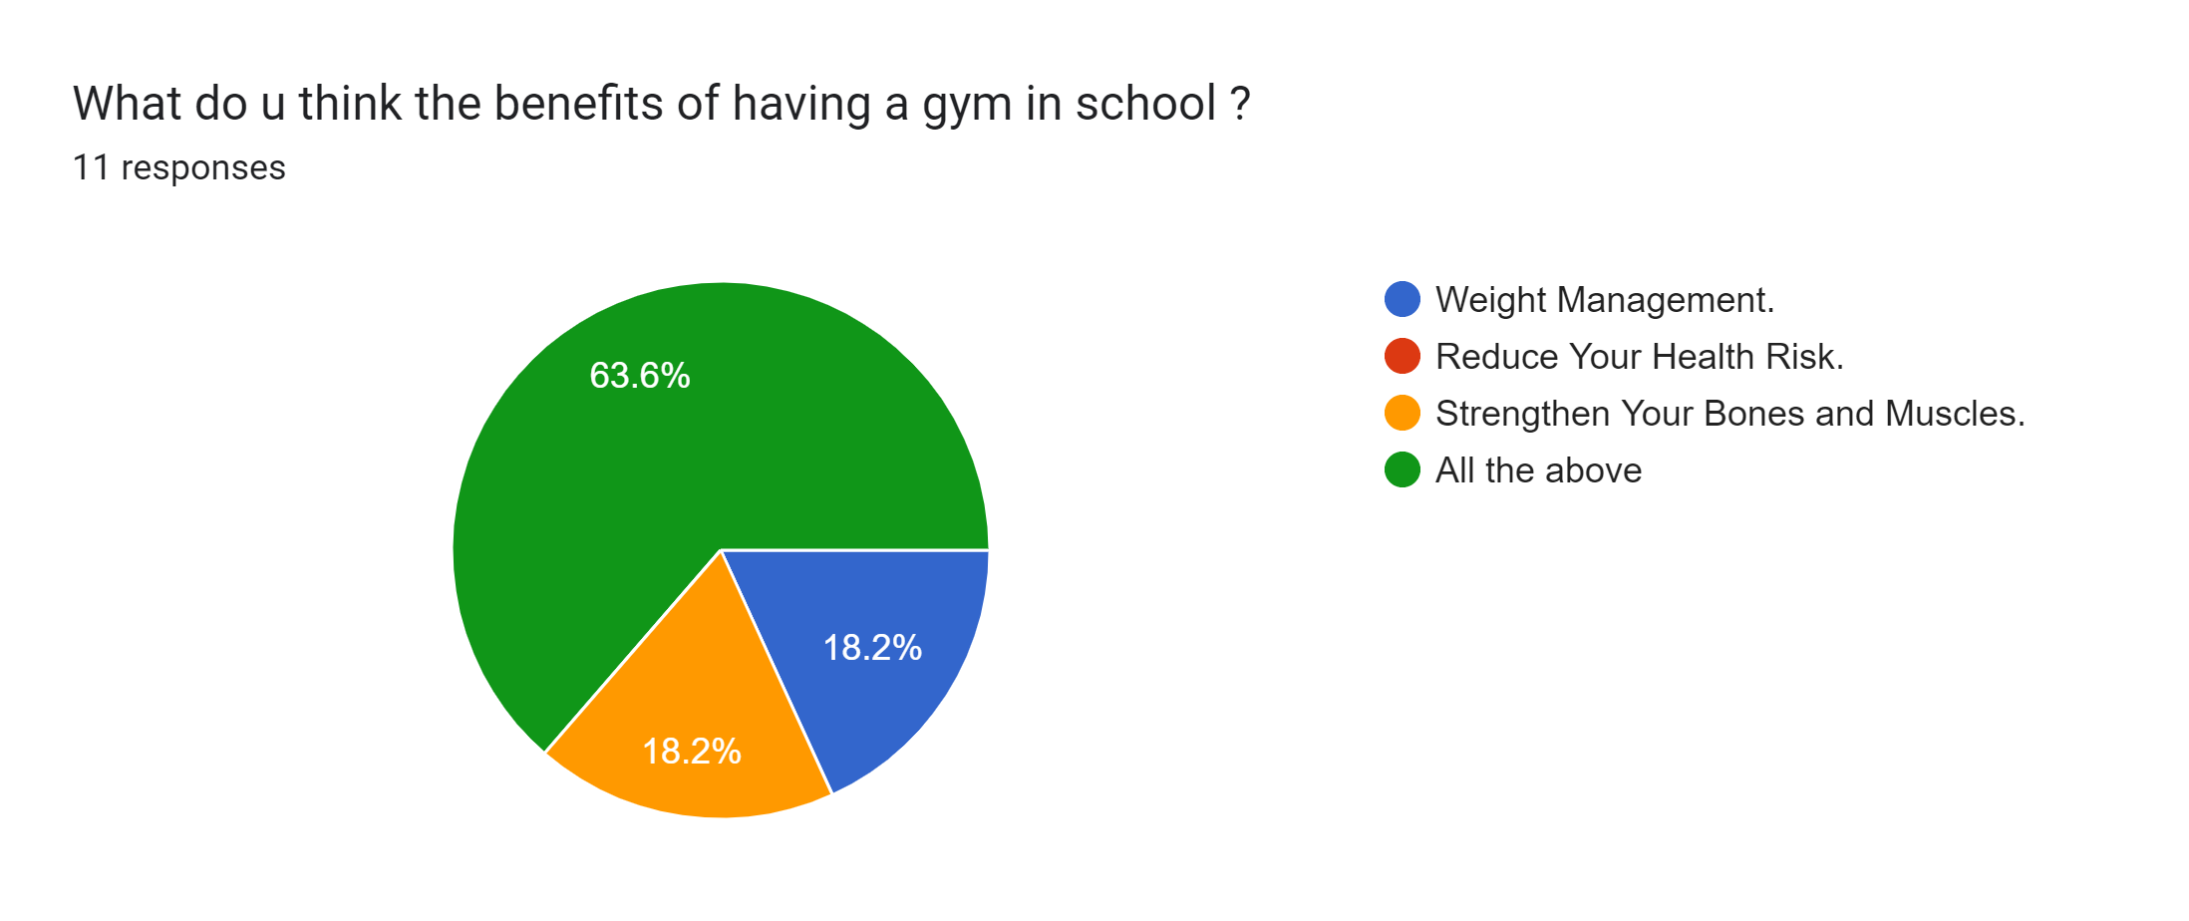
Causes

Slide 5
Causes
These are the responses for the pool in the NOS school:-
9.1% thought that it would help in taking care of their health’s
9.1% thought that it would help in strengthening your muscles
27.3% thought that it would help in increasing your flexibility
0% thought that it would help in high health impact, low body impact
54.5% thought that it would help in all of the above

Slide 6
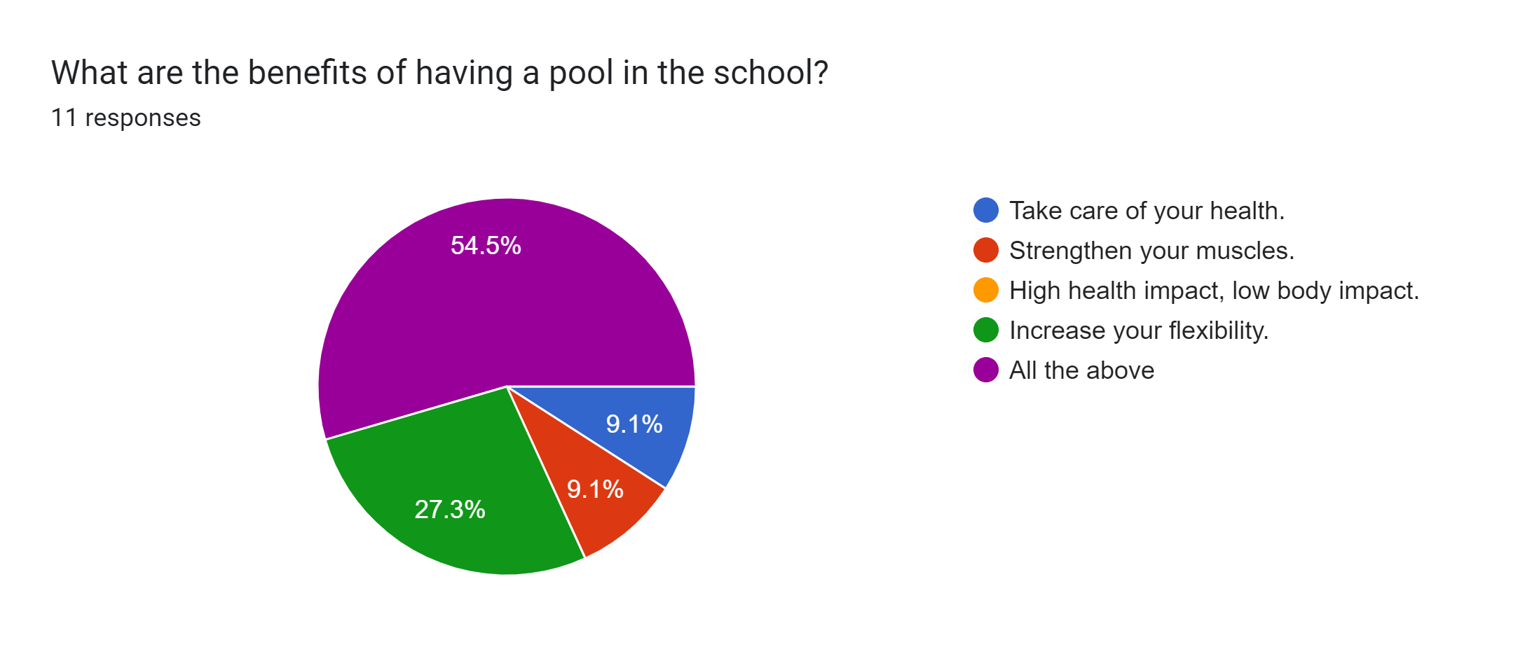
Causes

Slide 7
Cause
These are the responses for the tennis court in the NOS school:-
9.1% thought that it would help in lowering resting heart rate and blood pressure
9.1% thought that it would help in improving metabolic function.
9.1% thought that it would help in lowering body fat.
18.2% thought that it would help in increasing bone density.
54.5% thought that it would help in all the above

Slide 8
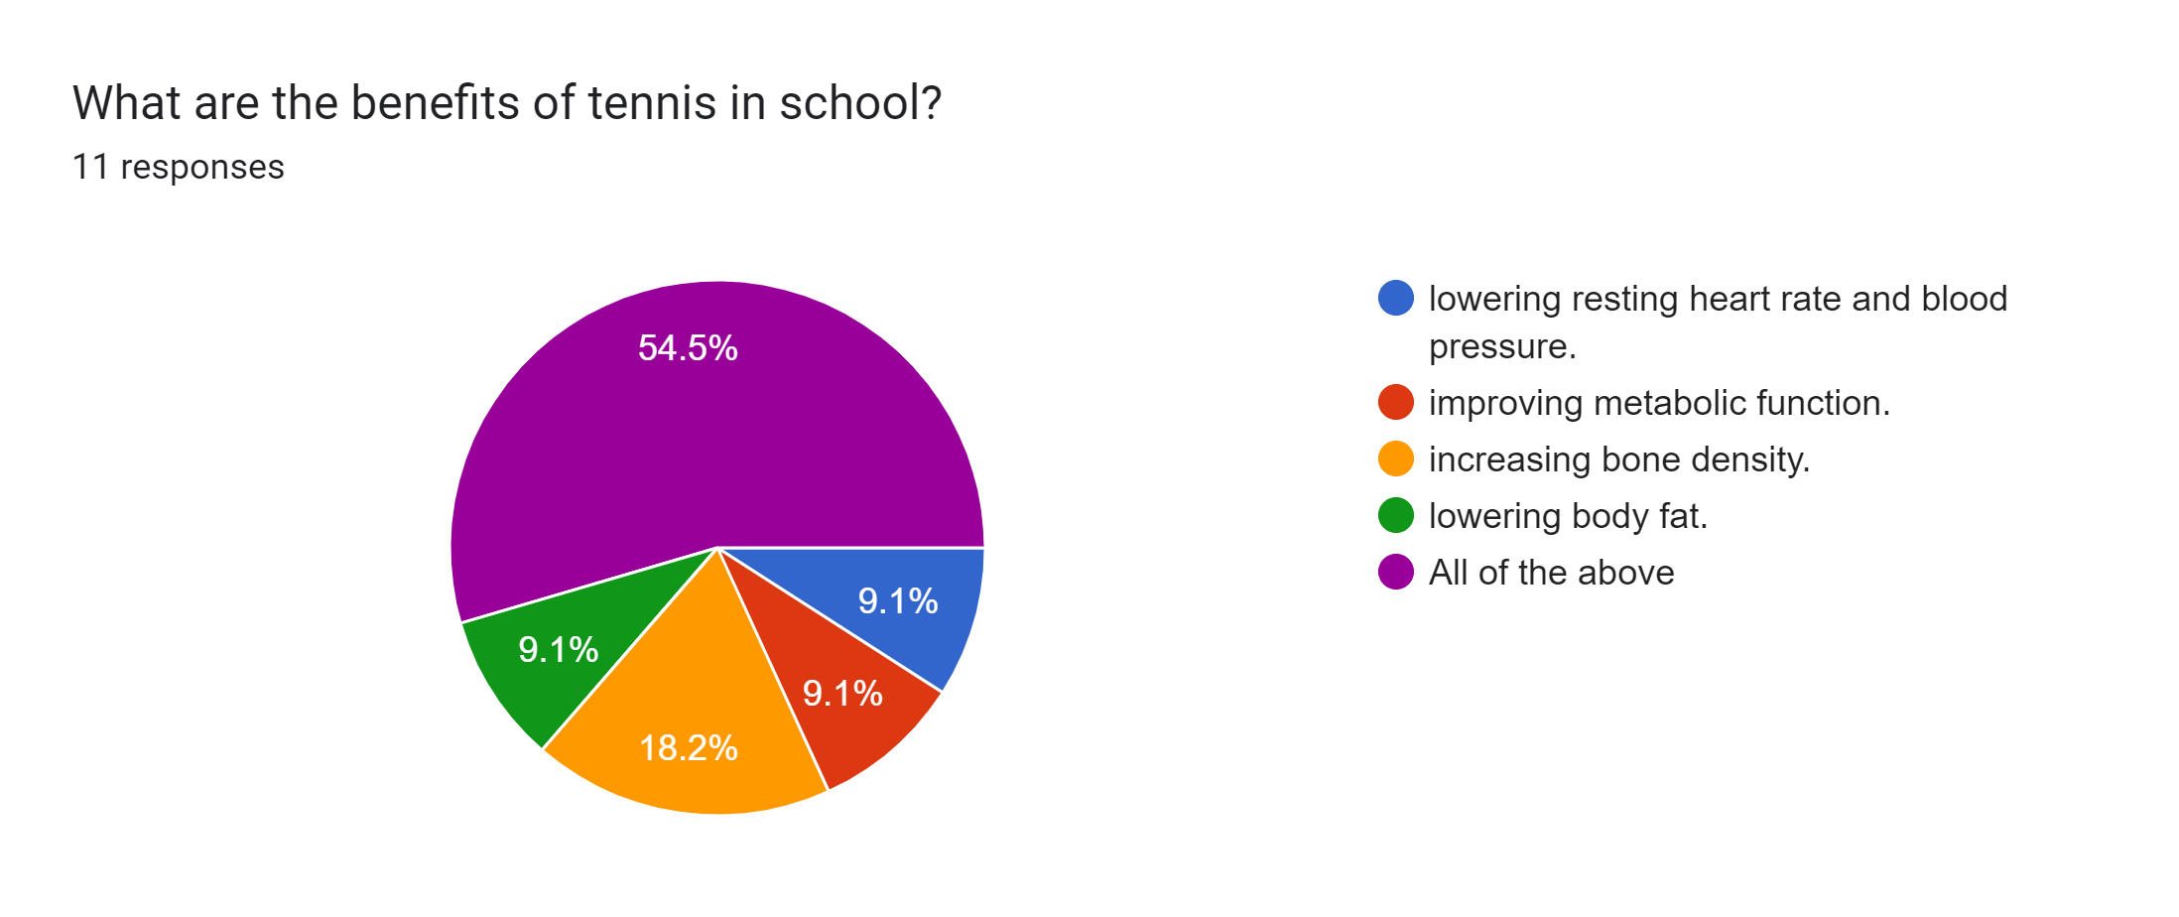
Cause

Slide 9
Consequences of having a Gym
1-There are multiple consequences for gym. One person said that someone might not have much knowledge about the equipment used in the gym and might injury themselves severely, but the school would make sure that there will always be a professional sport teacher that will make sure everyone is doing fine and safe.
2-A lot of people thought that it would be difficult to get the money for the gym and where we could place it, although we have thought of this already, and our thought’s were that we could do a bake sale for the entire NOS school (grade 1 to 12). Also we could have the students make stuff like accessories in their art classes or vocational education classes(this will benefit both the school and the students because they would be learning from that). For the placing of the gym we thought that we could build a new building to have the gym in it.
3-There were some people who thought there were no disadvantages of having a gym.

Slide 10
Consequences of having a pool
1-Most of the answers were that some people might not know how to swim and this will cause them to drown or some sort of injury to happen, and what the school can do to prevent any of this happening is we could put lifeguards in the place the pool would be located in and that would be the new building that we will build the gym in.
2-Other answers were that the cleaning of the pool would be difficult but the cleaning can take time after school hours have finished.
3-Some students didn’t couldn’t think of any disadvantages of having a pool is.

Slide 11
Consequences of having a Tennis Court
1-Some replies were that someone could get injured like a tennis ball hitting someone or a student might slip and fall but the school has amazing doctors that can help in any injures like these ones, and even though someone can get injured but it’s like any other sport that is in or outside of the school like football, basketball, volley and a lot more.
2-Some responds were that the sport tennis isn’t in high demand but even though it isn’t the school can give their students the option to play another sport and there is a possibility that students would love this sport and this would lead to more people knowing and playing tennis.
3-A person thought that there is going to be no space for the court but the new building that is going to be built would be big enough to have the court in it.
4-Most students we asked in the survey loved the idea and didn’t think that there were any disadvantages of having a tennis court.

