Slide 1
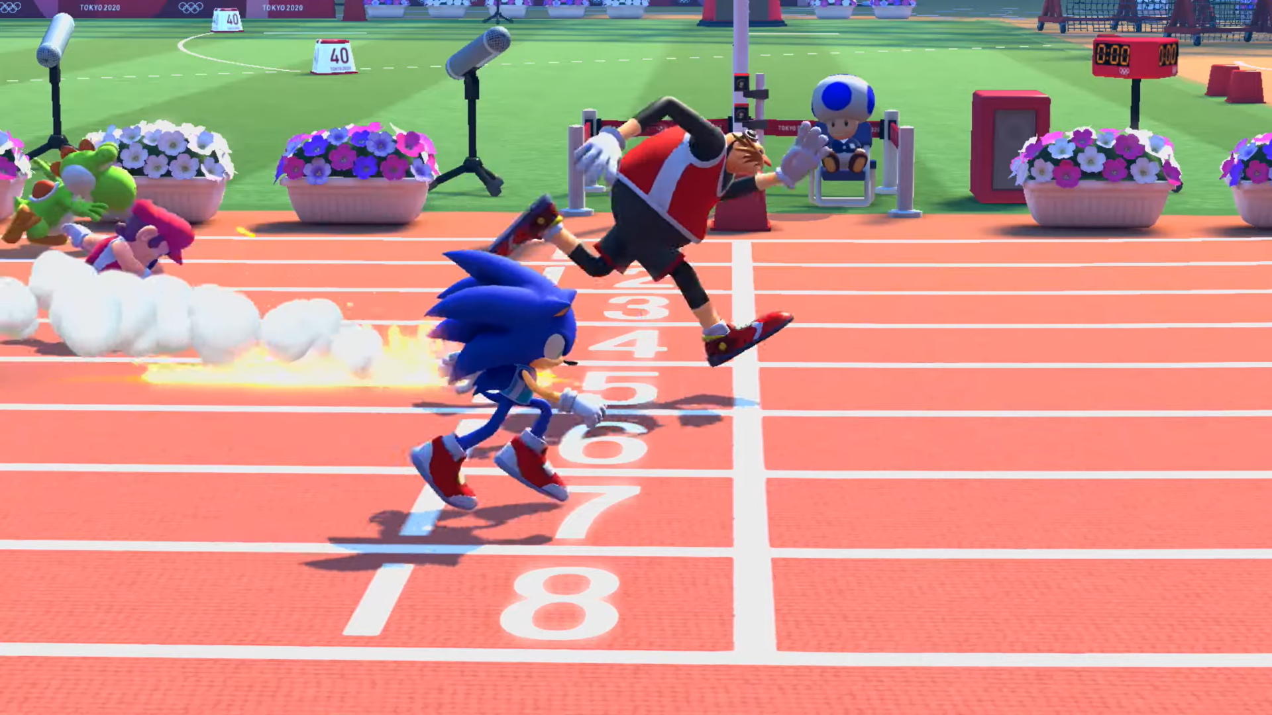
Track Team
By: Selina &Chelsea

Slide 2
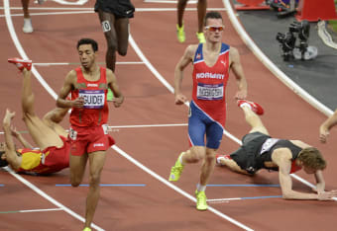
This PowerPoint concludes why the School should make a Team for Track. Participating in track and field can have numerous benefits for students, both in terms of their physical health and their well-being. As such, schools should consider providing a track team for their students to participate in, a successful Track Team can heavily improve the school’s reputation, spirit and community.

Slide 3
How will providing a Track Team Benefit the school?
Aside from the benefits to individual students, Some of the advantages of having a track team in the school include: Boosted spirit and community involvement:
Having a track team can help to boost the school’s spirit and pride. Students, teachers, and parents may feel more invested in the athletic programs and events at their school
Improved reputation:
A successful track team can help to improve the reputation of the school and attract new students and families. If the school is known for having a strong athletics program, it may be perceived as a desirable place to attend, which can increase enrollment.
Fundraising and sponsorship opportunities:
Athletic programs frequently offer fundraising and sponsorship opportunities. Schools may be able to raise funds by selling track meet tickets or obtaining sponsorship from local businesses. This additional funding can be used to support other school programs or to invest in the track team.

Slide 4
While there are many potential benefits to creating a track team at a school, there are also some potential disadvantages to consider. Time commitment: Track is a sport that requires a significant time commitment from athletes, as well as from coaches and other staff members. Students who participate in track may need to balance their athletic and academic responsibilities, which can be challenging and time-consuming. Potential for injury: Like all sports, track and field can be physically demanding and carries a risk of injury. Schools need to take steps to ensure the safety of their athletes, including providing appropriate equipment and coaching.
Overall, while there are some potential disadvantages to creating a track team at a school, many of these can be addressed through careful planning, effective coaching, and attention to safety and inclusivity. By considering both the advantages and disadvantages of a track team, schools can make informed decisions about whether to pursue this athletic opportunity.

Slide 5
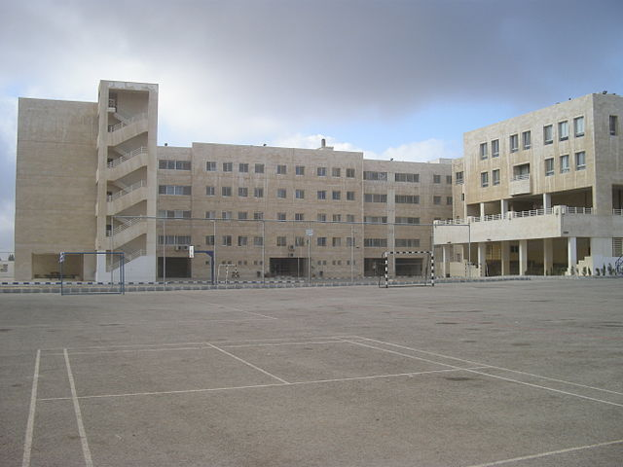
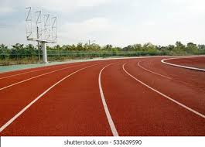
How much will the funding be as an estimate?
The funding would be an average of 10,000 at most, to build a mini replica of a Track at the school.
Where would it be built ?
In the middle of the recess area across from the football field
Here

Slide 6
We have conducted a student research survey to gauge interest in installing a running track at our school. In addition to providing students with an opportunity to increase physical fitness, a running track would allow us to host track events and competitions. Here are the results and statistics:

Slide 7
Over 50% of candidates insisted to join a Track Team

Slide 8
Over 80% of the responses positively want a Team for Track

Slide 9
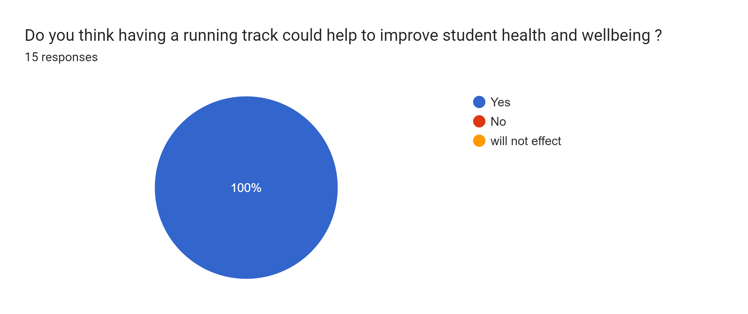
100% Think that providing a team for track will enhance students health and well-being.

Slide 10
100% also agree that the school should make more events regarding Track.

Slide 11
Sources:
https://www.rawhide.org/blog/sports/17-benefits-track-field-troubled-youth/
https://www.kfschools.org/site/default.aspx?PageType=3&DomainID=22&ModuleInstanceID=747&ViewID=047E6BE3-6D87-4130-8424-D8E4E9ED6C2A&RenderLoc=0&FlexDataID=1807&PageID=395
https://uk.riskracing.com/blogs/news/how-to-build-a-motocross-track-cost-soil-design
https://uk.riskracing.com/blogs/news/how-to-build-a-motocross-track-cost-soil-design

