Slide 1
Survey & Interviews
Work of students Naya Al-Qamhawi, Dalia Al-Ahwal and Noor Saba

Slide 2
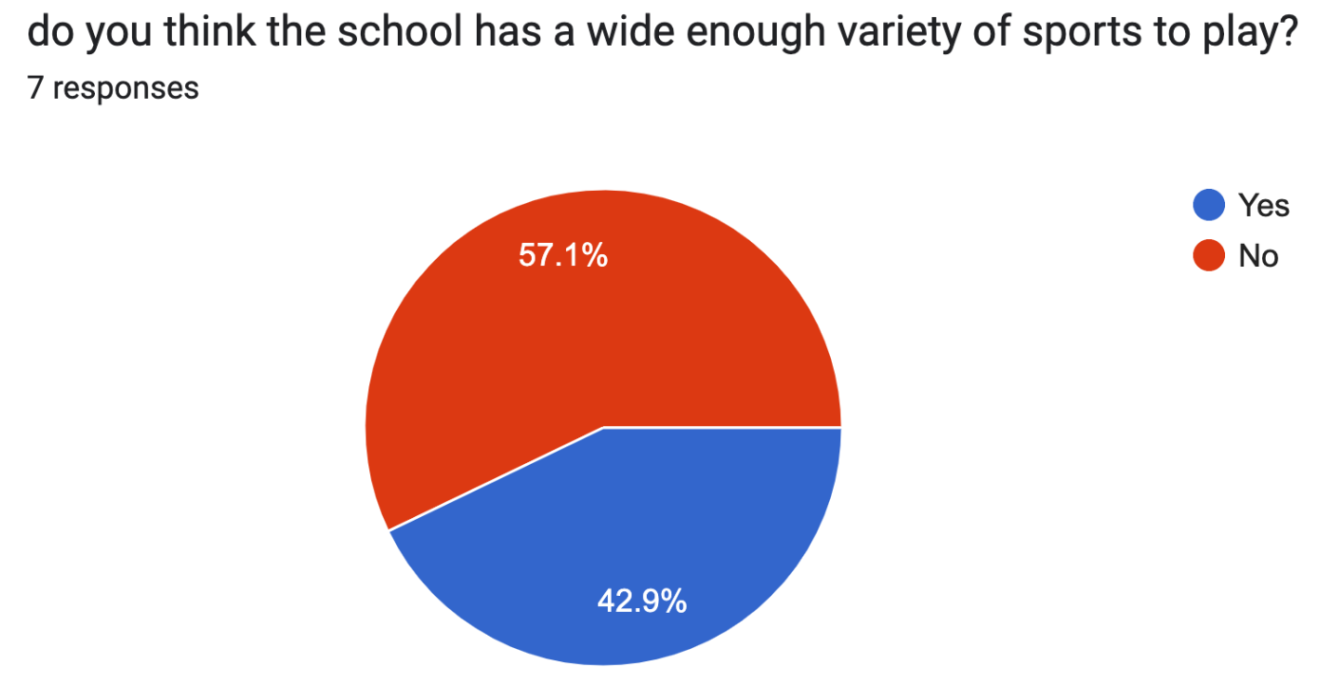
We asked a group of NOS students, section (6-8), a series of question about their thoughts on sports in general, and the school sports department in hopes of compiling some data about their overall opinions on it.
In this powerpoint we will be giving a summary of the questions asked, the results and suggestions we received from our fellow students, and mentioning some solutions to these issues
Here are some of the results we drew :
1-
1-

Slide 3
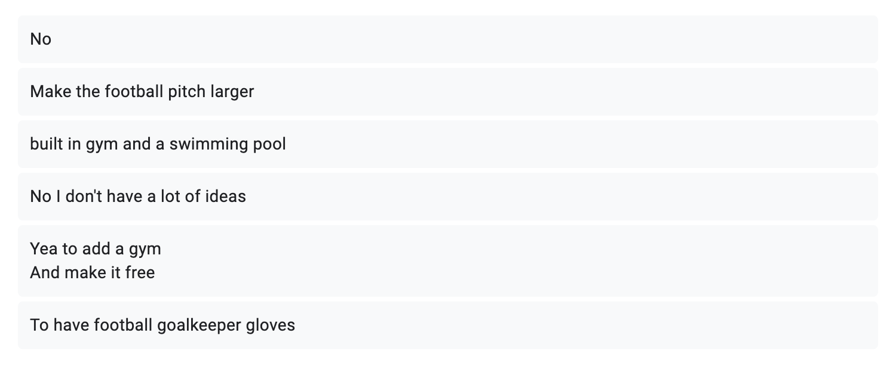
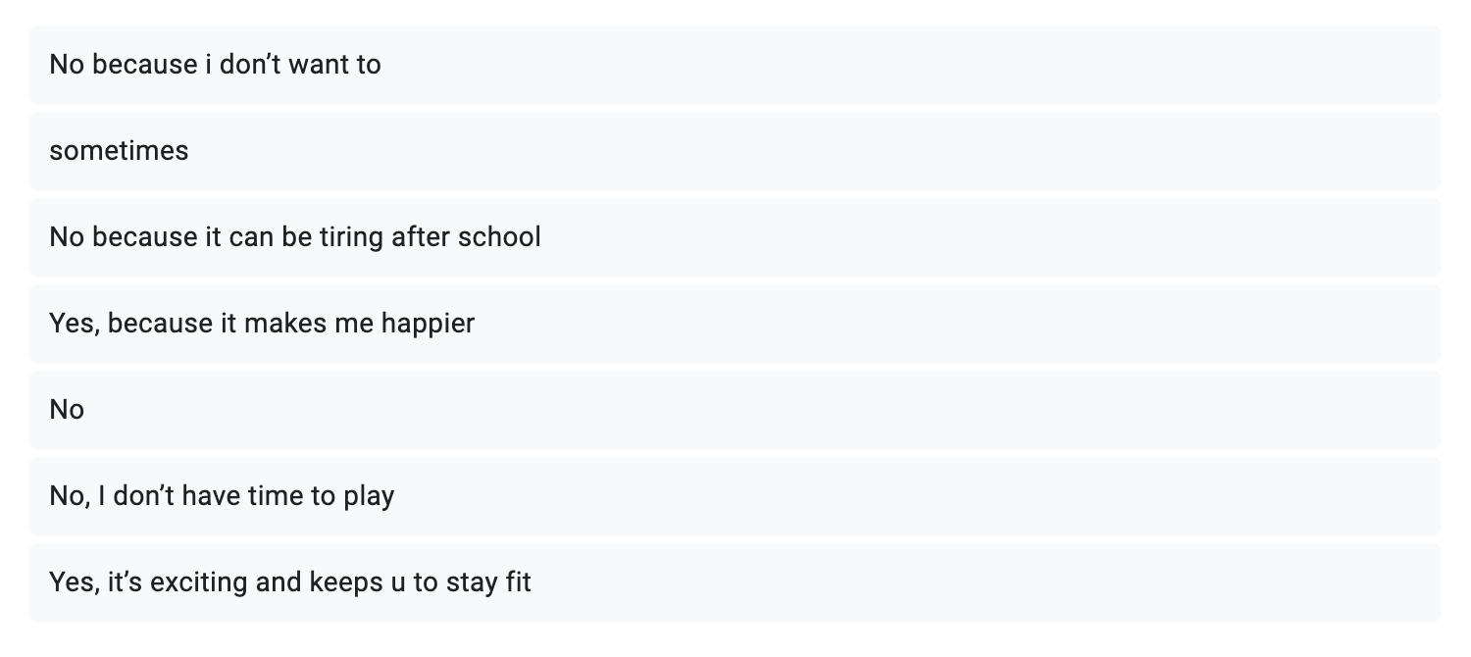
2- when asked for suggestions and improvements for the schools sport department, students answered :
3- as for the reasons they do/do not participate in afterschool sports clubs, these were the responses :

Slide 4
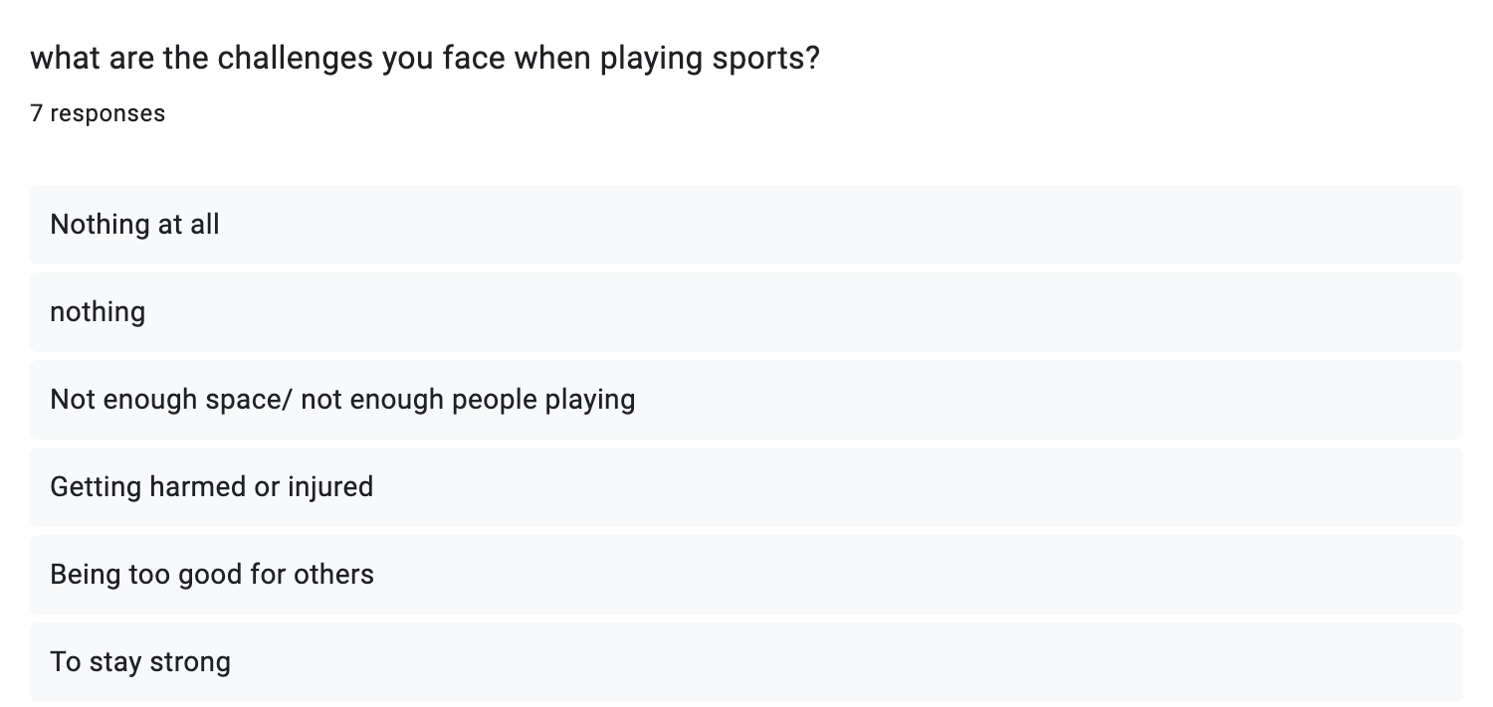
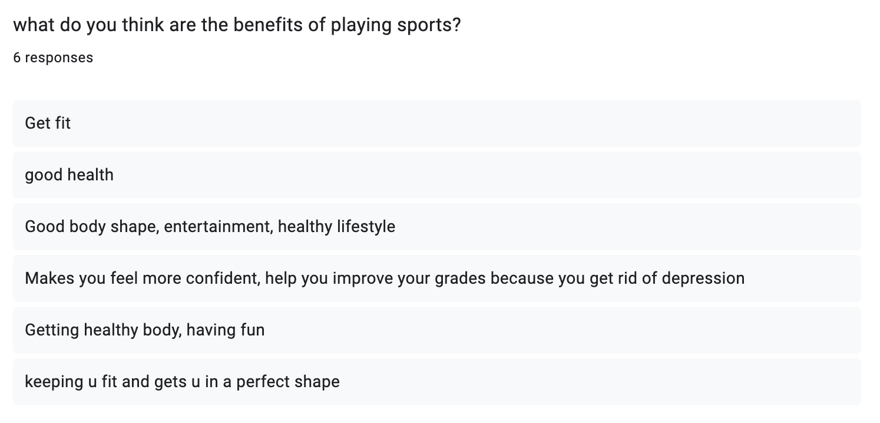
4-
5-

Slide 5
To conclude, students believe the causes of these problems are:
Lack of space
Not enough people participating in sport activities
Most people do not have enough time or energy to spend playing after school
School sports are currently not accessible enough for people with disabilities to take part in
We could easily fix these issues by simply :
Installing a larger football field
Encourage students to take part in sports
Provide protective equipment for players such as knee and elbow guards
Buy new sports equipment

Slide 6
Here is a link to the full form including all the questions we asked the students :https://docs.google.com/forms/d/e/1FAIpQLSebxEVXY-lBSXTA80-5wXgjwnEq1Jlg63PgX-Zr_huZR3Jz-Q/viewform?usp=sf_link
We also conducted a real life interview during some of the breaks , here is the link to the video :
https://drive.google.com/file/d/1RTblu10OnrzZLUvrjN7jw0Y1xbWOF3Ec/view
These were the questions asked
Do you practice any sports and why?
Do you have any suggestions/improvements for the school sports department? If so what are they?

