Slide 1
Bouldering in NOS
By: Leen Kurdi and Perla habash 8G

Slide 2
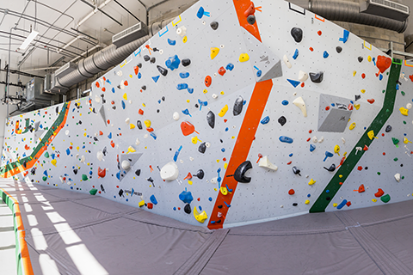
Introduction
Y93-31,good morning students today we have decide to chat with all of you about climbing wall , since we haven’t heard of any school build a climbing wall yet , we have official decided to do so , it will be a great opportunity for kids to train their bodies physically moreover it will most definitely let them face their fears thank you , for your attention and we hope you would interested.

Slide 3
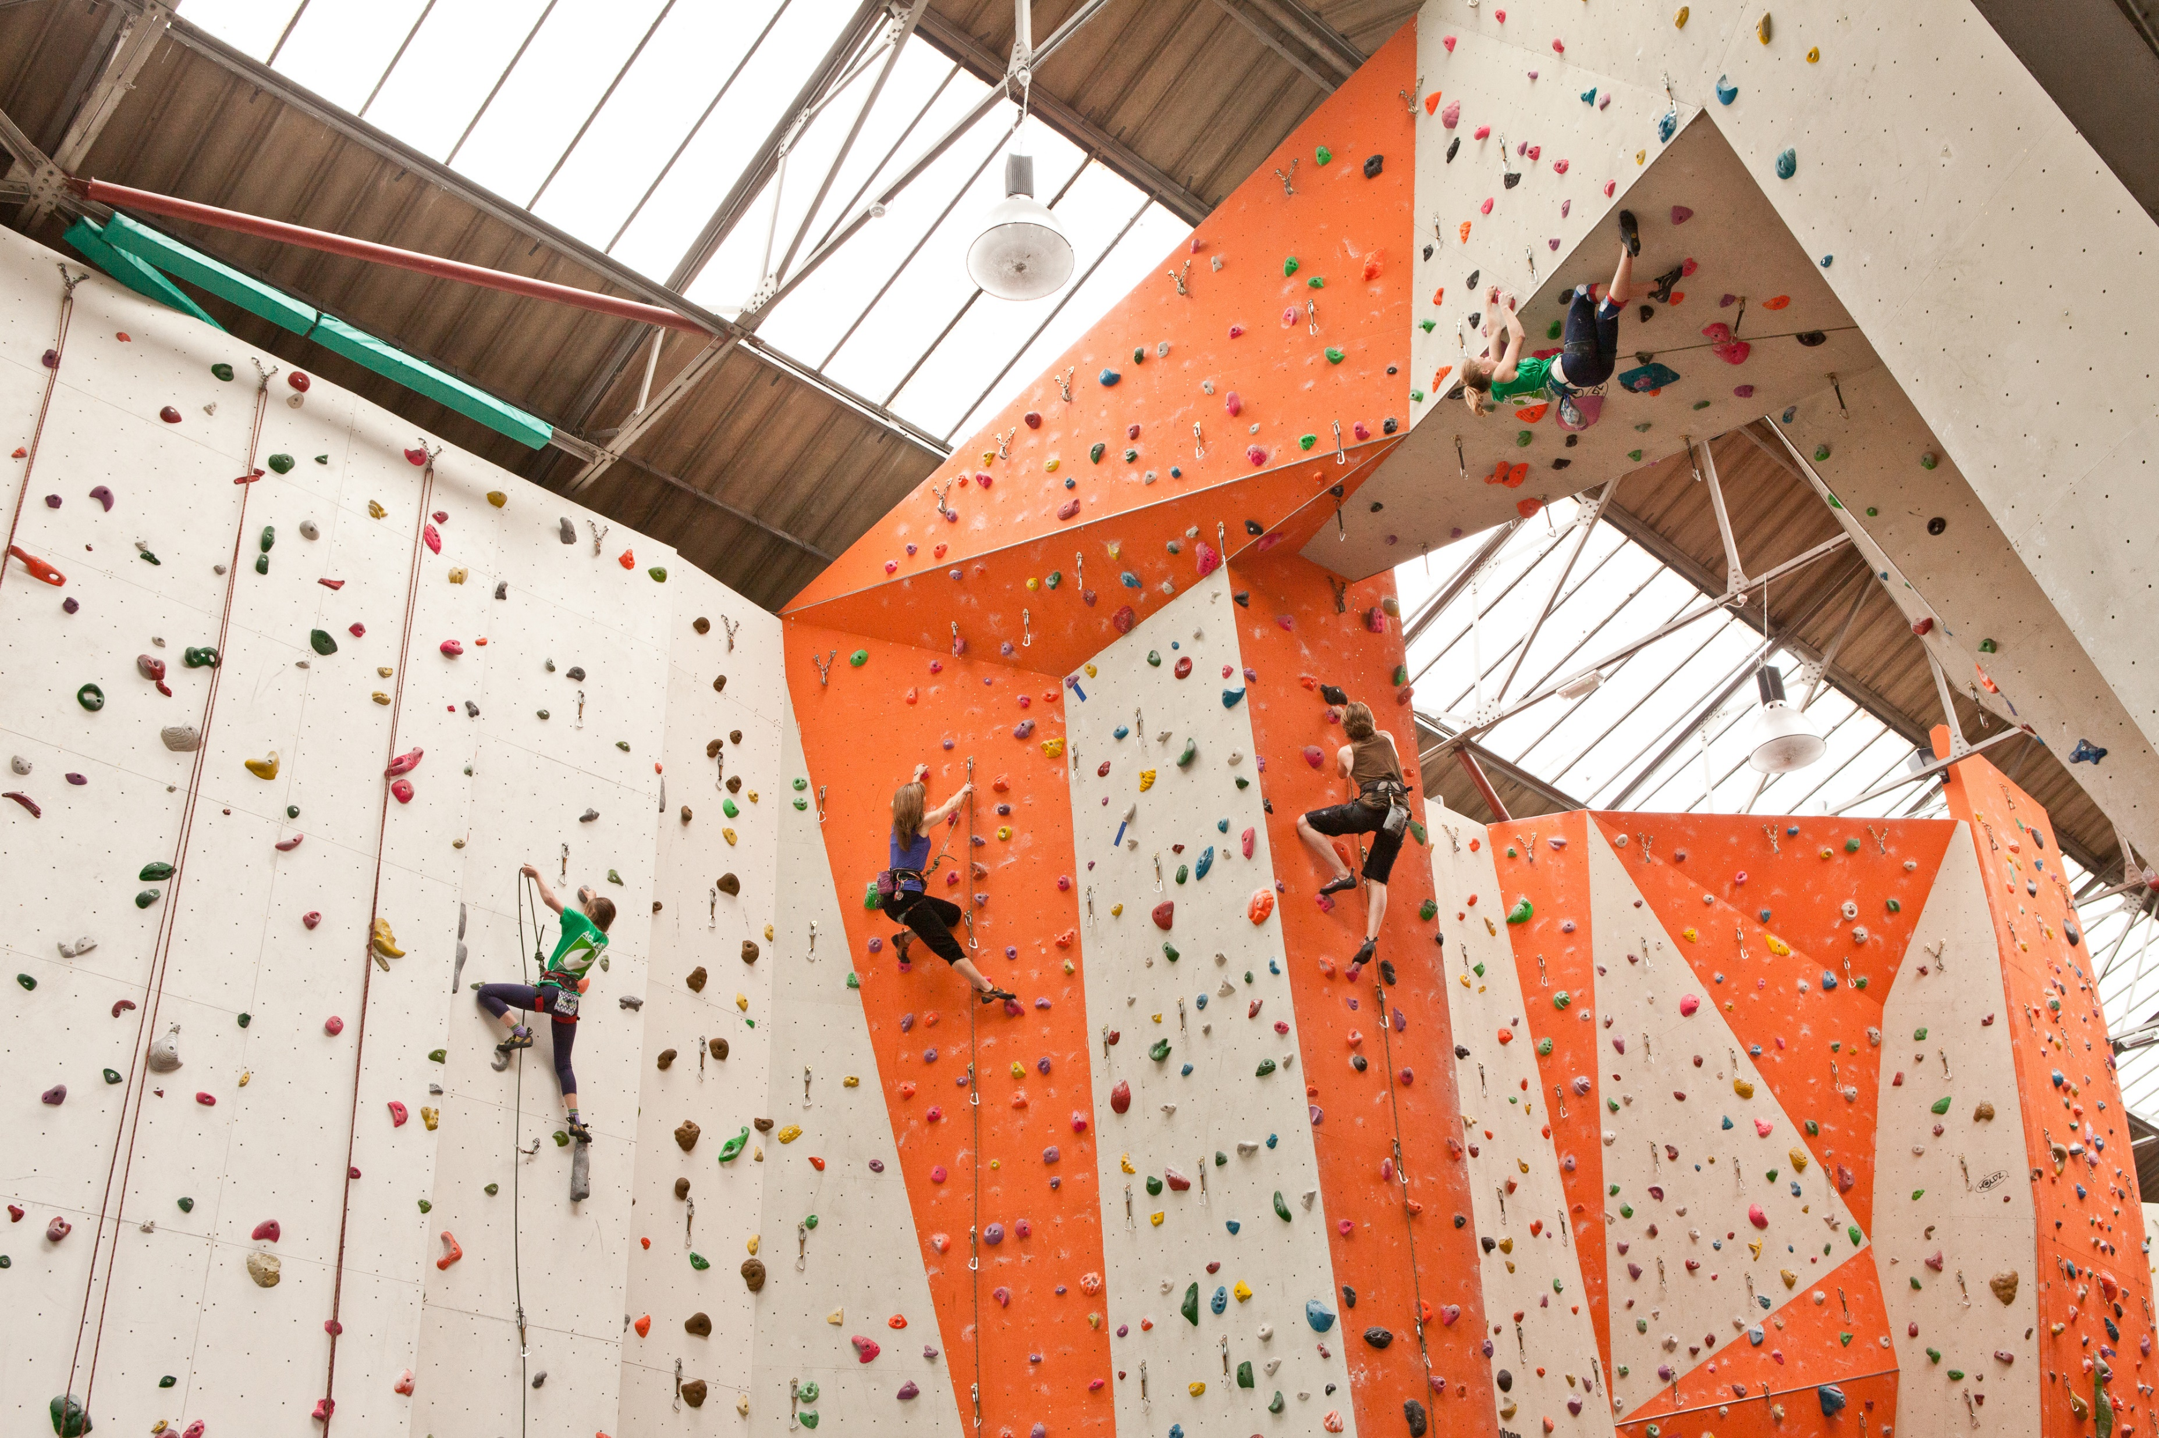
cons
Even though climbing gyms are built with safety in mind and are significantly safer than outdoor climbing, climbing is still risky. Despite the fact that the entire floor area is covered in mats, you still run the danger of sprained ankles and wrists if you leap or fall off a climbing wall.

Slide 4
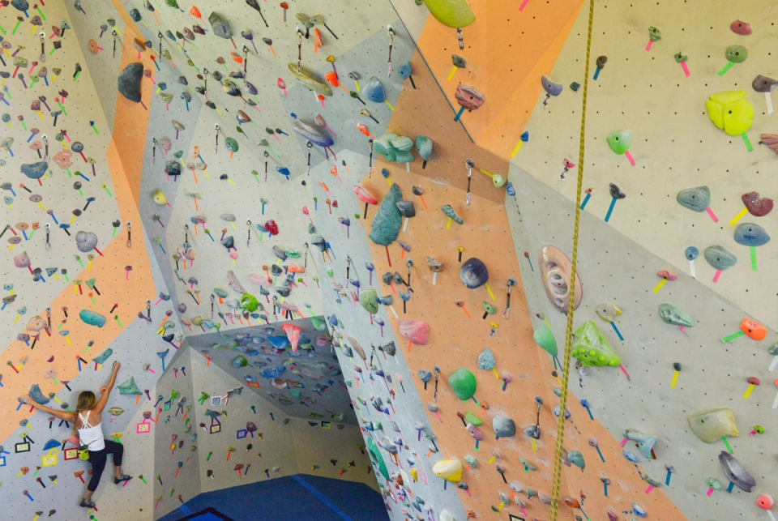
pros
The indoor climbing gyms are a great place to work out. For example, you can learn that most professional climbers train at their indoor gym. This may be due to the fact that indoor climbing provides additional opportunities like fitness equipment and a range of climbing problems all in one place. Also, indoor bouldering walls are where climbing contests are place. Because these walls are indoors, there is practically almost no risk involved, thus practicing indoors is a good option.

Slide 5
Why should the school add a climbing wall to the gym?
The development of early childhood motor abilities depends heavily on climbing. According to a Play Core study, climbing at a young age improves physical abilities like balance, hand-foot coordination
. On the other hand it will help the school with gaining profit for the school will let students from other schools participate as well , which will eventually lead to higher profit .It will be located next to the basketball, It will be built instead of the stairs that the students usually sit on.

Slide 6
How we will make this happen
We will hang posters on all of the school’s walls in order for us to know if anyone is interested and if so they will need to help us make enough money through paying a specific amount of money to build a climbing wall and we are quite positive that it will work out, since the majority of the students like to help and support the school most of the time .

